Slide 1
Closing the Basic Weather and Climate Data Gaps in Africa for Effective Adaptation in Africa Session 1: Setting the scene
11 – 13 September 2024

Slide 2
What is SOFF?

Slide 3
The Systematic Observations Financing Facility – SOFF
A specialized United Nations climate fund co-created by the World Meteorological Organization, United Nations Environment Programme, and United Nations Development Programme
Established to fill in major gaps in basic weather and climate data in the countries with the biggest capacity constraints – Least Developed Countries and Small Island Developing States
Mandated to support the implementation of the Global Basic Observing Network – GBON
Foundational element of the UN Early Warnings for All Initiative

Slide 4
GBON – An International agreement on the mandatory basic weather and climate observations
193 countries and territories of the World Meteorological Congress established in 2021 for the first time the minimum set of observations that all countries must generate and internationally exchange - Global Basic Observing Network (GBON)
While GBON compliance is mandatory, major data and capacity gaps exist in most developing countries, hampering effective climate action across the globe.
Least Developed Countries (LDCs) and Small Island Developing States (SIDS) generate and exchange less than 10 % of the GBON data.

Slide 5
Major observation gaps in developing countries
Surface stations
Upper air stations
Areas in dark red are far from meeting the Global Basic Observing Network (GBON) requirements. Source: SOFF Secretariat and WMO Global GBON Gap Analysis, June 2023
Notes:
Least Developed Countries (LDCs) and Small Island Developing States (SIDS) generate and exchange less than 10 percent of the internationally agreed and since January 2023 mandatory Global Basic Observing Network (GBON) data.

Slide 6
WMO’s Global Basic Observing Network GBON

Slide 7
Successful application of weather and climate services depend on a functioning meteorological value chain
Global meteorological infrastructure

Slide 8
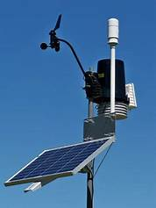
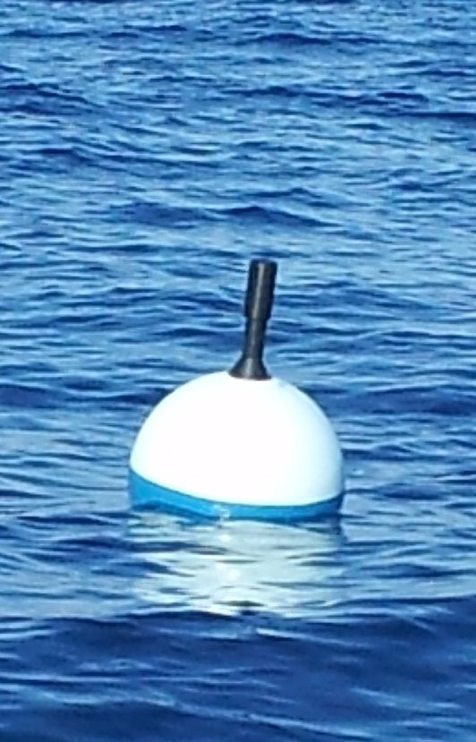
GBON requirements and SOFF scope
Securing an adequate supply of observational data to the global NWP centres that serve all countries with forecast and analysis products
GBON requirements - per station type | GBON Variables
 | Pressure | Temp | Hum | Wind | Precip | Snow Depth
Surface land stations Horizontal resolution: 200 km (500 km for small island states) Observing cycle: 1h Real-time data exchange to WMO Information System (WIS) | X | X | X | X | X | X
Upper-air stations operated from land Horizontal resolution: 500 km (1000 km for small island states) Vertical resolution: 100m, up to 30 hPa Observing cycle: twice a day Real-time data exchange to WMO Information System (WIS) |  | X | X | X
 | X | X
Open to SOFF investment today
Marine surface stations in EEZs
Horizontal resolution: 500 km
Observing cycle: 1h
Coastal stations not included, all contributions in EEZ, including foreign, count to country compliance
Gap analysis to be performed
Station compliance
Based on requirements above
Country compliance
Station compliance at required horizontal resolution (number of stations required for surface area of country)
INFCOM-3 approved WIGOS Guide
GBON Technical Regulations: WIGOS Manual (WMO-No. 1160) – Cg-Ext(2021)

Slide 9
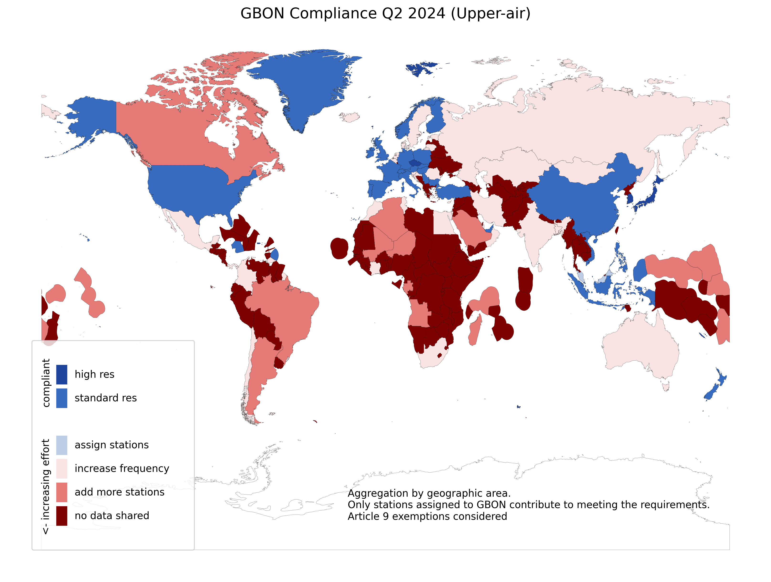
GBON Compliance in Q2 2024
GBON compliance app (wmo.int)

Slide 10
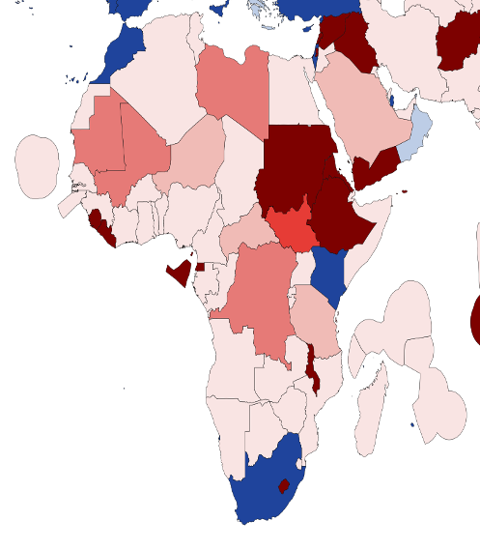
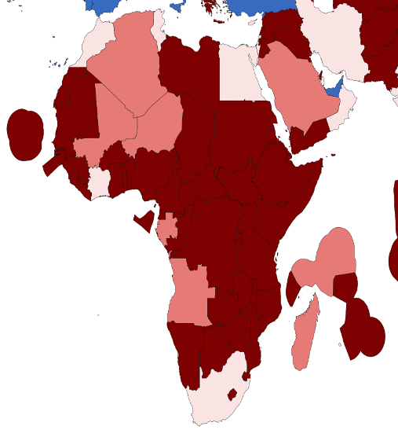
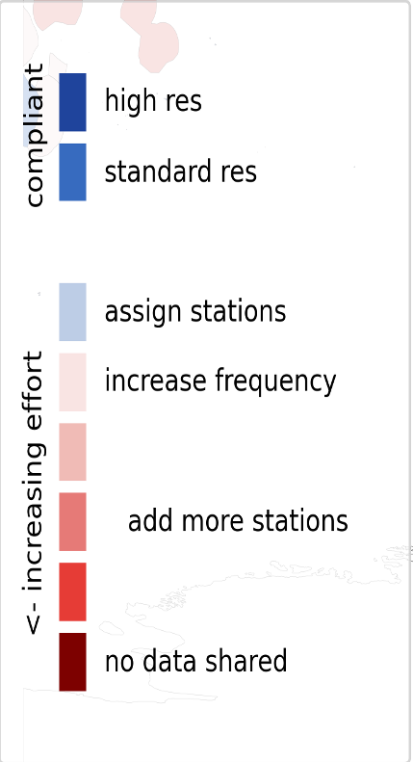
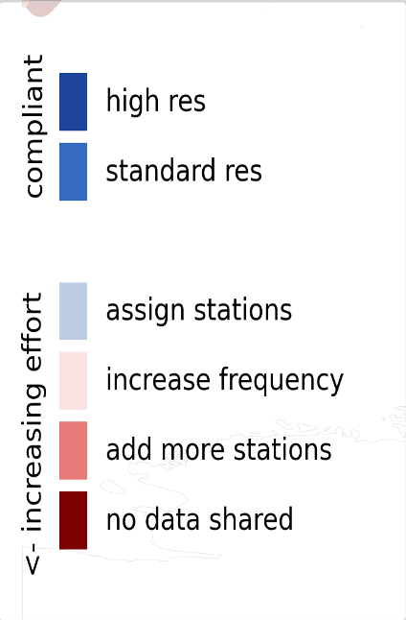
GBON Compliance in Q2 2024
surface observations
upper air observations
GBON compliance app (wmo.int)

Slide 11
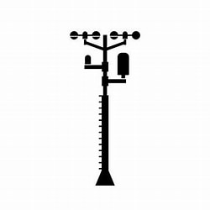
GBON Guide: EC-77 (Feb. 2023)
GBON compliance: tools and criteria
WMO regional centres supporting Members
GBON station compliance
Availability ≥80%
Timeliness <5%
Quality <5%
Security
Power
Comms
Comms
WIS2 node
Station
Data
processing
centre
WMO
Information
System
Global NWP
centre
Consumables
Trained operators
Regular maintenance and calibration
Correct metadata
WIGOS
Data Quality
Monitoring
System
WDQMS
Incidents identified by WIGOS Regional Centres
Notes:
For upper air, additionally we are looking at required resolution
WDQMS is operated in cooperation with DWD (Germany), ECMWF, JMA (Japan), and NOAA/NCEP (USA)

Slide 12
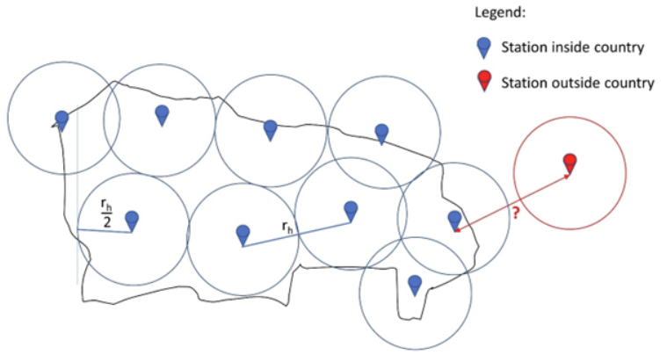
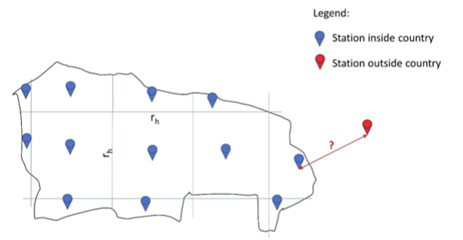
Horizontal resolution: methods of calculation
Target number of stations per surface area
GBON Global Gap Analysis used the method of dividing the total area of a Country by the square of the required horizontal resolution (SIDs: 500 km- Surface, 1000 km- Upper air)
Circle and Grid methods of spacing the network
Circle method to determine observing network spacing, where circles around existing
or newly planned observing stations with a radius corresponding to half of
the horizontal resolution requirement r_{h} are placed over country to verify
that required GBON horizontal resolution is fulfilled
Grid method to determine observing network spacing, where square grid with dimension r_{h} is placed over country to verify that required GBON horizontal resolution is fulfilled and there is a surface or upper-air station in each box

Slide 13
Africa: Global GBON Gap Analysis, June 2023
SOFF- supported country | Station type | Target | Reporting** | Gap (improve) | Gap (new) | Gap (total)
Burkina Faso | Surface land | 7 | 2 | 5 | 0 | 5
 | Upper-Air | 2 | 0 | 1 | 1 | 2
Cabo Verde | Surface land | 4 | 0 | 4 | 0 | 4
 | Upper-Air | 1 | 0 | 1 | 0 | 1
Chad | Surface land | 33 | 1 | 32 | 0 | 32
 | Upper-Air | 6 | 0 | 2 | 4 | 6
Comoros | Surface land | 1 | 0 | 1 | 0 | 1
 | Upper-Air | 1 | 0 | 0 | 1 | 1
Djibouti | Surface land | 1 | 0 | 1 | 0 | 1
 | Upper-Air | 1 | 0 | 0 | 1 | 1
DRC | Surface land | 59 | 0 | 35 | 24 | 59
 | Upper-Air | 10 | 0 | 0 | 10 | 10
Ethiopia | Surface land | 29 | 0 | 29 | 0 | 29
 | Upper-Air | 5 | 0 | 1 | 4 | 5
Guinea Bissau | Surface land | 1 | 0 | 1 | 0 | 1
 | Upper-Air | 1 | 0 | 0 | 1 | 1

Slide 14
Africa: Global GBON Gap Analysis, June 2023
SOFF- supported country | Station type | Target | Reporting** | Gap (improve) | Gap (new) | Gap (total)
Liberia | Surface land | 3 | 0 | 3 | 0 | 3
 | Upper-Air | 1 | 0 | 0 | 1 | 1
Madagascar | Surface land | 15 | 4 | 11 | 0 | 11
 | Upper-Air | 3 | 2 | 0 | 1 | 1
Malawi | Surface land | 3 | 10 | 0 | 0 | 0
 | Upper-Air | 1 | 0 | 1 | 0 | 1
Mauritius | Surface land | 9 | 1 | 5 | 3 | 8
 | Upper-Air | 3 | 0 | 1 | 2 | 3
Mozambique | Surface land | 20 | 0 | 20 | 0 | 20
 | Upper-Air | 4 | 0 | 0 | 4 | 4
Niger | Surface land | 32 | 0 | 31 | 1 | 32
 | Upper-Air | 6 | 1 | 1 | 4 | 5
Rwanda | Surface land | 1 | 0 | 1 | 0 | 1
 | Upper-Air | 1 | 0 | 0 | 1 | 1
Sao Tome and Principe | Surface land | 1 | 0 | 1 | 0 | 1
 | Upper-Air | 1 | 0 | 0 | 1 | 1

Slide 15
Africa: Global GBON Gap Analysis, June 2023
SOFF- supported country | Station type | Target | Reporting** | Gap (improve) | Gap (new) | Gap (total)
Senegal | Surface land | 5 | 2 | 3 | 0 | 3
 | Upper-Air | 1 | 0 | 1 | 0 | 1
Seychelles | Surface land | 6 | 0 | 1 | 5 | 6
 | Upper-Air | 2 | 1 | 0 | 1 | 1
Somalia | Surface land | 16 | 0 | 16 | 0 | 16
 | Upper-Air | 3 | 0 | 0 | 3 | 3
South Sudan | Surface land | 16 | 0 | 2 | 14 | 16
 | Upper-Air | 3 | 0 | 0 | 3 | 3
Tanzania | Surface land | 24 | 0 | 16 | 8 | 24
 | Upper-Air | 4 | 1 | 2 | 1 | 3
Uganda | Surface land | 7 | 0 | 7 | 0 | 7
 | Upper-Air | 1 | 0 | 0 | 1 | 1
Zambia | Surface land | 19 | 0 | 19 | 0 | 19
 | Upper-Air | 4 | 0 | 4 | 0 | 4

Slide 16
The importance of observations

Slide 17
Closing the basic weather and climate data gap is foundational to the climate services value chain
International exchange of observations
Observations from the entire globe
Global Numerical Weather Prediction
Weather and climate-related infrastructure – must be designed and coordinated globally
Activities undertaken primarily at regional, national and local level
Local data processing, forecast, warning and advisory products
Effective decision-making and action
Delivery of weather and climate services
The Meteorological Value Chain: All links in the chain must operate effectively to yield success. Adapted source: WMO Secretariat, 2021.

Slide 18
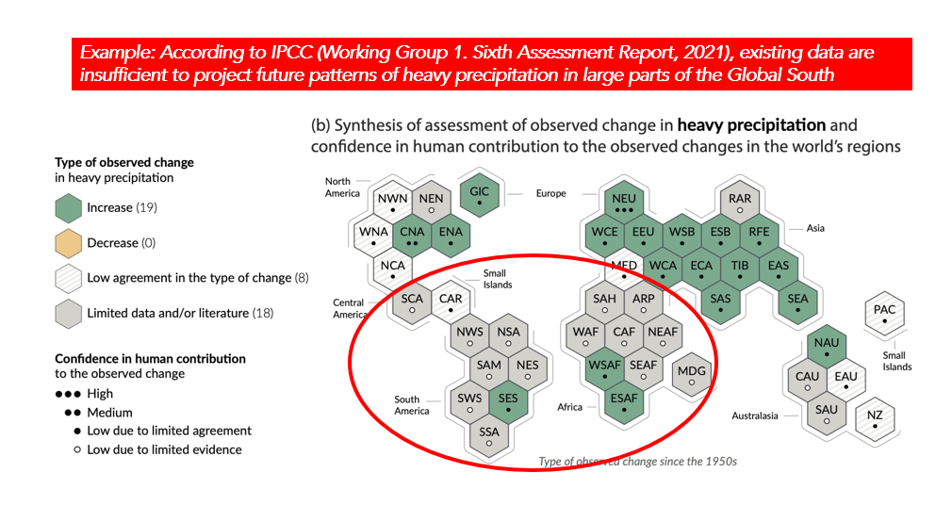
Closing the basic weather and climate data gaps is essential – IPCC
Recent IPCC reports showcase progress in monitoring and understanding the climate
WG I report stated - there is "evidence of observed changes in extremes and, in particular, their attribution to human influence, has strengthened."
However, in developing countries, lack of ongoing exchange of observations and access to long-term records limits the ability to design meaningful adaptation measures.

Slide 19
Closing the basic weather and climate data gaps is essential – economic importance
USD 5 billion
USD 162 billion
Benefits directly enabled by GBON implementation in countries with the largest data gaps are estimated to exceed USD 5 billion per year.
Weather and climate observations are essential to fully realize the USD 162 billion of estimated minimum annual socio-economic benefits of weather and climate prediction.

Slide 20
Why are there major weather and climate data gaps despite substantial investments?
The substantial investments in observing systems have not translated into increased observational data sharing.
Lack of a global approach to address the global nature of the problem
Lack of an appropriate measure of success
Lack of a long-term and systematic approach to strengthen capacity
Lack of a coordinated and integrated implementation approach
Lack of a realistic financing and effective technical assistance model

Slide 21
SOFF – A new approach
SOFF is a specialized UN climate fund that provides financial assistance through the coordinated support of many partners for the provision of a global public good
Peer-to-peer technical assistance provided by met offices from 28 countries – long term twinning arrangements
Single focus on data generation and exchange and crowding-in additional financing for investments in latter part of value chain.
SOFF is delivering at speed and scale. As of June 2023, 66 countries programmed, 60 receiving support, USD 115 million provided. Of these, 62 millions were allocated to African countries.
High country demand: 35 additional countries have requested SOFF support

Slide 22
SOFF – bringing together multiple partners under one roof
28
9
18
17
Steering Committee members
Implementing Entities
Advisory Board members
Peer Advisors
WMO
meteorological offices from advanced countries to provide technical assistance
Multilateral Development Banks and UN agencies
donors, co-founders and other stakeholders,
incl. LDC Group, AOSIS, CREWS
“enablers”
incl. REAP, IFRC, UNDRR, climate funds, private sector, civil society
Technical Authority and SOFF Secretariat host
Notes:
as a UN fund, SOFF effectively brings together:
27 met offices from advanced countries to provide technical assistance
9 Implementing Entities
MDBs, UNDP, UNEP, WFP, IFAD
11 donors and several additional stakeholders in SOFF Steering Committee
incl. LDC Group, AOSIS, CREWS
“enablers” in SOFF Advisory Board
incl. UNDRR, climate funds, private sector, civil society

Slide 23
SOFF Phases of support

Slide 24
SOFF phases of support
Readiness
GBON gap analysed and screened (NGA)
GBON national contribution developed and screened (NCP)
Country Hydromet Diagnostics undertaken (CHD)
SOFF funding for peer advisory services to support the country in developing these products
Investment
SOFF provides a grant for the implementation of the GBON National Contribution Plan, i.e., GBON stations and capacity building
GBON infrastructure in place GBON human and institutional capacity developed
Compliance
GBON data internationally shared and results-based finance provided
SOFF provides annual results-based payments for GBON-verified data sharing.

Slide 25
SOFF support in Africa
Country | Peer advisors | Implementing entity | Readiness Phase | Investment Phase
Burkina Faso | Spain - Nigeria | AfDB | Implementation in progress
Cabo Verde | Netherlands | UNEP | Completed | Implementation underway
Chad | Austria | WFP | Completed | Funding request approved
Comoros | Morocco | AfDB | Delayed
Djibouti | Austria | UNDP | Implementation in progress
DRC | Switzerland | AfDB | Implementation in progress
Ethiopia | Norway-Finland | UNDP | Completed | Implementation underway
Guinea Bissau | Portugal | UNEP | Implementation in progress
Liberia | Nigeria | AfDB | Completed
Madagascar | Germany | AfDB | Completed | Funding request provisionally approved
Malawi | Norway-Iceland | UNDP | Completed | Funding request provisionally approved

Slide 26
SOFF support in Africa
Country | Peer advisors | Implementing entity | Readiness Phase | Investment Phase
Malawi | Norway-Iceland | UNDP | Completed | Funding request provisionally approved
Mauritius | South Africa-India | AfDB | Delayed
Mozambique | South Africa | WFP | Completed | Implementation underway
Niger | Nigeria | AfDB | Implementation in progress
Rwanda | Finland | UNDP | Completed | Implementation underway
Sao Tome and Principe | Netherlands | UNDP | Close to completion
Senegal | Netherlands | IsDB | Close to completion
Seychelles | South Africa | AfDB | Implementation in progress
Somalia | Nigeria | UNDP | Implementation in progress
South Sudan | Austria | AfDB | Completed | Implementation underway (pending AfDB signature)
Tanzania | Denmark | UNDP | Completed | Implementation underway
Uganda | Netherlands | IsDB | Completed | Funding request approved
Zambia | United Kingdom | WFP | Completed | Funding request submitted

Slide 27
SOFF Regional Implementation

Slide 28
SOFF implementation progress
SOFF promotes regional approaches to ensure optimal design of the observing network and to promote coordinated implementation, pursuing efficiency gain and economies of scale.
Regional Approaches
Atlantic | Workshop in Cabo Verde co-hosted by SOFF and KNMI, November 2023 3 Atlantic SIDS and partners
Pacific | Workshop in Fiji co-hosted by SOFF and Fiji Met, April 2024 13 Pacific islands countries and partners
Africa | Workshop in Cote d’Ivoire co-hosted by SOFF and AfDB, September 2024 23 African countries and partners
South Asia | Workshop in Bhutan co-hosted by SOFF and NCHM, September 2024 4 South Asian countries and partners
Caribbean | Virtual engagement started in July with 16 countries Workshop in person foreseen for January/February 2025

