Slide 1
Closing the Basic Weather and Climate Data Gaps in South Asia: Advancing SOFF implementation and creating synergies Country updates Bangladesh
24 – 26 September 2024

Slide 2
Outline
Brief introduction of the NMHS
Update on SOFF Implementation
Lessons learned and opportunities

Slide 3
Position of Bangladesh in the Asia Map
Bangladesh is a Southeast Asian country extends from 20⁰ 30’ to 26⁰ 40’N and from 88⁰ 03’ to 92⁰ 40’E on the map.

Slide 4
Brief introduction of the NMHS
Bangladesh Meteorological Department (BMD) is the only authorized government organization
to provide weather forecasts and to issue warnings for meteorological disaster.

Slide 5
Mandate of BMD
Monitor and issue forecasts and warnings of all meteorological extreme events like tropical cyclone, severe thunderstorm/ tornadoes, heavy rainfall, drought, cold and heat wave along with daily routine forecasts round the clock.
Issues short, medium and long-range forecasts for agricultural planning and operation of daily farmer’s activities.
Observe Weather Elements Over the Country and share related Data with the Stakeholders.
Provides seismological information in and around the country along with Tsunami Advisories and warnings to the Government and public.

Slide 6
Mandate of BMD
Supply and facilitate the application of climate data and information to the Government and private agencies for planning and performance of socio-economic development activities.
BMD is involved in monitoring of the change/variability of climate and accordingly have to advise government & public for their measures towards proper implementation of climate change strategy & action plan.
Archives all weather and climate data, maintenance of historical records of all meteorological and seismological extreme events in numeric and graphical forms.

Slide 7
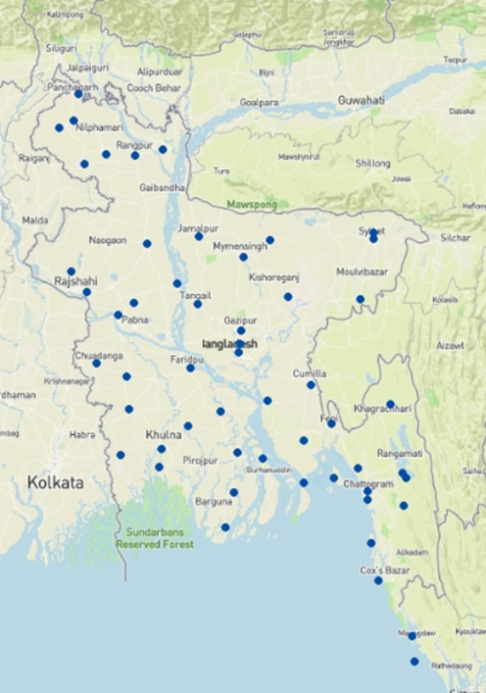
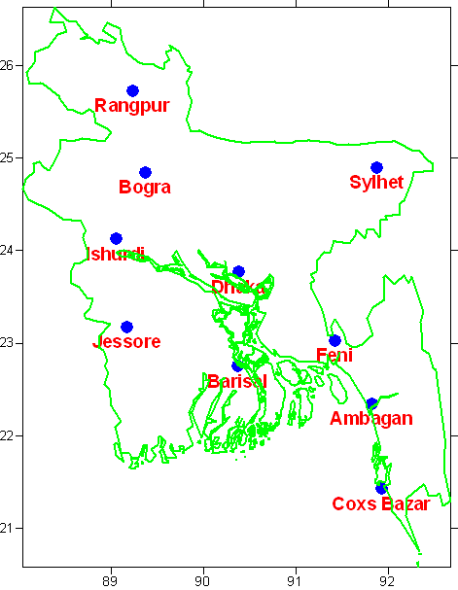
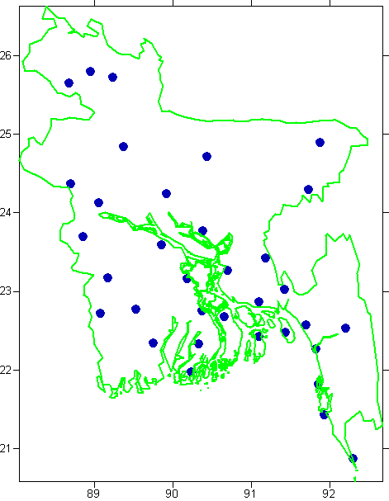
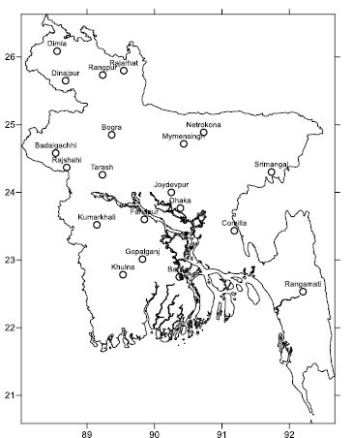
Manual Observatories in BMD
a. Synoptic observatories : 58
b. Pilot Observatories : 11
c. Rawinsonde Observatories : 06
d. Agromet observatories : 19
e. RADAR Stations : 5
f. Earthquake Monitoring Stations: 10
g. Lightening Sensor : 11
Synoptic Observatory
Khepupara
Pilot Balloon Observatory
Rawinsonde Observatory
Agromet Observatory

Slide 8
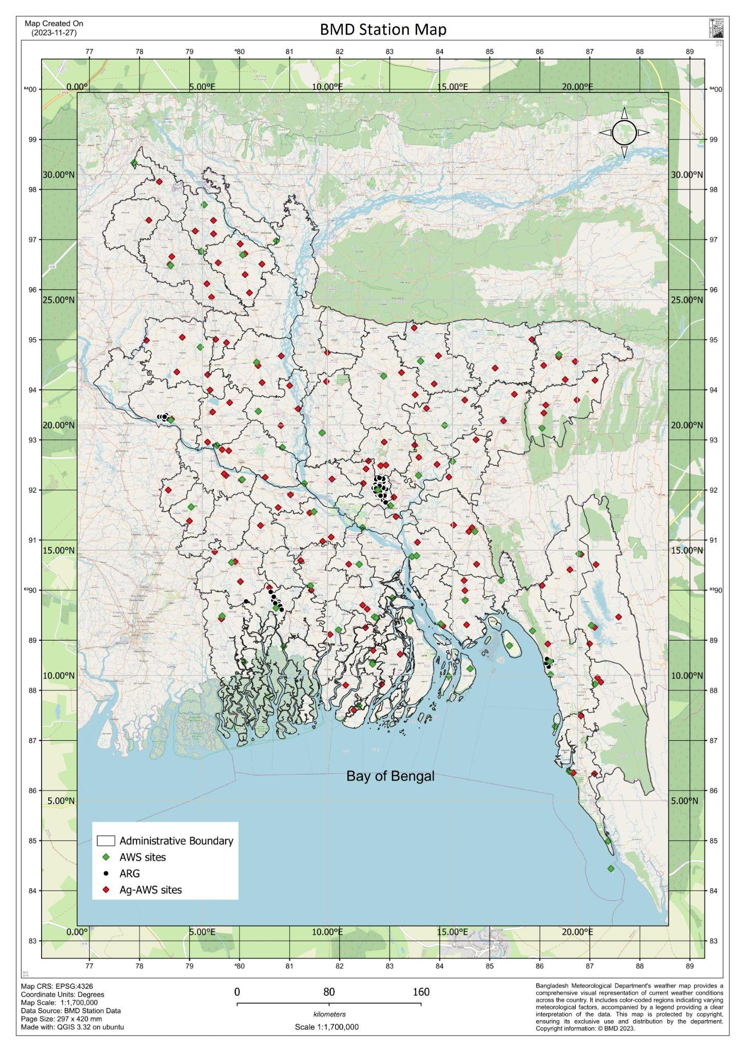
Automatic Observatories
a. Automatic Weather Station(AWS): 61
b. AgriAWS: 125
c. Automatic Rain Gauge: 65

Slide 9
15 GBON designated surface land stations

Slide 10
01 GBON designated upper-air station

Slide 11
Update on SOFF Implementation
18 October 2024 - deadline for first draft of funding request
30 November 2024 - deadline for final version of funding request

Slide 12
Lessons learned and opportunities
WMO Member: Bangladesh
Surface area: 148,460 square km
Station type | Target | Reporting
GBON Surface Land stations (standard density) | 4 | 15
GBON Surface Land stations (high density) | 15 | 15
GBON Upper-Air stations over land | 1 | 1
Need to remove problem with hourly data transmission
Need to improve Data quality
Need to improve Calibration facility and timely calibration
Need to improve ICT infrastructure and services at BMD for complete data processing and data transmission from the automatic observing stations to the Global NWP centers in real-time through WIS 2 box.
Need to improve CDMS and establish back up CDMS.

Slide 13
Surface land stations : 4
Standard density 200km
Variables: SLP, T, H, W, P
Observing cycle: 1h
All stations are Automatic Weather Stations (AWS)
Upper-air stations operated from land: 1
Standard density²⁷ 500km
Vertical resolution: 100m,
up to 30 hpa
Variables: T, H, W
Observing cycle: twice a day
The fifth surface station (yellow circle) is added for SOFF consideration

Slide 14
Thank you

