Slide 1
Closing the Basic Weather and Climate Data Gaps in South Asia: Advancing SOFF implementation and creating synergies Country updates - MALDIVES
24 – 26 September 2024
Abdulla Wahid
Director General Meteorology
Maldives Meteorological Service

Slide 2
Outline
Brief introduction of the NMHS
Update on SOFF Implementation
Lessons learned and opportunities

Slide 3
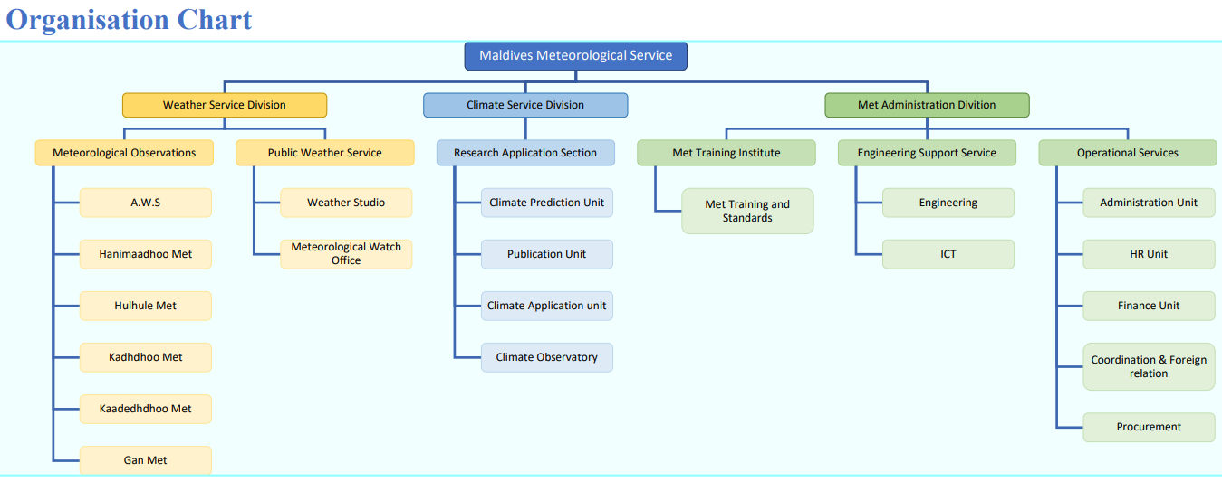
Brief introduction of the NMHS

Slide 4
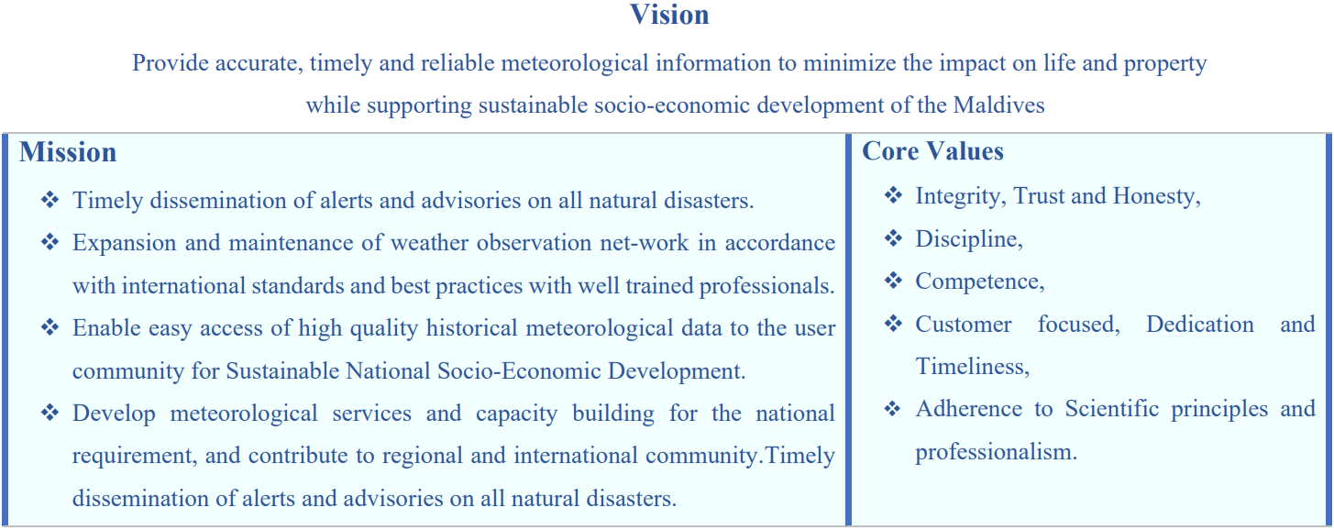
Brief introduction of the NMHS

Slide 5
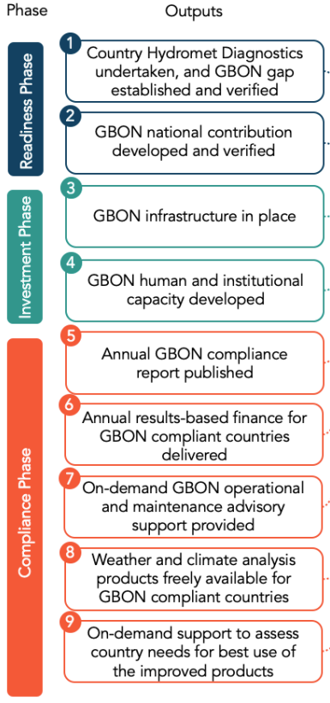
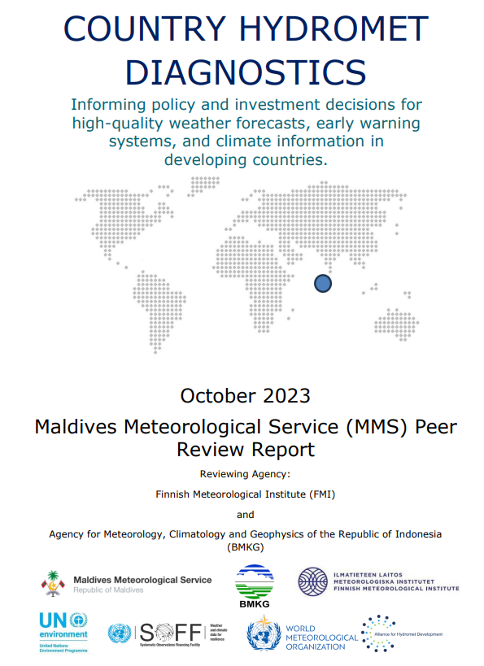
Update on SOFF Implementation

Slide 6
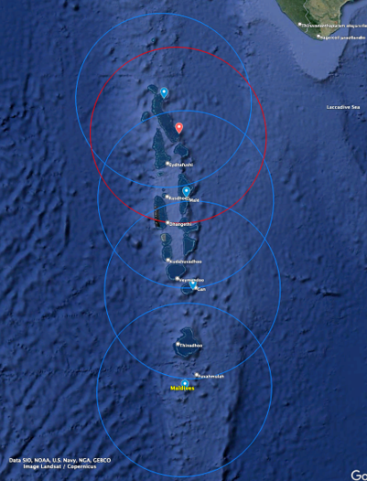
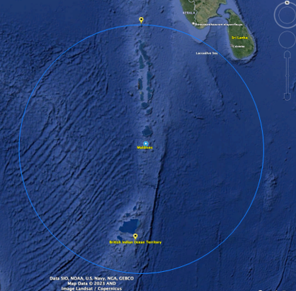
Update on SOFF Implementation
Distribution of proposed GBON surface stations to be supported by SOFF. Existing stations in blue markers and proposed new station (tentatively in Maafaru) in red, all with diameter of 500 km
Gan sounding station location in blue dot and circle of 1000 km radius. (Neighboring counties’ sounding stations in yellow markers)

Slide 7
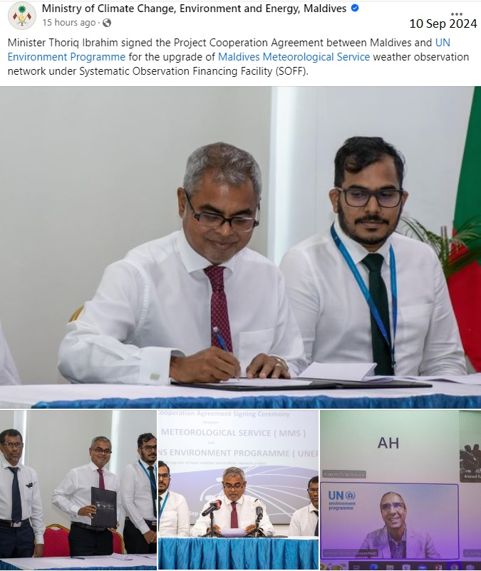
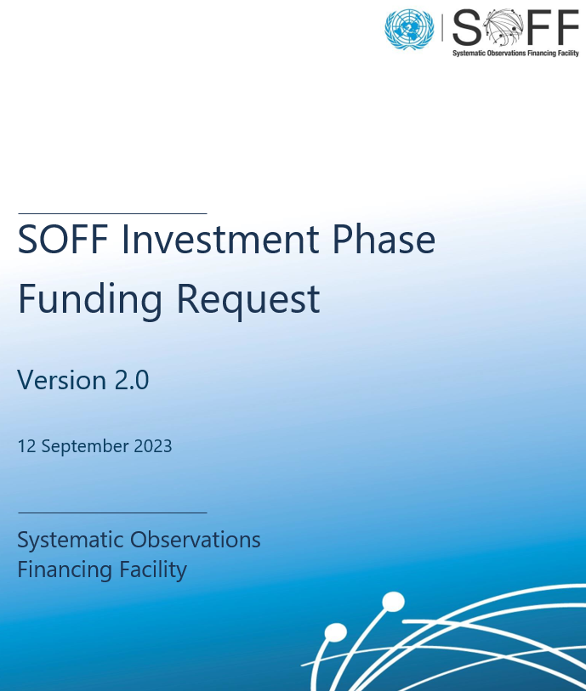
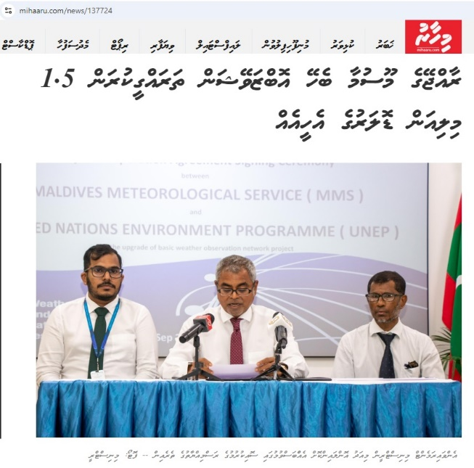
Update on SOFF Implementation

Slide 8
Lessons learned and opportunities
Lessons Learn
Existing CHD report and Fast-track update and development of other reports together with the great support and assistance from WMO, UNEP, FMI, BMKG, RIMES, IMD etc.
Commitment by the Government and local authorities including NMHS, CCD of MCCEE etc.
Geographically Maldives is located in a data sparse area in the Indian Ocean, this facilitates in filling the data gaps in the GBON, contribution from Maldives observation stations will contribute to global community in many areas which include climate change studies, NWP data assimilation hence improve global weather model hence contribute to EW4All initiative as well.
Opportunities
Support for additional AWS to upgrade to GBON compliant stations hence more contribution to regional and global communities.
Explore establishment and support in observation from marine based ( buoy ) platforms.
Explore regional support in calibration and maintenance of AWS sensors.
Challenges
Operation, regular calibration and maintenance of sensors.
Limited local expertise, equipment and facility in calibration and maintenance
Financial constraints.

Slide 9
Thank you
Photo Credit : https://visitmaldives.com

