Slide 1
Closing the Basic Weather and Climate Data Gaps in South Asia: Advancing SOFF implementation and creating synergies Session 1: Setting the scene
24 – 26 September 2024

Slide 2
What is SOFF?

Slide 3
The Systematic Observations Financing Facility - SOFF
A specialized United Nations climate fund co-created by the World Meteorological Organization, United Nations Environment Programme, and United Nations Development Programme
Established to fill in major gaps in basic weather and climate data in the countries with the biggest capacity constraints – Least Developed Countries and Small Island Developing States
Mandated to support the implementation of the Global Basic Observing Network - GBON
Foundational element and delivery vehicle of the UN Early Warnings for All Initiative

Slide 4
SOFF – A new approach
SOFF provides financial assistance to generate, exchange and sustain basic observations – global public good financing mechanism
Peer-to-peer technical assistance provided by advanced met offices – long term twinning arrangements
Single focus on data generation and exchange and crowding-in additional financing for investments in latter part of value chain.
SOFF is delivering at speed and scale. As of June 2023, 66 countries programmed, 60 receiving support, USD 115 million provided. Of these, USD 10 million were allocated to South Asian countries.
High country demand: 35 additional countries have requested SOFF support

Slide 5
SOFF – bringing together multiple partners under one roof
28
9
18
17
Steering Committee members
Implementing Entities
Advisory Board members
Peer Advisors
WMO
meteorological offices from advanced countries to provide technical assistance
Multilateral Development Banks and UN agencies
donors, co-founders and other stakeholders,
incl. LDC Group, AOSIS, CREWS
“enablers”
incl. REAP, IFRC, UNDRR, climate funds, private sector, civil society
Technical Authority and SOFF Secretariat host
Notes:
as a UN fund, SOFF effectively brings together:
27 met offices from advanced countries to provide technical assistance
9 Implementing Entities
MDBs, UNDP, UNEP, WFP, IFAD
11 donors and several additional stakeholders in SOFF Steering Committee
incl. LDC Group, AOSIS, CREWS
“enablers” in SOFF Advisory Board
incl. UNDRR, climate funds, private sector, civil society

Slide 6
Closing the basic weather and climate data gap is foundational to the climate services value chain
International exchange of observations
Observations from the entire globe
Global Numerical Weather Prediction
Weather and climate-related infrastructure – must be designed and coordinated globally
Activities undertaken primarily at regional, national and local level
Local data processing, forecast, warning and advisory products
Effective decision-making and action
Delivery of weather and climate services
The Meteorological Value Chain: All links in the chain must operate effectively to yield success. Adapted source: WMO Secretariat, 2021.

Slide 7
What is GBON? Global Basic Observing Network

Slide 8
GBON - an International agreement on the mandatory basic weather and climate observations
193 countries and territories of the World Meteorological Congress established in 2021 for the first time the minimum set of surface-based observations that all countries must generate and internationally exchange - Global Basic Observing Network (GBON)
While GBON compliance is mandatory, major data and capacity gaps exist in most developing countries, hampering effective climate action across the globe.
Least Developed Countries (LDCs) and Small Island Developing States (SIDS) generate and exchange less than 10 % of the GBON data.

Slide 9
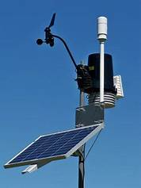
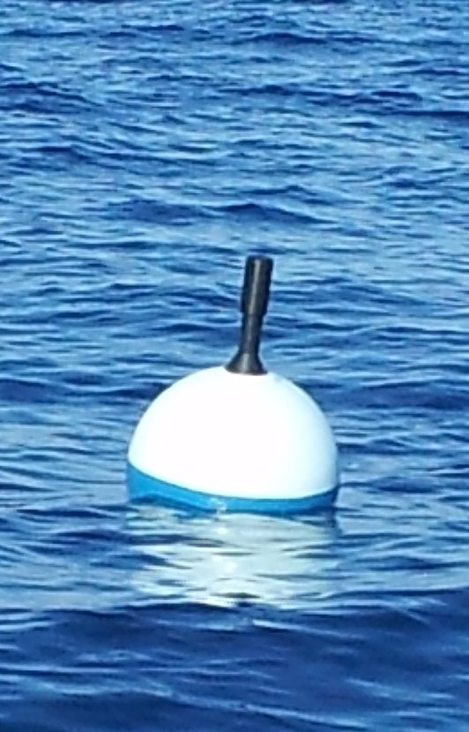
GBON requirements and SOFF scope
Securing an adequate supply of observational data to the global NWP centres that serve all countries with forecast and analysis products
GBON requirements - per station type | GBON Variables
 | Pressure | Temp | Hum | Wind | Precip | Snow Depth
Surface land stations Horizontal resolution: 200 km (500 km for small island states) Observing cycle: 1h Real-time data exchange to WMO Information System (WIS) | X | X | X | X | X | X
Upper-air stations operated from land Horizontal resolution: 500 km (1000 km for small island states) Vertical resolution: 100m, up to 30 hPa Observing cycle: twice a day Real-time data exchange to WMO Information System (WIS) |  | X | X | X
 | X | X
Open to SOFF investment today
Marine surface stations in EEZs
Horizontal resolution: 500 km
Observing cycle: 1h
Coastal stations not included, all contributions in EEZ, including foreign, count to country compliance
Gap analysis to be performed
Station compliance
Based on requirements above
Country compliance
Station compliance at required horizontal resolution (number of stations required for surface area of country)
INFCOM-3 approved WIGOS Guide
GBON Technical Regulations: WIGOS Manual (WMO-No. 1160) – Cg-Ext(2021)

Slide 10
South Asia: Global GBON Gap Analysis, June 2023
SOFF countries | WMO GBON Global Gap Analysis, June 2023 |  |  |  | Approved for SOFF support
 | Target |  | Gap (total) |  | Total for investment
 | Surface | UAS | Surface | UAS | Surface | UAS
Bangladesh | 4 | 1 | 4 | 0 | 5 | 1
Bhutan | 1 | 1 | 0 | 1 | 1 | 1
Maldives | 4 | 1 | 4 | 1 | 5 | 1
Nepal | 4 | 1 | 4 | 1 | 5 | 2
Afghanistan | 17 | 3 | 17 | 3
India | 83 | 14 | 83 | 0
Myanmar | 17 | 3 | 17 | 3
Pakistan | 20 | 4 | 20 | 4
Sri Lanka | 2 | 1 | 2 | 1

Slide 11
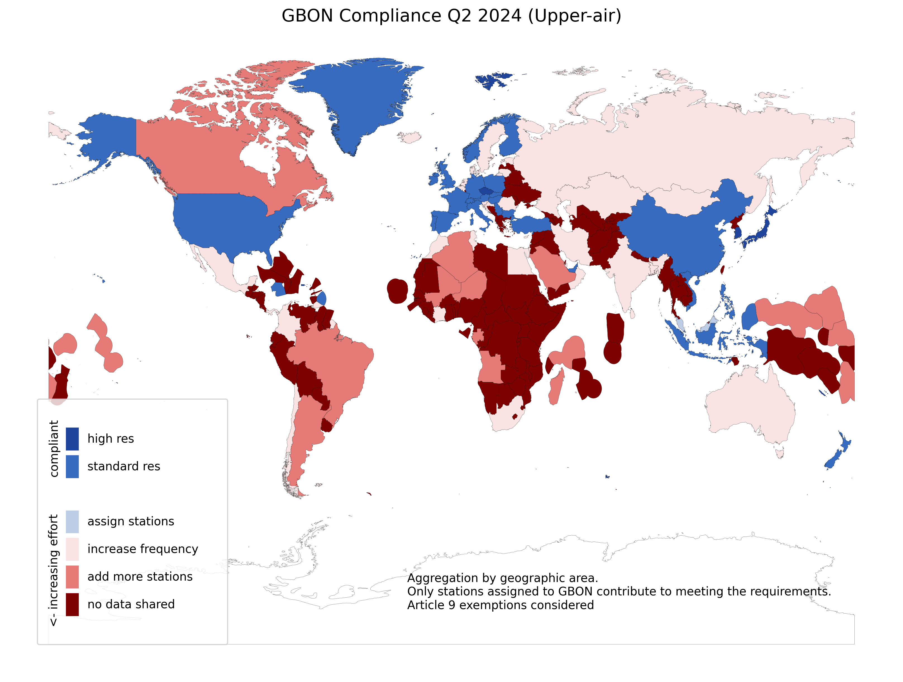
GBON Compliance in Q2 2024
GBON compliance app (wmo.int)

Slide 13
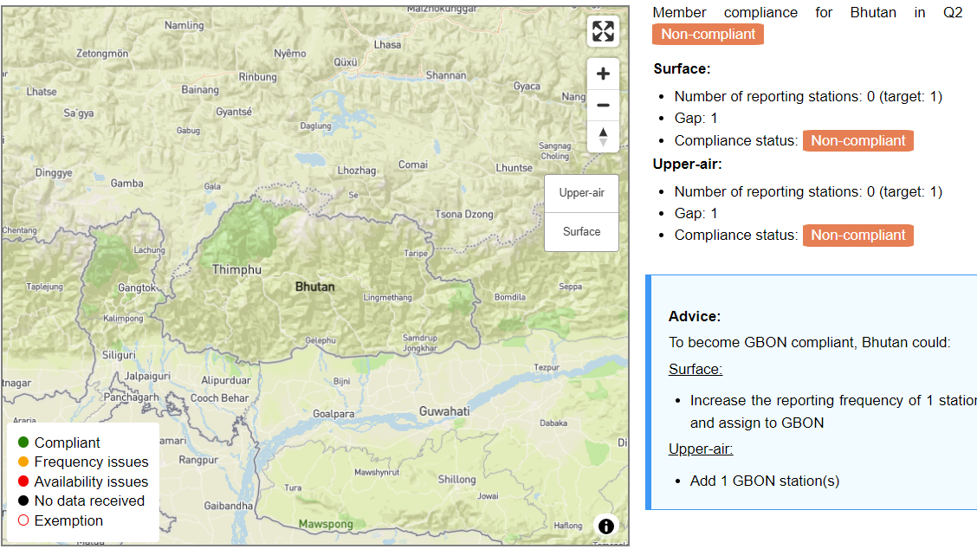

Slide 15
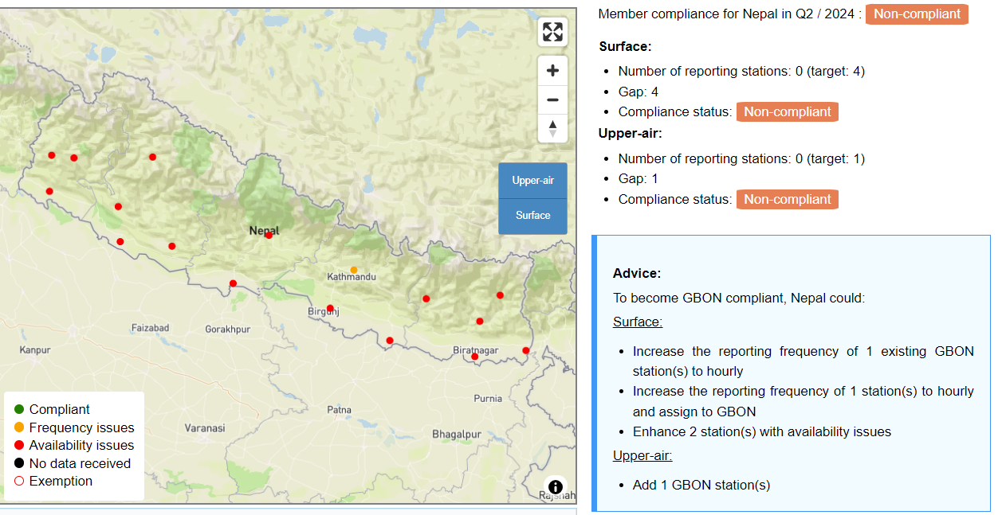

Slide 16
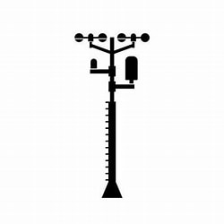
GBON Guide: EC-77 (Feb. 2023)
GBON compliance: tools and criteria
GBON station compliance
Availability ≥80%
Timeliness <5%
Quality <5%
Security
Power
Comms
Comms
WIS2 node
Station
Data
processing
centre
WMO
Information
System
Global NWP
centre
Consumables
Trained operators
Regular maintenance and calibration
WIGOS
Data Quality
Monitoring
System
WDQMS
WMO and WIGOS Regional Centres
Tailored SOFF reporting
Notes:
For upper air, additionally we are looking at required resolution
WDQMS is operated in cooperation with DWD (Germany), ECMWF, JMA (Japan), and NOAA/NCEP (USA)

Slide 17
THANK YOU!

