Slide 1
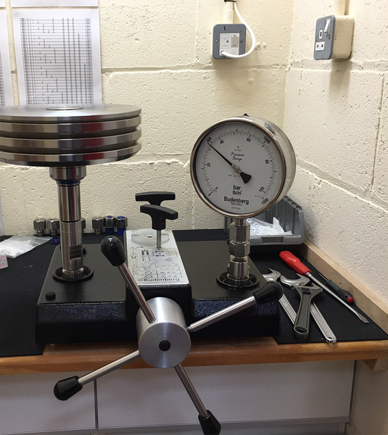
Calibration
Calibration: operation performed on a measuring instrument or a measuring system that, under specified conditions
1. establishes a relation between the values with measurement uncertainties provided by measurement standards and corresponding indications with associated measurement uncertainties and
2. uses this information to establish a relation for obtaining a measurement result from an indication
NOTE 1: The objective of calibration is to provide traceability of measurement results obtained when using a calibrated measuring instrument or measuring system.
NOTE 2: The outcome of a calibration may be expressed by a statement, calibration function, calibration diagram, calibration curve, or calibration table.
Calibration ≠ Verification Calibration ≠ Adjustment

Slide 2
Why Calibration is needed?
NMHS
Precize status of the observing network
Traceability of instruments to the international chain (QMS)
End User / national stakeholders
TRUST
Evidences provided on the quality of observations and products
NWP and International community
TRUST
Reliable studies, data sets, analysis
Check compliance to WMO standards and guidance
Confidence on the results obtained using NMHS data
More reliable NWP outputs over the country and region
Best decision making

Slide 3
What we need for Calibration?
Equipment
Hight performance Instruments (standards)
Procedures
Qualified Staff
Controlled technical environment
Calibration in Meteorology
Temperature
Humidity
Pressure
Precipitation
Solar Radiation

Slide 4
How frequent is the Calibration?
When To Perform Calibration?
Before first time usage of a new device or instrument.
After the due date, recalibration is done.
According to the specifications of manufacturer.
To meet the requirements of regulatory bodies.
In case of any shock or damage.
How to define the Calibration Interval / Frequency ?
It is initially defined based on expert advice.
It is defined based on previous experience with such an instrument.
Based on manufacturer recommendations.
Based on regulatory requirements.
Nature of work for which it is used.
Frequency of use.
Some examples:
Temperature Pt100 probe: up to 5 years
Humidity probe: 6 months or 1 year
Digital barometer: 1year or 2 years
Depends on the class of the instrument, the annual drift, the working environment...etc

Slide 5
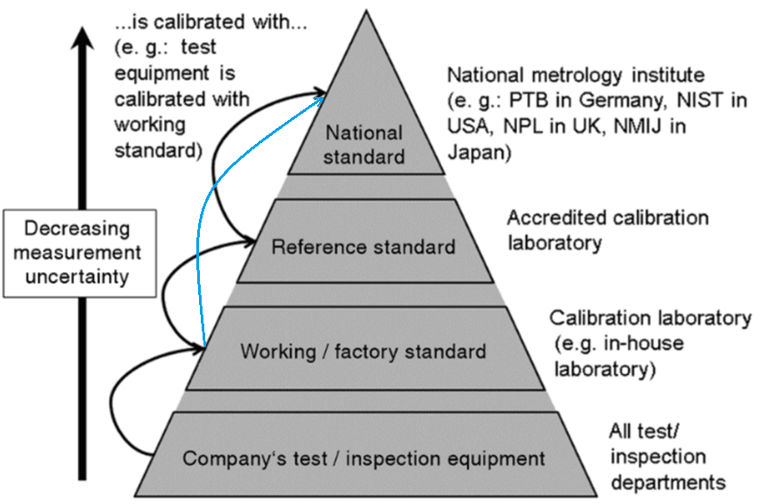
Working standards are usually used in the laboratory to test the product for quality and consistency. Reference standards, on the other hand, are typically used in the final testing of the product to ensure that it meets the required specifications. It is also used to regularly calibrate and ensure traceability of the working standards Reference standards should be regularly calibrated using high level standards that can be found in the National Metrological institute (NMI). Note: in the absence of a reference standards, the traceability of the working standards could be ensured using the NMI standards. For instruments that could not be brought to the calibration laboratory, travelling standards / inspection equipment may be used. The traceability of the travelling standards/ inspection equipment will be ensured using the working standards.
How to ensure the traceability of the measurements to the international chain?

Slide 6
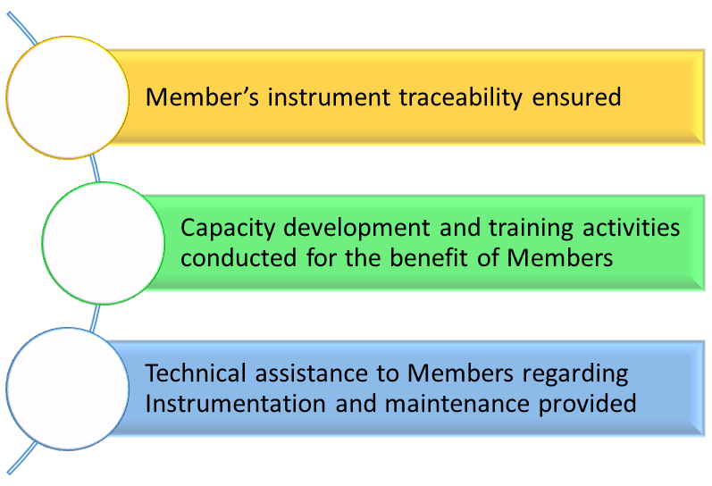
How to ensure the traceability of the measurements to the international chain?
WMO - Regional Instrument Centres
Capabilities:
shall have the necessary facilities and laboratory equipment;
shall maintain a set of meteorological standard instruments and establish the traceability to the International System of Units (SI);
shall have competent managerial and technical staff;
shall have technical procedures for calibration;
shall have and maintain a quality management system, preferably according to the ISO/IEC 17025 standard;
shall participate in, and/or organize inter-laboratory comparisons of standard calibration instruments and methods;
shall, as appropriate, utilize the available resources and capabilities to the Members’ best interest;
Strengthening RIC capabilities
Corresponding Functions:
shall assist Members of the Region, and possibly of other Regions, in calibrating their national meteorological standards and related environmental monitoring instruments;
shall make a positive contribution to Members regarding the quality of measurements;
shall advise Members on enquiries regarding instrument performance, maintenance and the availability of relevant guidance materials;
shall actively participate, or assist, in the organization of workshops on calibration and maintenance of meteorological and related environmental instruments;
shall contribute to the standardization of meteorological and related environmental measurements;
shall conduct or support the regular assessment of Members’ needs for RIC services;
shall regularly inform Members and report, on an annual basis, to the WMO Secretariat on the services offered to Members and activities carried out.

Slide 7
Thank you

Slide 8
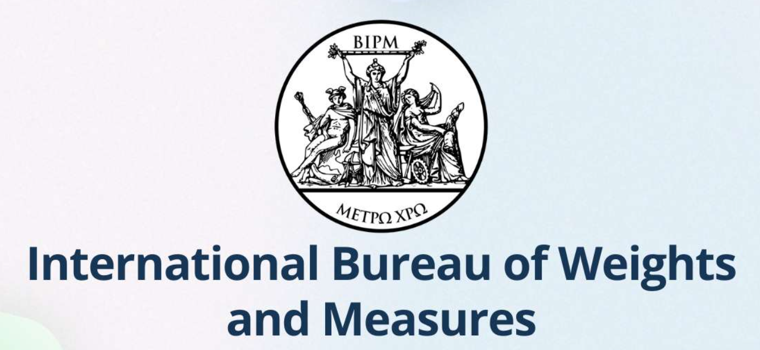
International Vocabulary of Metrology
Quantity in the general sense kind of quantity property whose instances can be compared by ratio or only by order
Measurement: process of experimentally obtaining one or more values that can reasonably be attributed to a quantity together with any other available relevant information
Instrument Drift: gradual undesirable change over time in indiction of a measuring instrument due to its limited stability for the same quantity being measured
Operating conditions: state of a measuring instrument or measuring system when it is in operation
NOTE The state of a measuring instrument or measuring system can include whether and how it is powered / energized, the state of internal components / circuitry / interconnections when energized (for example, what is constant and what varies with time), and what are the values of the environmental quantities that are known to influence the indication in a significant, predictable but otherwise undesirable way

Slide 9
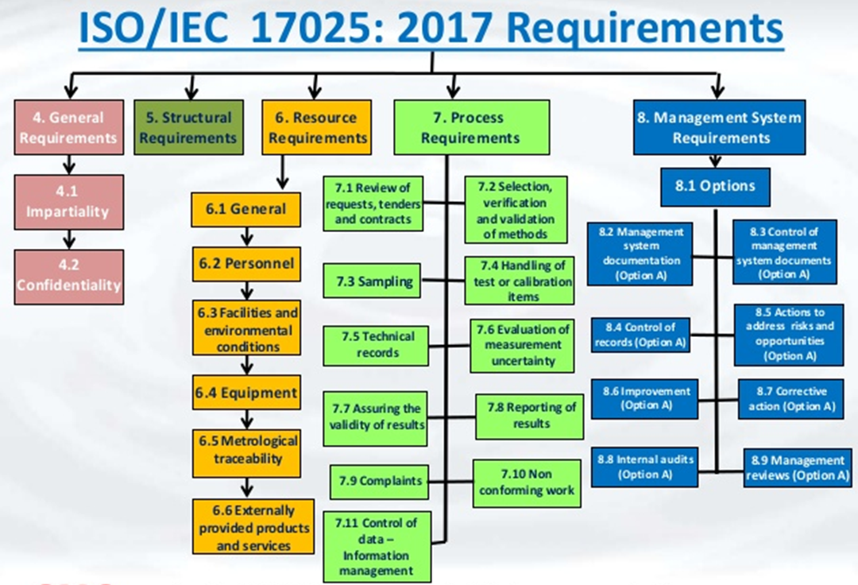

Slide 10
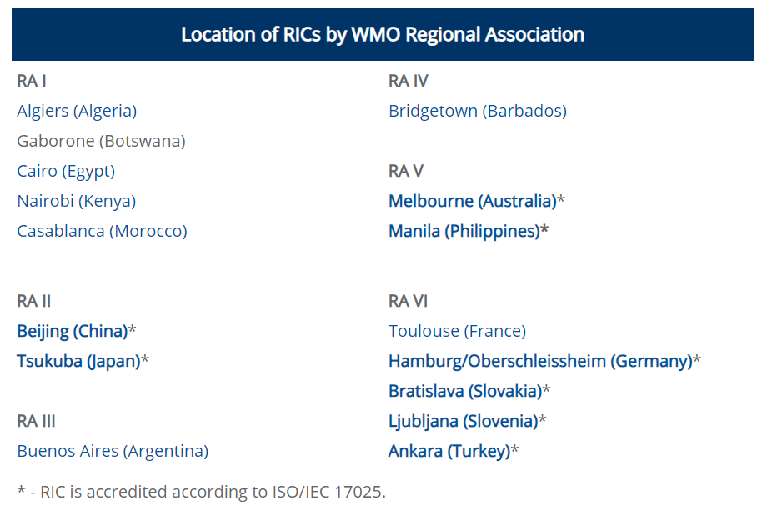
WMO - Regional Instrument Centres
Regional Instrument Centres shall have the following capabilities to carry out their corresponding functions:
Capabilities:
An RIC shall have the necessary facilities and laboratory equipment to perform the functions necessary for the calibration of meteorological and related environmental instruments;
An RIC shall maintain a set of meteorological standard instruments and establish the traceability of its own measurement standards and measuring instruments to the International System of Units (SI);
An RIC shall have competent managerial and technical staff to fulfil its functions;
An RIC shall have technical procedures for calibration of meteorological and related environmental instruments using calibration equipment employed by the RIC;
An RIC shall have and maintain a quality management system, preferably according to the ISO/IEC 17025 standard;
An RIC shall participate in, and/or organize inter-laboratory comparisons of standard calibration instruments and methods;
An RIC shall, as appropriate, utilize the available resources and capabilities to the Members’ best interest;
An RIC shall, as far as possible, apply international standards applicable for calibration laboratories, such as ISO/IEC 17025 standard¹;
An RIC shall ensure it is assessed by a recognized authority or by a WMO evaluation team, at least every four years, to verify its capabilities and performance.
Corresponding Functions:
An RIC shall assist Members of the Region, and possibly of other Regions, in calibrating their national meteorological standards and related environmental monitoring instruments;
An RIC shall participate in, and/or organize, inter-laboratory comparisons, and support instrument intercomparisons following relevant WMO recommendations;
According to relevant recommendations on the WMO Quality Management Framework, an RIC shall make a positive contribution to Members regarding the quality of measurements;
An RIC shall advise Members on enquiries regarding instrument performance, maintenance and the availability of relevant guidance materials;
An RIC shall actively participate, or assist, in the organization of workshops on calibration and maintenance of meteorological and related environmental instruments;
An RIC shall contribute to the standardization of meteorological and related environmental measurements;
An RIC shall conduct or support the regular assessment of Members’ needs for RIC services;
An RIC shall regularly inform Members and report, on an annual basis, to the WMO Secretariat on the services offered to Members and activities carried out.

Slide 11
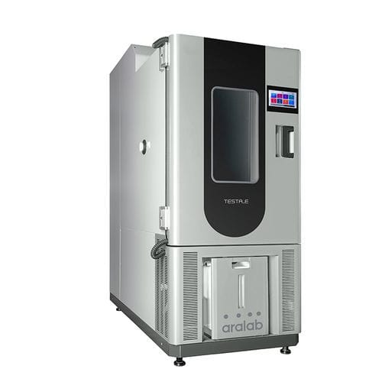
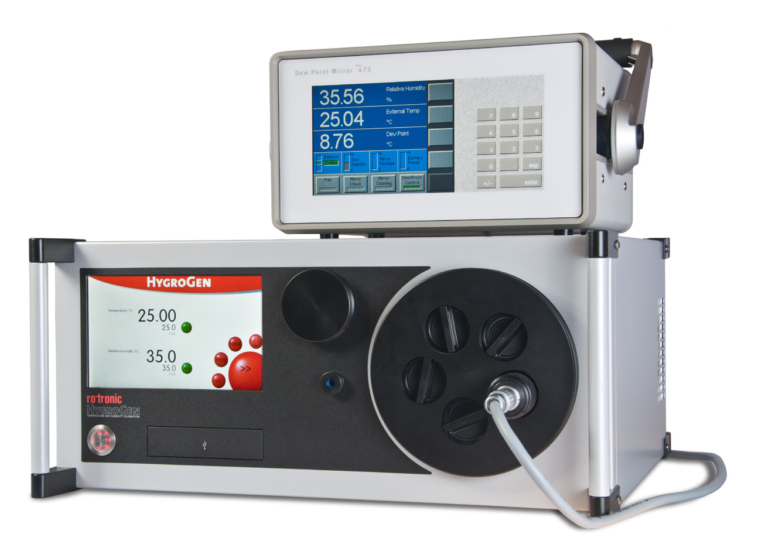
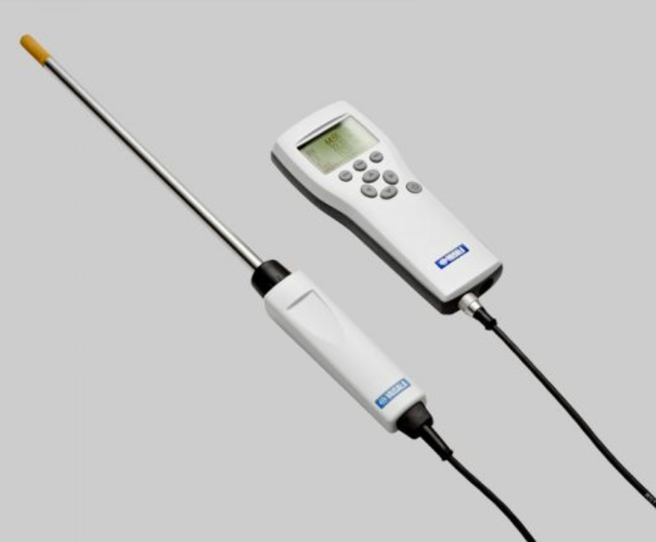
Calibration facilities
Humidity

Slide 12
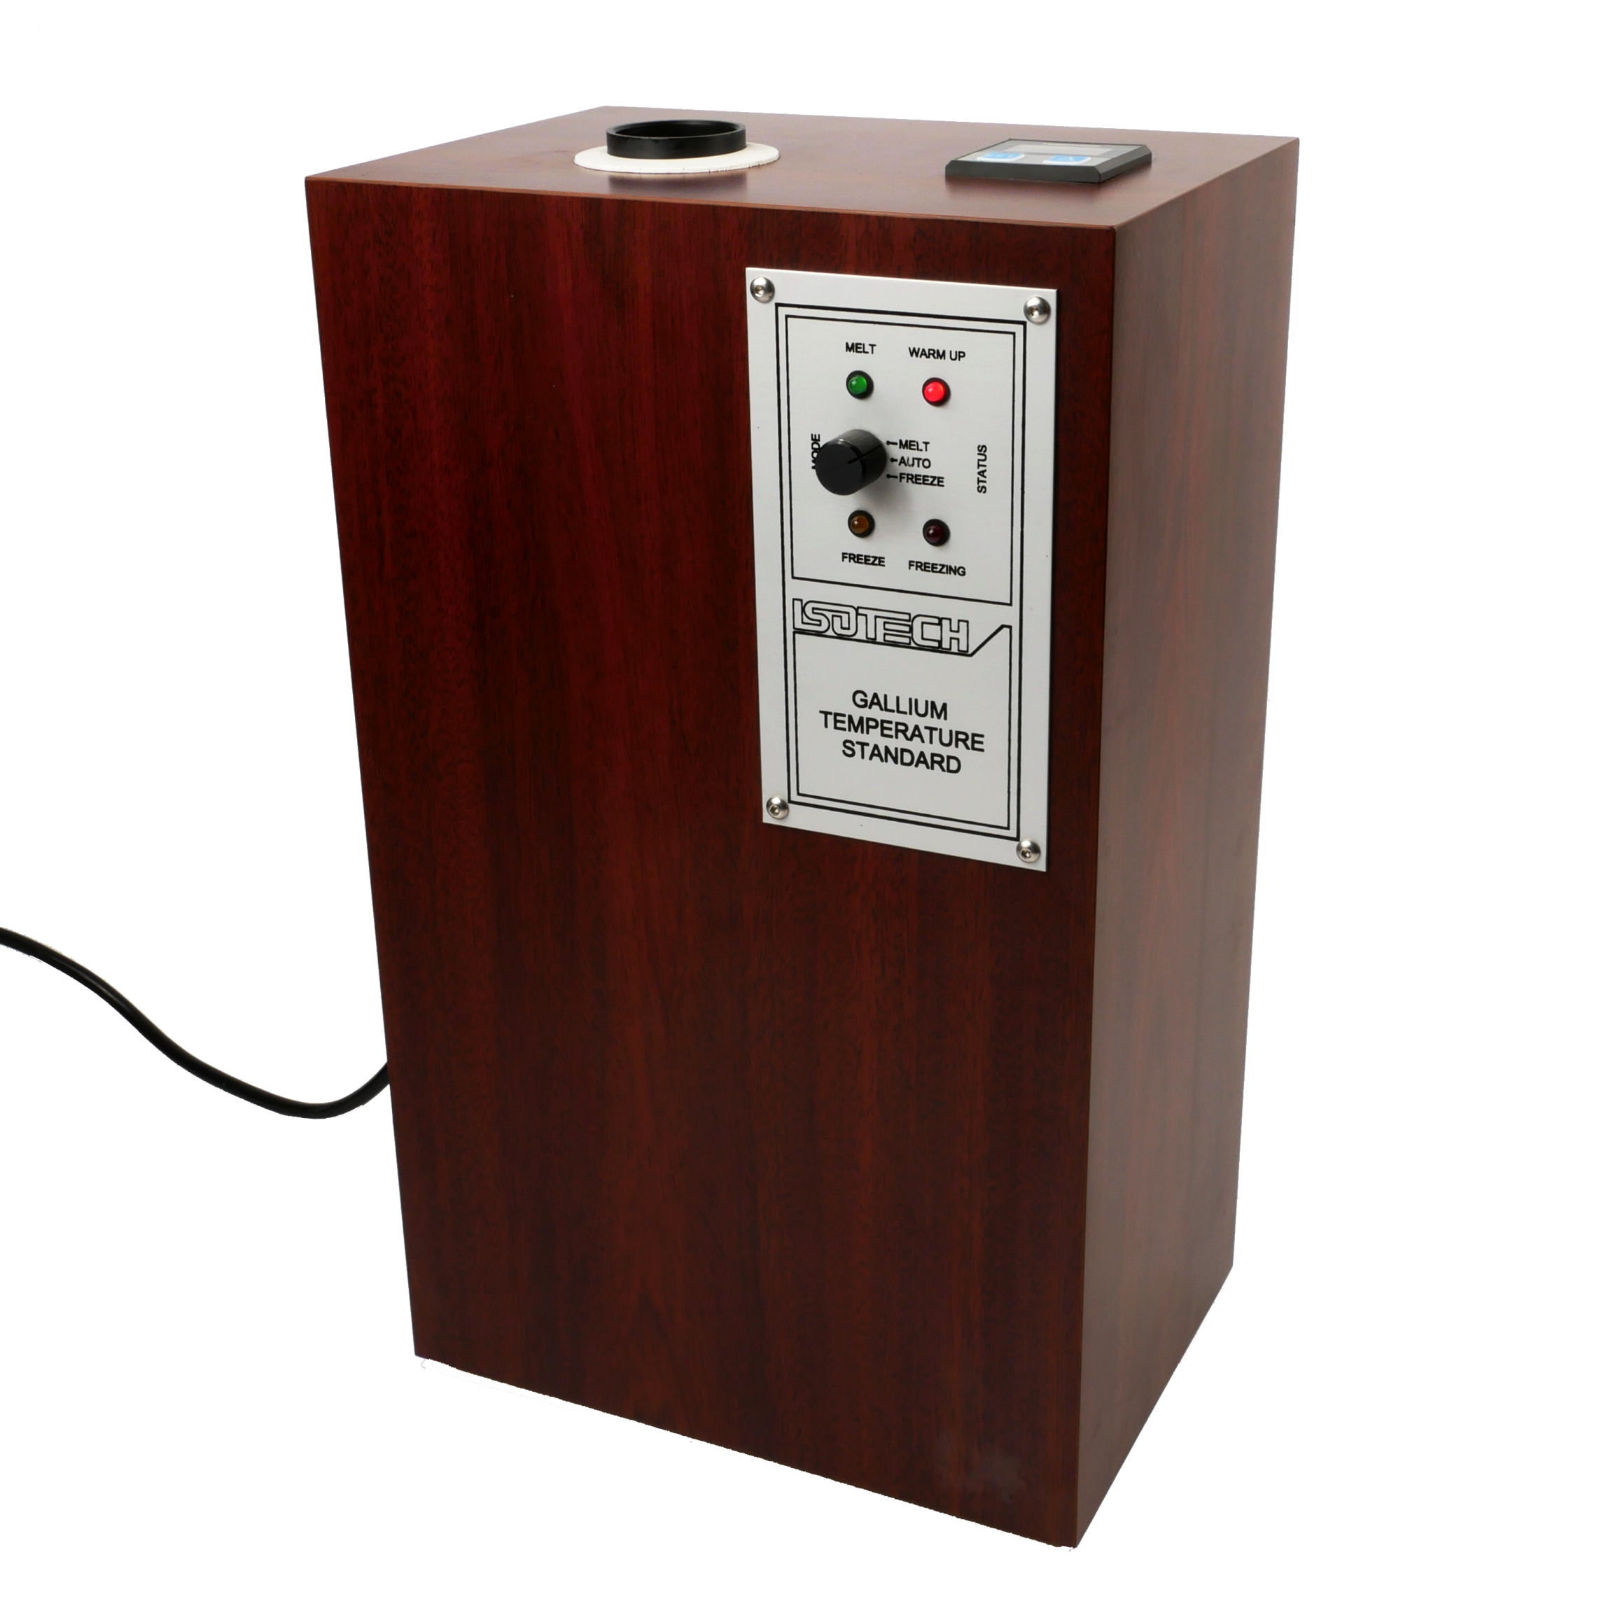
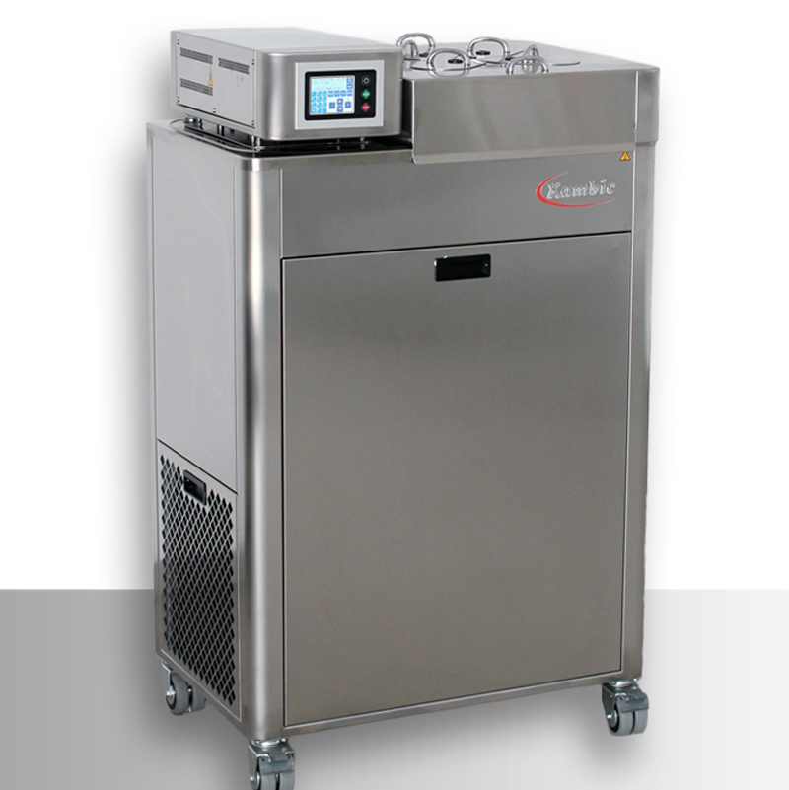
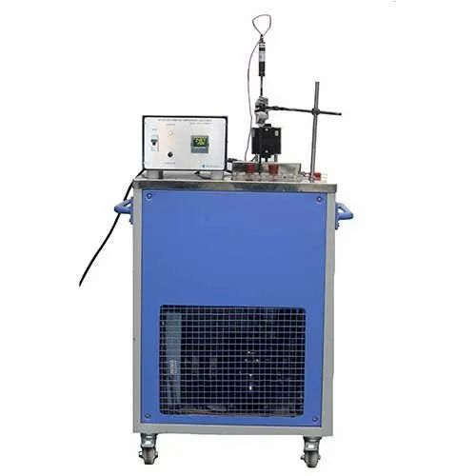
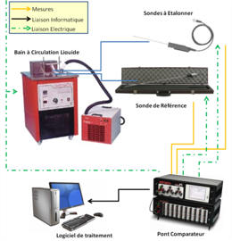
Temperature
Fixed point: melting point of Gallium
Fixed point: triple point of water
Liquid bath for P probes
Climatic Chamber
Complete calibration solution

Slide 13
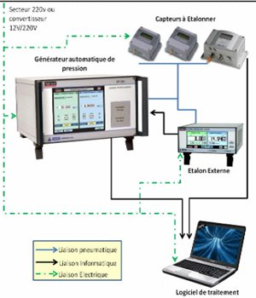
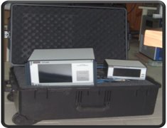
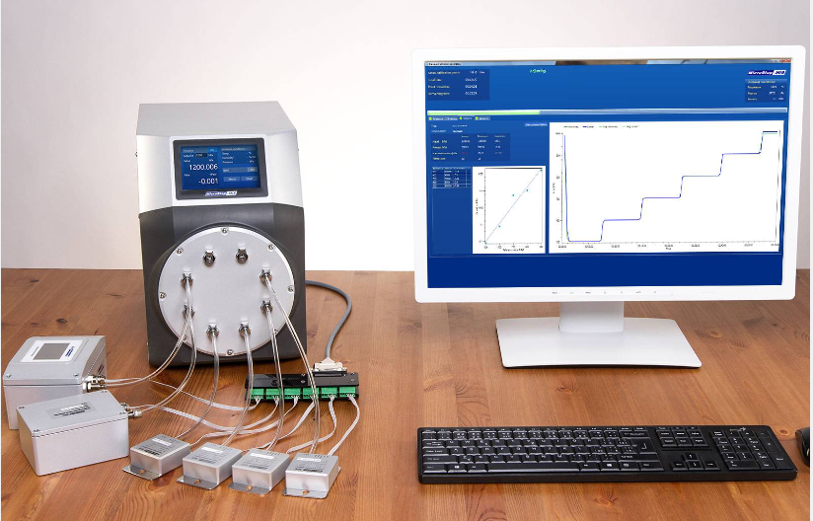
Calibration facilities
Atmospheric Pressure
Atmospheric Pressure

Slide 14
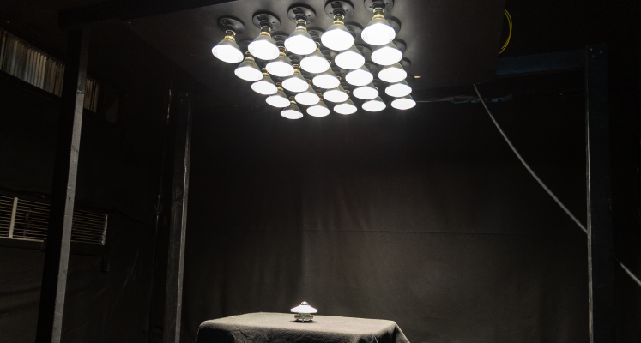
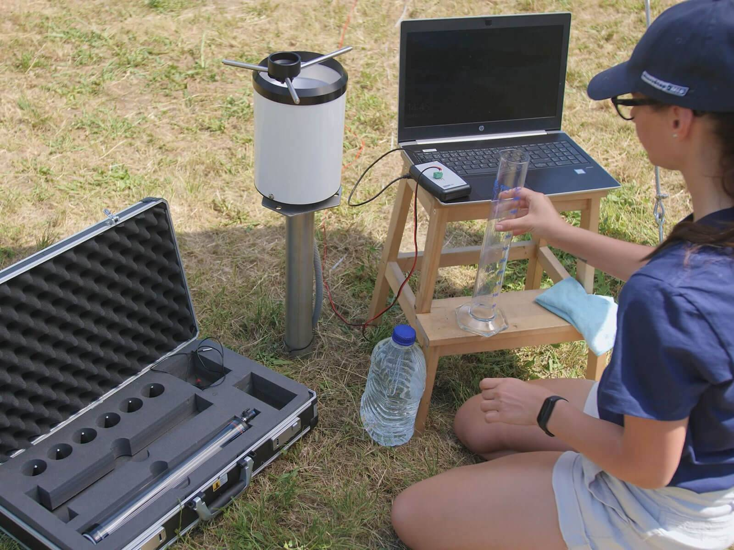
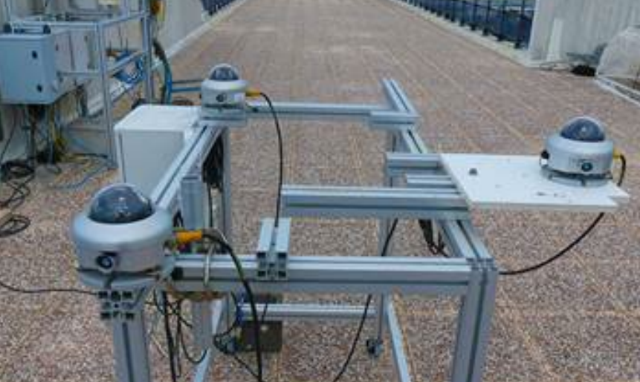
Precipitation and Solar Radiation

Slide 15
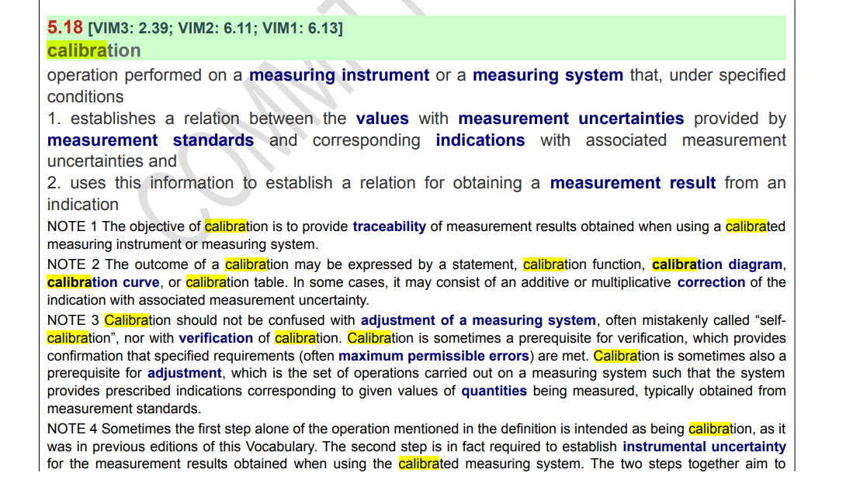

Slide 16
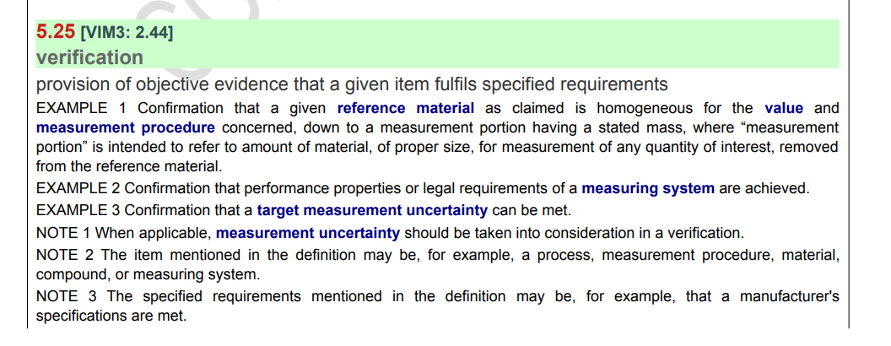
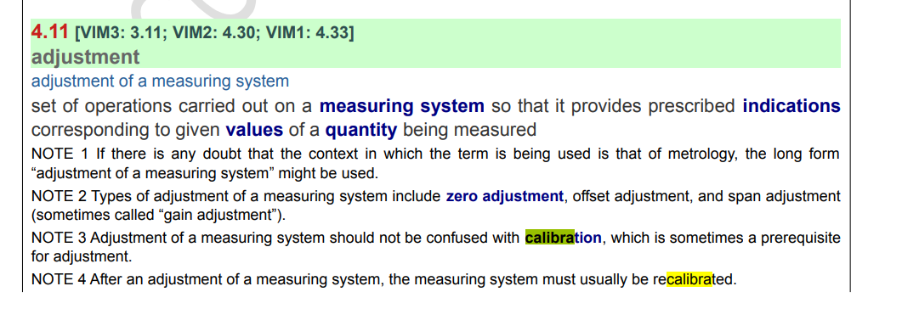

Slide 18
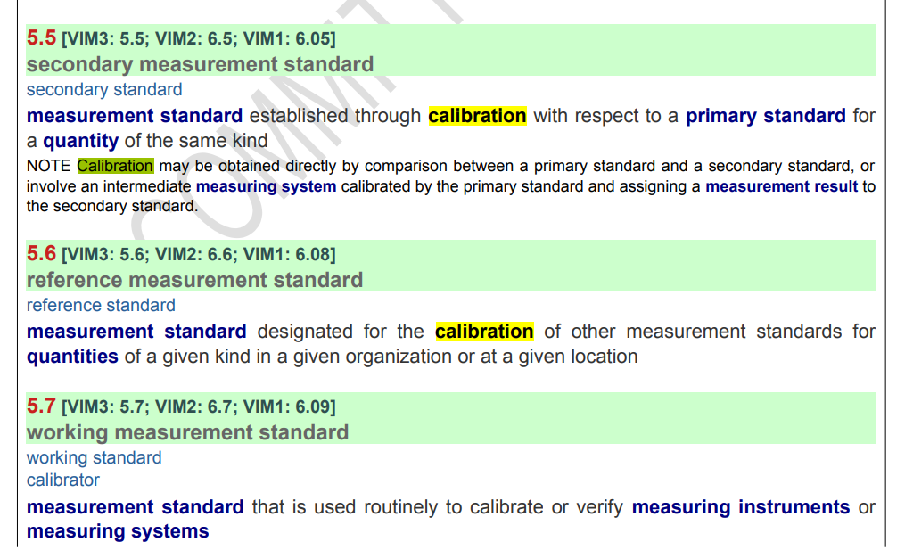

Slide 19
