Slide 1
Closing the Basic Weather and Climate Data Gaps in South Asia: Advancing SOFF implementation and creating synergies Session 3: Creating regional synergies and tapping opportunities
24 – 26 September 2024

Slide 2
Regional implementation opportunities
Regional network- GBON & RBON
Data sharing infrastructure – WIS 2.0
Data quality, monitoring and incident management – Regional WIGOS Centers (RWCs)
Calibration-Regional Instrument Centers (RICs)
GBON related capacity development
Notes:
Number countries in RA II

Slide 3
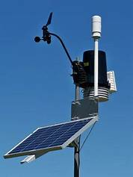
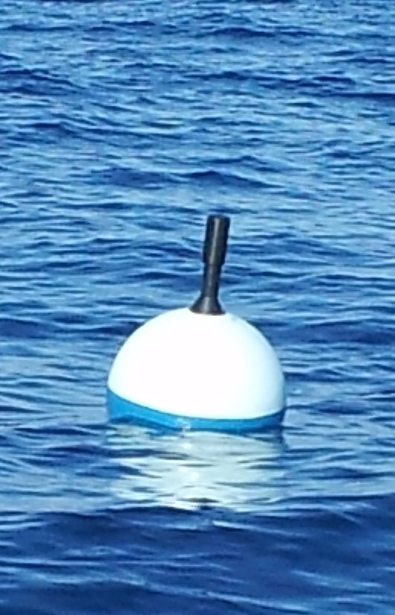
GLOBAL BASIC OBSERVING NETWORK (GBON)
A global public good for improved weather prediction and climate reanalysis
Members in 2021 accepted obligation to take and share GBON observations at minimum horizontal and time resolution
Surface land at 200 km, hourly
Upper air over land at 500 km, 2x daily
Surface marine in EEZ at 500 km, hourly
WMO co-created the Systematic Observations Financing Facility (SOFF) to help Members meet that GBON obligation, with priority on support to LDCs and SIDS
GBON Implementation Web pages

Slide 4
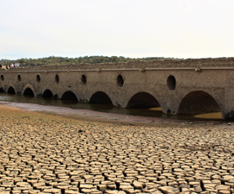
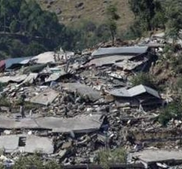
REGIONAL BASIC OBSERVING NETWORK (RBON)
Defined by the relevant WMO Regional Association
Purpose- to identify key challenges based on the region requirements
Network of surface‑based meteorological, hydrological and environmental observing stations/platforms to address the key regional weather, water, climate and other environmental challenges
GBON is part of RBON
RBON Implementation Web page

Slide 5
Observations have no value unless shared
WIS2 Architecture
Global Services
Discovers data from
Each WMO Member shall implement at least one WIS2 node to share data in WIS2
A WIS2 node replaces the GTS Message Switching System
Data and discovery metadata are shared through a WIS2 node
A WIS2 Node shares data via an HTTPS service and sends notifications to MQTT subscribers
A WIS2 node shares data only with Global Services
Subscribes to
Receives notifications of new data from
Downloads data from
data
Receives notifications of new data
Subscribes to
WIS2 node
Notes:
The users of WIS 2.0 will be able to access data in
real-time by subscribing to a Global Broker and
receiving notifications when new data are available for download from a Global Cache or from the data provider. The Global Discovery Catalogue will allow users to discover the available datasets on WIS 2.0 and provide information on how and where to access the data.

Slide 6
WIS2 node implementation
Infrastructure
Software
Operation
On-premise
Public cloud (AWS, Azure, Google,...)
Open source (wis2box)
Commercial (IBL …)
Custom
NMHS
Regional, sub-regional
Private company
(Synoptic …)
Private cloud (EWC/GISC-Casablanca)
Support
Level 0 = No support
Level 1 = Generic answers
Level 2 = Bespoke suggestions
Level 3 = Technical intervention
From 2025 onward (start of the operational phase):
For day-to-day support, the GISCs will support the WIS Centres in their area of responsibility.
WMO Global Information system centers (GISCs) in RA II: China, India, Iran, Japan, Republic of Korea
WIS 2.0 Training Workshops for 2024
Brazil (Spanish, 16-20 September)
Fiji (English, 7-11 October)
Marocco (French) 11-15 November
WIS 2.0 Training Workshops for 2025 (TBC)
China
Italy
Oman
Ethiopia

Slide 7
WIS2 IMPLEMENTATION TIMELINE APPROVED BY EC-76
2023
2024
2025
2022
Pilot Phase
Pre-operational
Operational
2030
2033
Pilot Global Brokers
Pre-oper Global Brokers
Global Brokers operation
Pilot Global Discovery Catalogue
90% of Members migrated to WIS 2.0
Stop transition infrastructure and GTS transmission
Pilot Global Caches
Pre-oper Global Caches
Global Caches operation
Technical Regulations
NCs
DCPCs
Pre-oper Global Discovery Catalogue
Global Discovery Catalogue operation
WIS 2.0
Guidelines
Q1
Q2
Q3
Q1
Q2
Q3
Q1
Q2
Q3
WIS2 box release 1.0
Transition Infrastructure
WIS2 Monitoring
NCs & DCPCs
NCs & DCPCs
Workshops and training
INFCOM-2
EC 75
Cg-19
EC 76
WIS 2.0 Tech- Reg approved
Guidelines for WIS 2.0
implementation published
INFCOM-3
EC 77
technical guidance in the Guide to WIS
Report on WIS2 progress
NCs/DCPCs may stop WIS1 functions if migrated to WIS2
GISCs contributing to Global Services may stop WIS1
WIS Newsletter (Issue: 2024-No.1) WIS2.0 Implementation and Workshops
WIS support: wis@wmo.int and wis2-support@wmo.int

Slide 8
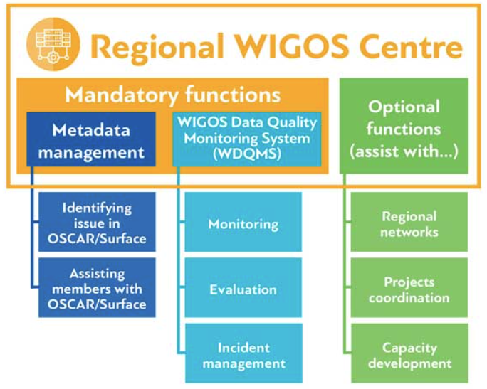
DATA QUALITY AND PERFORMANCE MONITORING/INCIDENT MANAGEMENT
Regional WIGOS Centres for RA II – Beijing and Tokyo
These centres have a function in monitoring, evaluation, and incident management that is highly relevant for the SOFF compliance phase

Slide 9
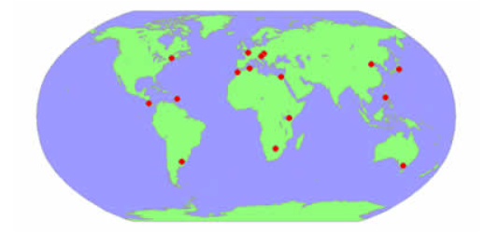
CALIBRATION
WMO Regional Instrument Centres (RIC) are established to maintain relevant calibration standards and support Members in the region
RA I: Beijing (China) and Tsukuba (Japan) are WMO-recognized RICs
WMO workshop/meeting announcements on calibration

Slide 10
CALIBRATION
KNOWLEDGE SHARING PORTAL ON INSTRUMENTS AND METHODS OF OBSERVATIONS
1. Siting and Exposure
2. Guidance and Training Material
3. Quality Assurance and Quality Control
4. Instrument Tests, Evaluations and Comparisons
5. Methods of observation and Applications
6. Safety Procedures
7. Selected Conference Proceedings
8. Other relevant WMO publications
9. Other Relevant Links

Slide 11
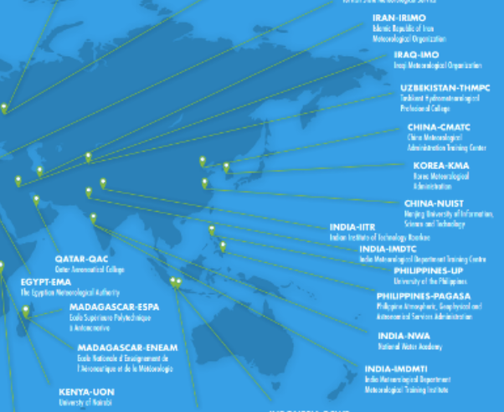
CAPACITY DEVELOPMENT
1. WMO Regional Training Centers (RA II)
2. WMO Fellowship Programme
- Offers fellowships to support qualified and
suitable
candidates from WMO Members in topics of
meteorology, hydrology and climatology
- Level of study: BSc, MSc, PhD, Certificate,
Diploma
3. WMO E-Learning Resources
- Calendars and Resources | World Meteorological Organization (wmo.int)
- WMOLearn Resources: WMOLearn Events Calendar
4. WIGOS Learning portal including GBON
Notes:
Region II Capacity building institutes:
China
- Nanjing University of Information, Science and Technology (NUIST) Nanjing - RTC China
- China Meteorological Administration Training Center (CMATC) Beijing - RTC China
2. India
National Water Academy (NWA) - RTC India
Meteorological Training Institute (IMD) Pune - RTC India
India Meteorological Department Training Centre (IMD) New Delhi - RTC India
Indian Institute of Technology Roorkee (IITR) Roorkee - RTC India
3. Iran
Islamic Republic of Iran Meteorological Organization (IRIMO) Tehran - RTC Iran
Iraqi Meteorological Organization (IMO) Baghdad - RTC Iraq
4. Republic of Korea
Korea Meteorological Administration (KMA) - RTC Korea
5. Qatar
Qatar Aeronautical Academy (QAA) Doha -RTC Qatar
6. Uzbekistan
- Tashkent Hydrometeorological Profecional College (THMPC) Tashkent - RTC Uzbekistan

Slide 12
Discussion: How to reflect regional approach into investment phase funding requests
What opportunities and synergies can be addressed regionally? (data sharing, trainings, O&M, calibration)
What could be the role of regional partners?

Slide 13
Thank you!

Slide 14
Outcome 1
Key regional challenges
Application areas, high priority variables and requirements, defined from impact studies.
Monitoring stations against RBON requirements.
Stations registered in OSCAR/Surface and assigned to RBON
Gap analysis
Road map for improving Regional observing capabilities
Observing capabilities: Surface-based and Space-based.
Outcome 2
Outcome 3
Notes:
RBON Design process (4-year cycle)
In consultation with representatives from the user communities and observations providers for the region, discuss the selected short-list of key challenges in more details…
Prioritize key regional weather, climate, water and other environmental challenges to be addressed for different application areas
Small number of challenges proposed
List Application Areas under each challenge
Consider impact studies
Identify top-level high priority variables to be observed, and what are the most important criteria e.g., horizontal spacing, accuracy, all of them, etc.
Start with Horizontal Resolution, observing cycle, and timeliness, and identify most stringent requirements by variable
Other criteria discussed after first selection of stations (some stations may need to be upgraded)
Assess Members capabilities (observing networks – NMHSs & partners – data exchange mechanisms)
Do gap analysis: Identify missing elements e.g., from impact studies to support selection of top-level high priority variables, or lack of observing stations, or lack of established data exchange mechanisms, and prioritize the gaps for each top priority variable.
(see also INFCOM-3/Doc 8.1(2) – Annex, Chapter 12)

Slide 15
key challenges in region II apr. by RAII-MG in Nov 2022
(heavy rainfall (thunderstorms/lightning) pluvial,
flash floods,
Landslide
drought,
tropical cyclones/typhoons,
heat/cold waves),
sand and dust (suspension, deposition and sedimentation)

Slide 16
What is WIS2-in-a-box ?
WIS2-in-a-box (wis2box) is reference implementation of a WIS2 Node
Free Open-Source Software (FOSS) developed as a docker-compose stack using pre-existing https://github.com/wmo-im/wis2box
Designed to be cost-effective and low-barrier to operate
Tools to facilitate international data sharing:
data-conversion: csv2bufr, synop2bufr, bufr2bufr
web-interfaces to configure datasets, data-mappings and station metadata
web-interface for manual data input (FM-12/csv)
data visualization and monitoring to detect issues
OGC-API to share data in GeoJSON format
wis2box host requirements:
minimum 2 vCPUs with 4GB Memory and 24GB of local storage
requires Python, Docker and Docker Compose pre-installed
HTTP and MQTT ports routed to a publicly accessible address
https://docs.wis2box.wis.wmo.int
WMO Support

Slide 17
REGIONAL BASIC OBSERVING NETWORK (RBON)
network of surface‑based meteorological, hydrological and related observing stations/platforms to address the key regional weather, water, climate and other environmental challenges.
leads to improved services by delivering more and enhanced observations to stakeholders.
enables the full benefit of regional and national observing capabilities to be realized.
consider EW4All observational user requirements and gaps through RBON.
is defined and adopted by the relevant WMO Regional Association, or the Executive Council or the World Meteorological Congress for the Antarctic.

Slide 18
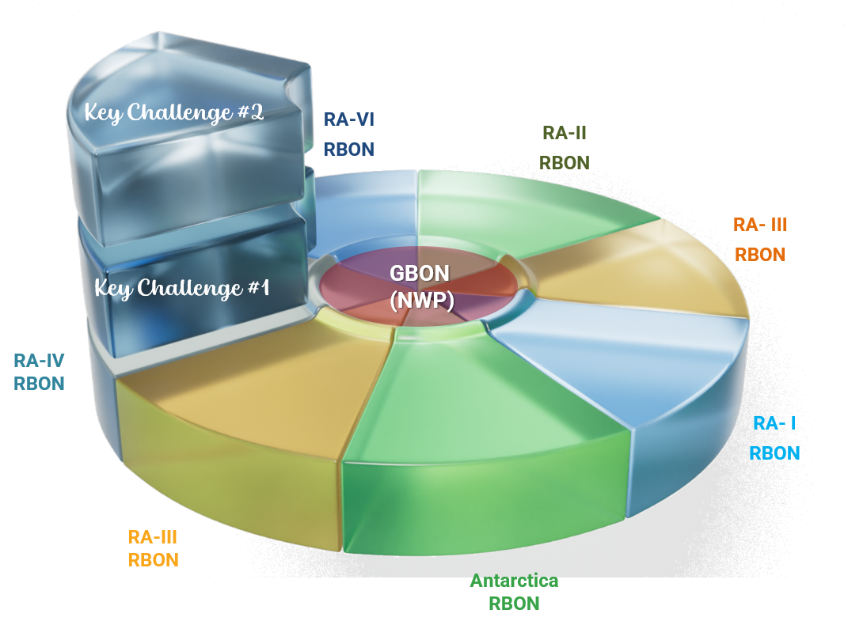
RBON - updated design process and global plan
GBON
Purpose
- global requirements,
- global NWP
- climate reanalysis
Stations (shall)
- surface land meteorological (SLP, T, H, W, P, SD)
- upper-air land meteorological (T, H, W)
- surface marine in EEZ (SLP, SST)
- upper-air marine in EEZ (T, H, W)
Stations (should)
- aircraft-based (T, H, W)
- remote sensing profilers (T, H, W)
In charge: INFCOM
RBON
Purpose
- regional requirements,
- key challenges in region II apr. by RAII-MG in Nov 2022 (heavy rainfall (thunderstorms/lightning) pluvial, flash floods, landslide drought, tropical cyclones/typhoons, heat/cold waves), sand and dust (suspension, deposition and sedimentation)
Stations (shall)
- all surface-based observing stations as per requirements defined by Region
Stations (should)
- weather radars
In charge: RA
Note: GBON is part of RBON
GBON vs RBON
GBON

Slide 19
Gbon and rbon
Governance – ra 2
purpose
Scope – variables
Implementation – mandatory since XX

