Slide 1
ECMWF products: access and training
SOFF Regional Workshop in South Asia
Florian Pappenberger

Slide 2
ECMWF Open Data
ECMWF Open Charts: All static charts are open and free: https://apps.ecmwf.int/webapps/opencharts
ECMWF Open Data: Subset of NWP data at 0.25 degrees, 3-hourly time, four times per day https://www.ecmwf.int/en/forecasts/datasets/open-data
WMO Essential: https://www.ecmwf.int/en/forecasts/datasets/wmo-essential

Slide 3
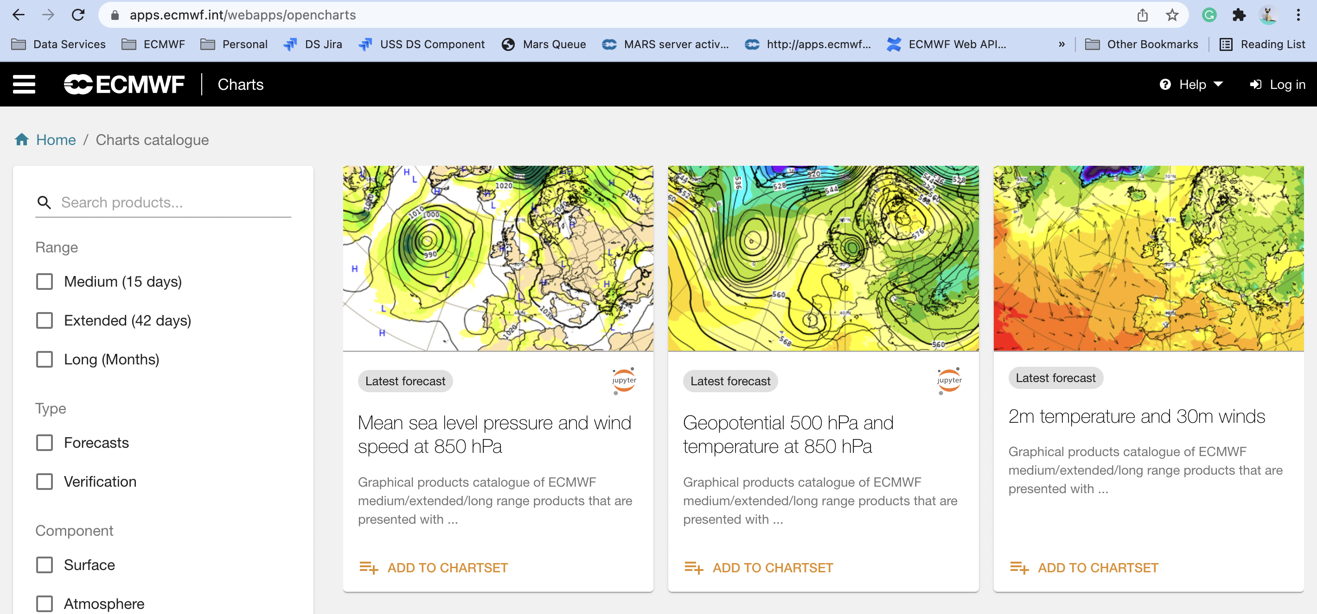
OpenCharts Catalogue: charts.ecmwf.int

Slide 4
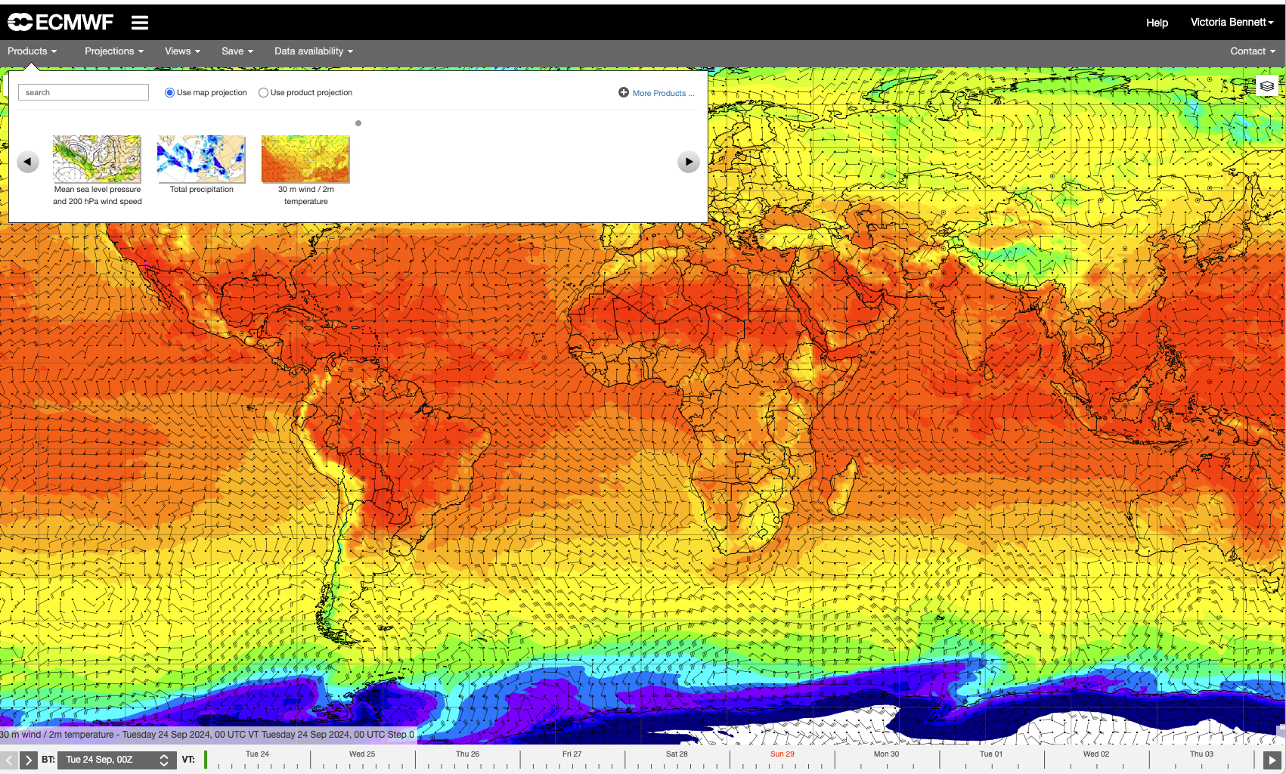
ecCharts : free access for WMO NMHS

Slide 5
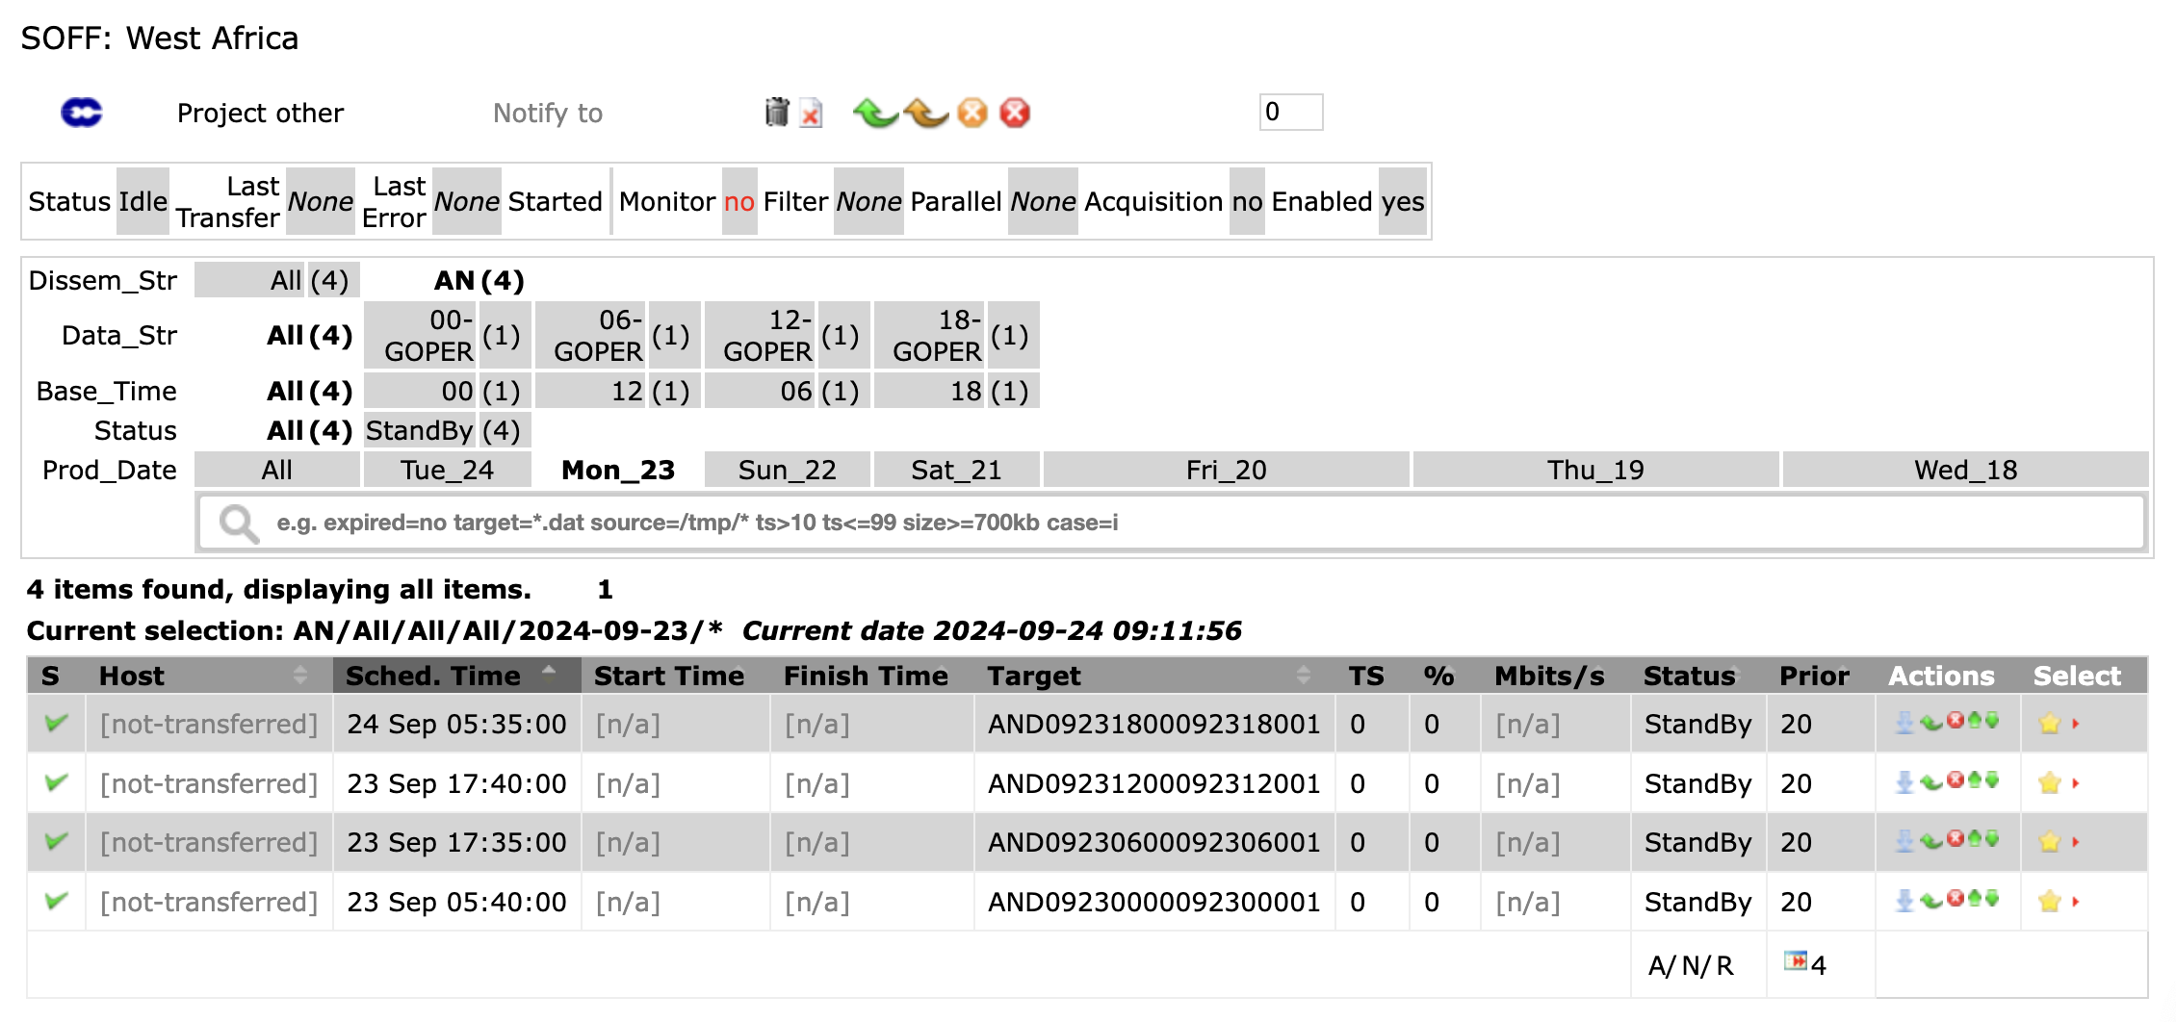
ECMWF Forecast Products for SOFF countries
SOFF pilot data distribution
37 countries
Data routinely pushed to dedicated folders on ECMWF FTP pull server
Contacting countries and gathering feedback
Extend to all WMO NMHSs by 2027:
ECMWF developing a tailored service package
Consistent set of variables for different regions
“Self-service” with documentation and training materials
Notes:
(for every country we created an account/password that the user can use to access the data via FTP. Note: the user downloads the files from the server)

Slide 6
Which data?
Parameters from Set-I Atmospheric Model high resolution 10-day forecast
Analysis (slt)
Forecast model levels (t/u/v/w/q/clwc/ciwc/crwc/cswc/lnsp)
Forecast pressure levels (z/t/u/v/r)
Forecast surface levels (10u/10v/2t/2d/lsm/sp/msl/skt/src/ci/sst/rsn/sd/asn/tsn/stl1/stl2/stl3/stl4/swvl1/swvl2/swvl3/swvl4/z)
Resolution: 0.1 deg
Steps: 0 to 90 by 3

Slide 7
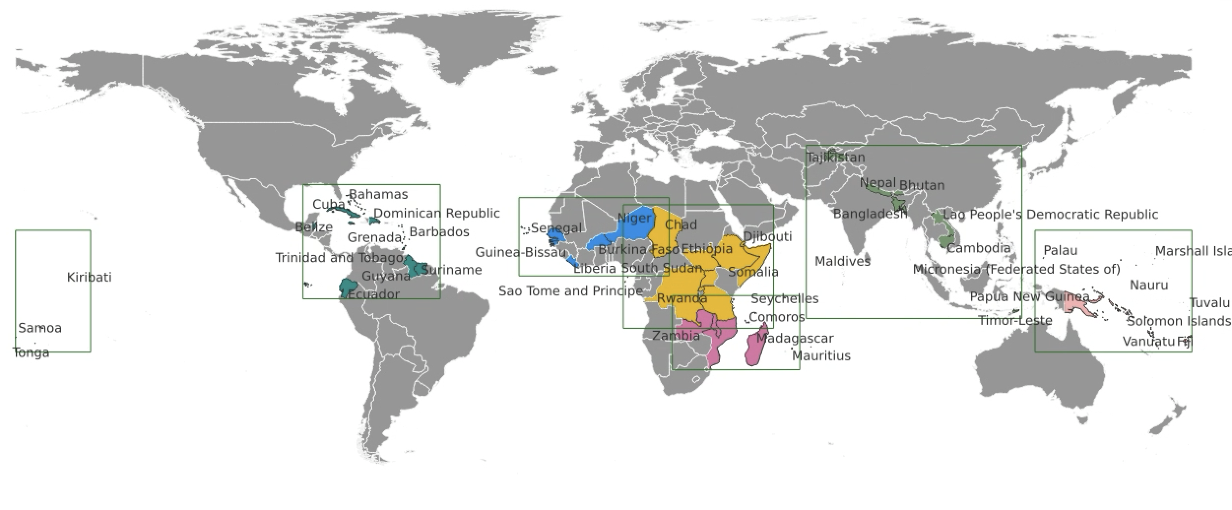
Countries
Data is split into 6 regions
West Africa (4 countries)
Central and Easter Africa (6 countries)
Southern Africa (7 countries)
Asia (6 countries)
Pacific (9 countries)
Latin America and the Caribbean (5 countries)
Notes:
All users except 6 have been contacted so far (those 6 users are not part of the ECMWF WMO mailing list, so Fabio is searching some contacts).
Countries are part of the 1st and 2nd batch from the SOFF groups, and Barbados which is part of the 3rd batch

Slide 8
SOFF – proposed Train-the-trainer programme
Training Scope: Enable forecasters in SOFF beneficiary countries to use ECMWF NWP outputs with potential deeper dives on the EW4All 5 major hazards identified by Congress (floods, heat waves, droughts, tropical cyclones, fire, etc).
ECMWF’s role: Develop the training material; deliver the training to the Peer Advisors; on-demand backstopping and support to Peers Advisors; quality assurance incl. “certification” of trainers.
Training from ECMWF -> Peer Advisors -> Beneficiary Countries. Peer Advisors best placed to provide training to best suit the needs of that country. 5-year programme proposed with five objectives:
Organise and run an in-person workshop to co-design training
Understand training needs of SOFF beneficiary countries
Understand challenges to access forecasting data and understanding it
Organise and run Train-the-Trainer course/s for Peer Advisors
Provide training knowledge and resources on ECMWF products and services to Peer Advisors
Facilitate a ‘Train-the-Trainer’ network
Facilitate a network for the Peer Advisors for discussion between themselves and ECMWF on training in SOFF beneficiary countries
Develop e-learning resources to support Peer Advisors and SOFF beneficiary countries
Develop e-learning resources to support Peer Advisors in SOFF beneficiary countries.
Evaluate, review and revise Train-the-Trainer course and training material
Evaluate and review of impact of the Train-the-Trainer course to SOFF beneficiary with Peer Advisors.
Revise training resources in line with evaluations

