Slide 1
Closing the Basic Weather and Climate Data Gaps in South Asia: Advancing SOFF implementation and creating synergies Session 5: Creating leverage with other partners- technical assistance and investments
24 – 26 September 2024

Slide 2
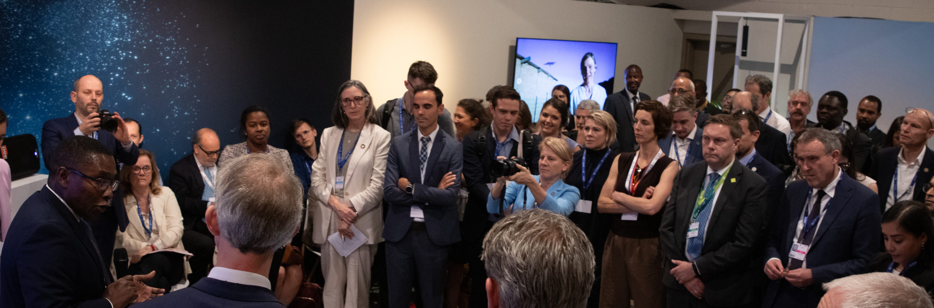
Framework for collaboration for enhancing systematic observations
Framework developed by the Secretariats of SOFF, AF, CIF, CREWS, GCF, GEF
Adopted by 6th Steering Committee
Signed at COP28 by representatives of the six funds

Slide 3
Framework for collaboration for enhancing systematic observations
Aims to enhance complementarity, collaboration, and joint action across the Secretariats of the SOFF, AF, CIF, CREWS, GEF, and GCF for enhancing systematic observations and improving the use of basic weather and climate data for effective climate action.
Each SOFF Investment funding request aims at building on, leveraging and sustaining investments from the other funds as well as from SOFF Implementing Entities
In addition to the 5 major climate funds, SOFF through the operational partners identifies other investments and initiatives in the region that will complement and leverage SOFF investments – South Asia opportunities?

Slide 4
Leverage created within the Collaboration Framework
Investment leverage ratio with the five funds 1:4.5
Largest financial leverage with CIF (124.1m USD) and GCF (120.5m USD)
Largest leverage in terms of operations with CREWS (16 out of 18 countries under Investment Phase)

Slide 5
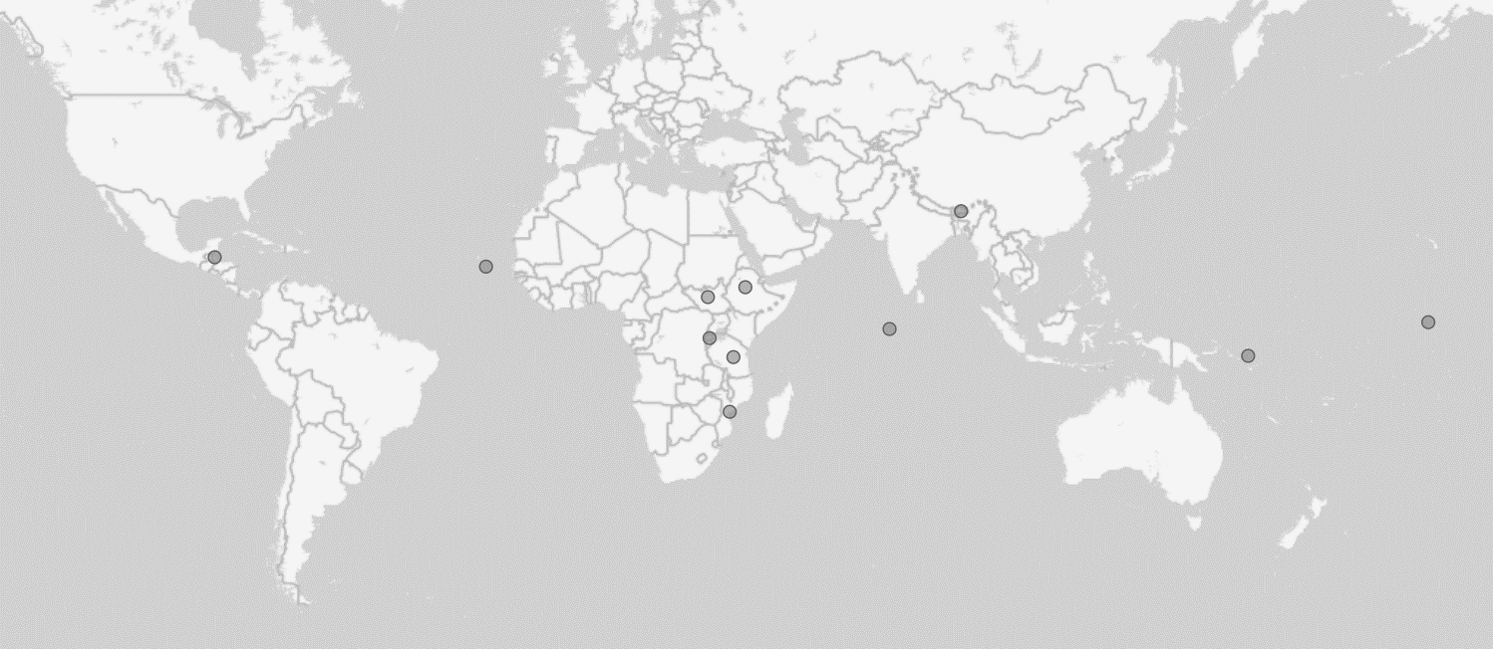
SOFF Investments in South Asia & other climate funds
Bhutan
AF | CIF | CREWS | GCF | GEF
Maldives
AF | CIF | CREWS | GCF | GEF

Slide 6
SOFF leverage beyond the Collaboration Framework with multilateral climate funds
SOFF leverage through Implementing Entities’ climate investments
SOFF leverage as a delivery vehicle of the EW4All underpinning investments in latter parts of the value chain

