Slide 1

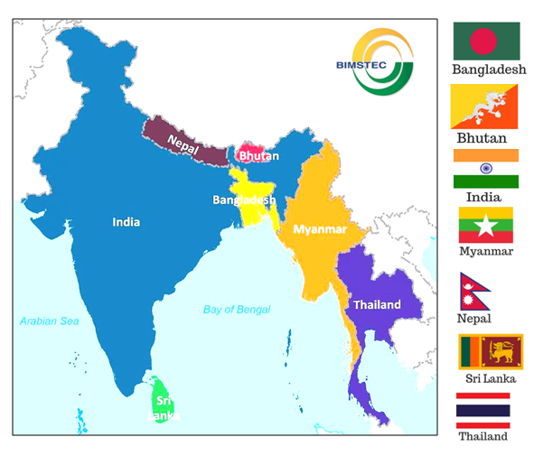
BIMSTEC Centre for Weather and Climate (BCWC): Activities and Plans
Dr. V.S. Prasad
Head / Director
National Centre for Medium Range Weather Forecasting (NCMRWF)
Ministry of Earth Sciences (MoES), Govt. of India

Slide 2
Objectives of BCWC
Establishment of BIMSTEC centre for Weather and Climate (BCWC) at NCMRWF, Noida.
Preparation and dissemination of weather and climate products for societal applications to BIMSTEC member countries; Develop Customized Models
Augmentation of HPC and storage systems at BCWC/NCMRWF for generating the weather and climate products
Capacity building in the field of weather and climate in the BIMSTEC region through training programs, workshops and award of research fellowships for the scientists in the BIMSTEC region. (Augment Observations over BIMSTEC Region)

Slide 3
BCWC Milestones
1997 to 2013
  Ministerial Meetings and two Summits on different aspects of BIMSTEC were held.
2013
  In February 2013, the Cabinet of the Government of India approved the signing of the MoA for establishing the BIMSTEC Centre for Weather and Climate.
  In April 2013, Ministry of Earth Sciences approved a scheme for the BIMSTEC Centre for Weather and Climate to be implemented at NCMRWF, Noida.
2014
  On March 2014, the MoA was signed among the BIMSTEC member countries (by Foreign Ministers) during BIMSTEC Summit at Nay PyiTaw, Myanmar.
  On March 28 2014, the BCWC was launched at NCMRWF
  Project scientists were recruited to carry out relevant work and BIMSTEC Centre’s work initiated

Slide 4
BCWC Milestones
2018
  First Governing Board (GB) and Scientific Advisory Committee (SAC) meetings held at NCMRWF from 30-31 Jul 2018.
2022
  The Indian Prime Minister, Shri Narendra Modi promised 3 Million USD for the BIMSTEC Centre for Weather and Climate in Noida, India which will help in mitigating several natural disasters in the BIMSTEC zone.
  Second Governing Body (GB) and Scientific Advisory Committee (SAC) meetings held at NCMRWF from 1-2 Nov 2022
2023
  Host country Agreement signed.
  Third Governing Body (GB) and Scientific Advisory Committee (SAC) meeting Dec 2023
  Dr Karma Dupuchu, Director National Centre of Hydrology and Meteorology (NHCM), Bhutan , Chairman, BCWC.

Slide 5
Key Achievements
Forecast products are provided through NCMRWF website, and through ftp
Observational data received from member countries are monitored
Skill of forecast products are being evaluated routinely for the region
Weekly Weather & Climate Discussion (Map Discussion) is held online to assess the prevailing weather and climate over BIMSTEC member countries and assessment of forecasts.
BIMSTEC Training and Science Workshops are organized
Scientists from BIMSTEC countries visited for capacity building and joint work.
Research papers have been published in peer reviewed journal by the scientists working in BIMSTEC Centre for BIMSTEC region weather/Climate

Slide 6
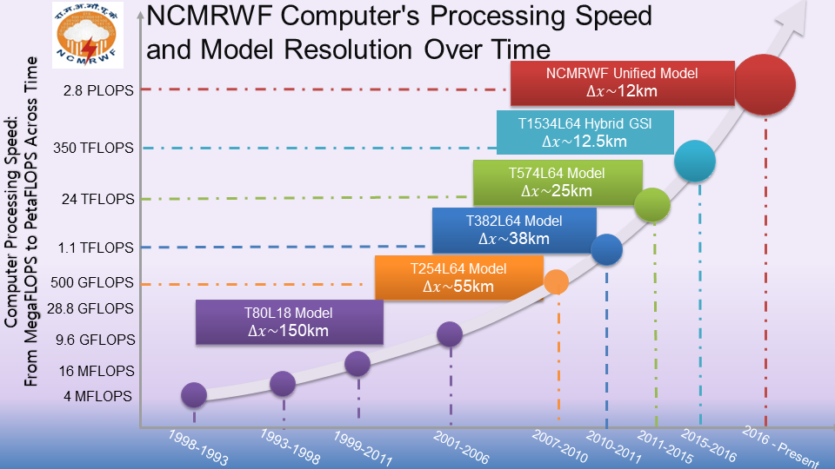
8.9 PF

Slide 7
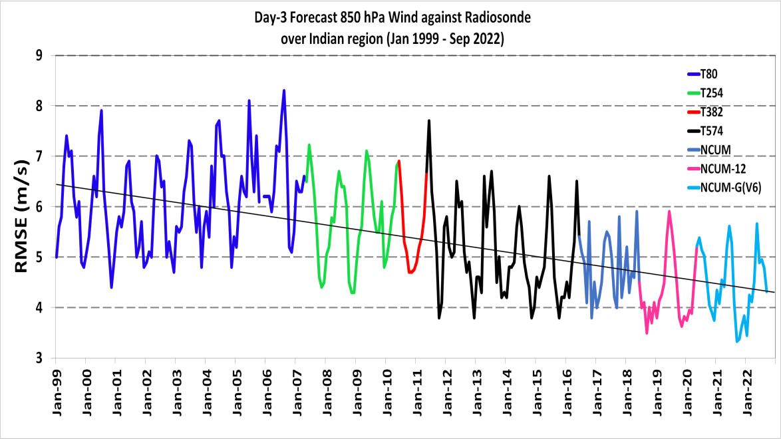
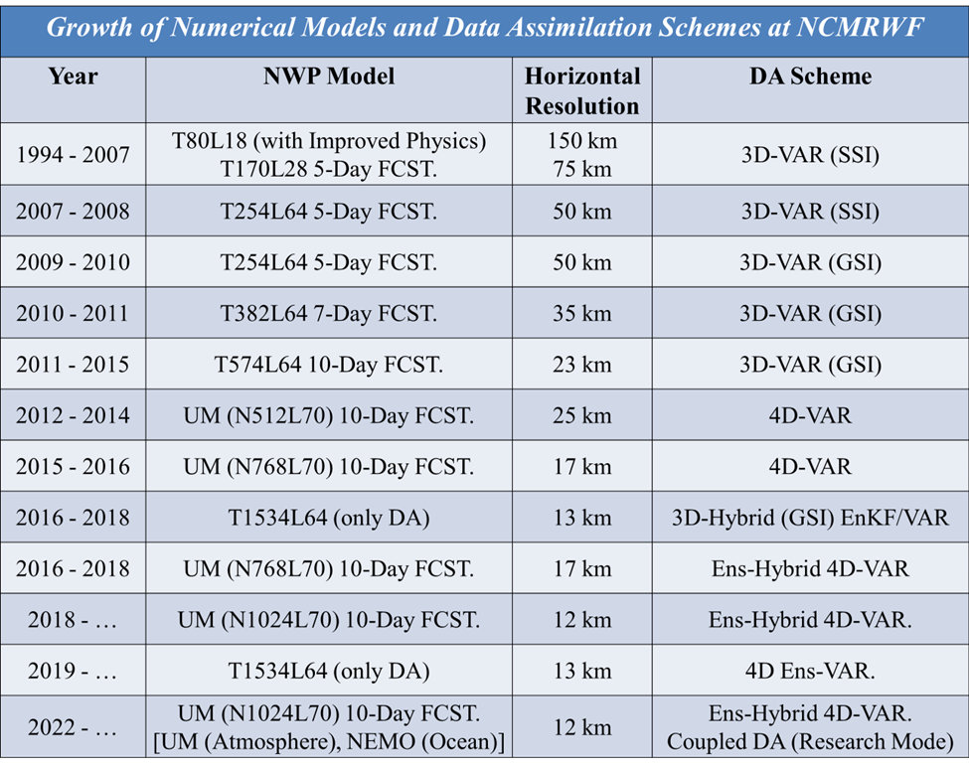
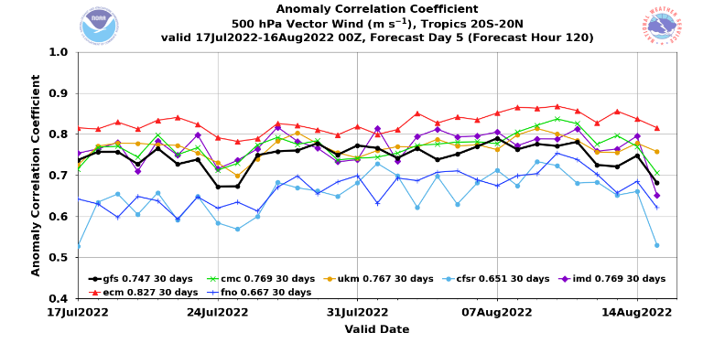

Comparison with other Global systems
The overall decrease in the RMSE can be attributed to
Improvements in the Data Assimilation and Modeling Techniques
Improvement in the amount of data being assimilated
Improvement in the computing Resources.
Improvement in the Skill of the Model over the Years (RMSE of Day-3 FCST 850 hPa wind)

Slide 8
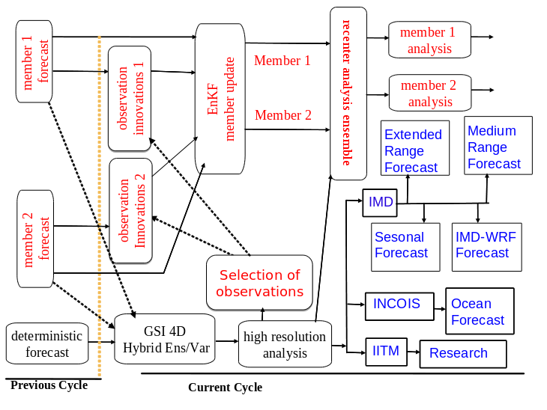
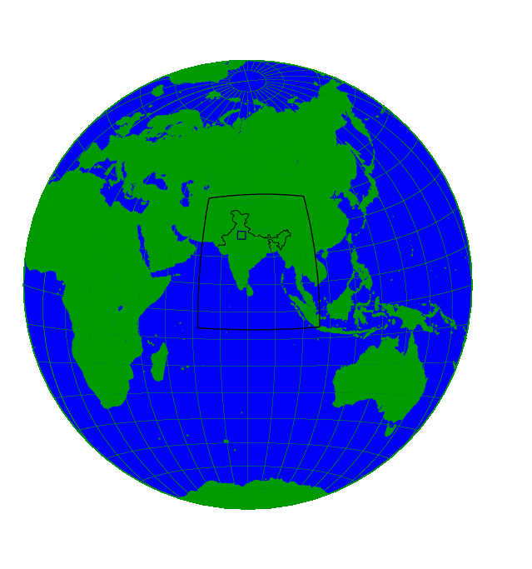
Operational NWP Suites in Ministry of Earth Sciences (MoES)
Data Assimilation for
IMD-GFS & GEFS Systems
NCUM and Data Assimilation System
330 m Delhi Fog Model
(36 hrs forecast based on 00 UTC)
1.5 km
Regional Model
(48 hours forecasts based on 00 UTC)
4 km
Regional Model
(72 hours forecasts based on 00 UTC)
12 km
Global Model
(10 Days forecasts based on 00 UTC)
GEFS Global Ensemble Prediction System
(12 km)
80 members
(10 Days forecasts
based on 00 UTC)
Global Ensemble Prediction System (NEPS) – 12 km
23 members
(10 Days forecasts based on 00 UTC
IMD-GFS Global Prediction System (12 km)
(10 Days forecasts
based on 00 UTC)
60km Global Coupled Model (NCUM+JULES+NEMO+CICE)
(One Month forecast)

Slide 9

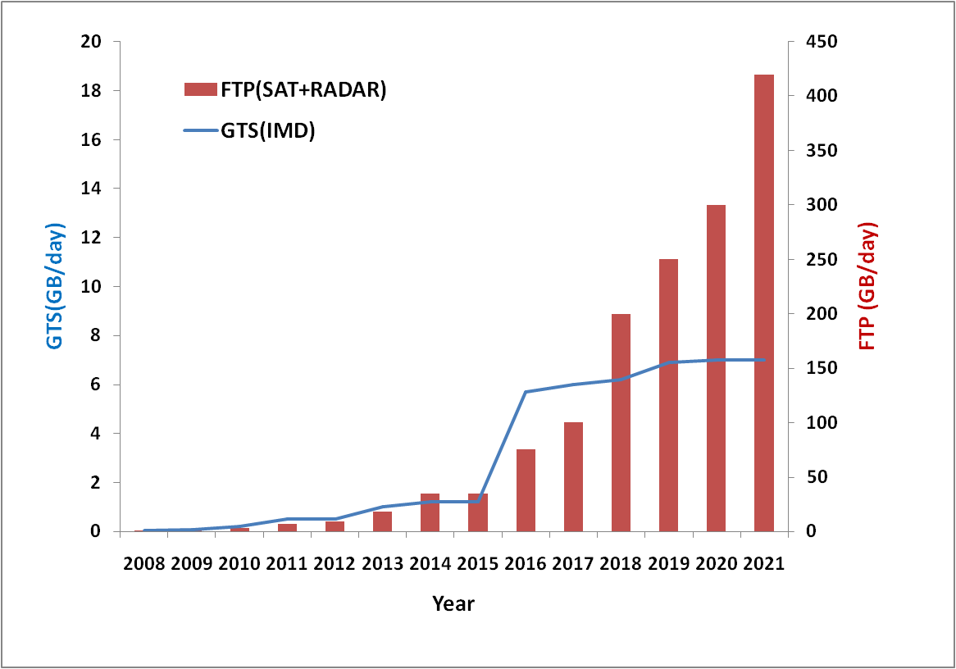
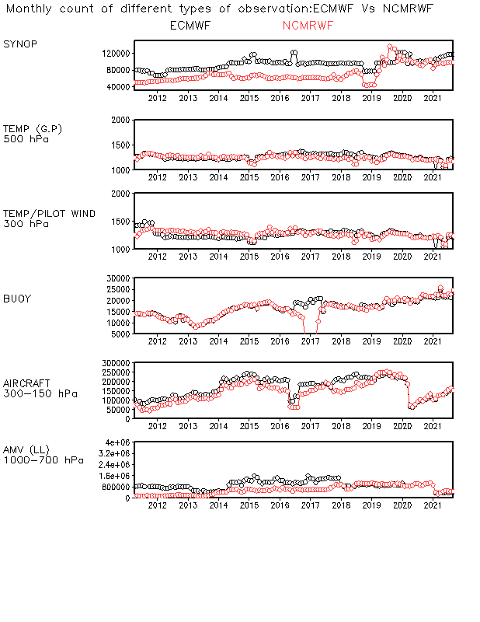
Data Reception at NCMRWF
NCMRWF
Year-wise increase in the volume of NCMRWF data reception
ECMWF/NCMRWF data comparison
Recent data addition
Aeolus-HLOS , wind profilers
COSMIC-2/PAZ GPSRO
GPS-IPW (Global IGNSS network)
OMPS(GOES)-OZONE,
METOP-Dual AMVs
ABI/AHI radiances
IMD-DWR
INSAT 3D-R

Slide 10
Improved NCUM Observation Pre-processing System
GTS
EUMETCast
IMD/
ISRO
NESDIS/
EUMETCast
NESDIS
NCEP Decoder
ECMWF Decoder /ecCodes
h5dump
UKMO Decoder
ECMWF Decoder
/ecCodes
AAPP &
ECMWF Dec
WMO ASCII and BUFR
BUFR
hdf
BUFR
BUFR
Write Observations as per Element List
“Obstore” Preparation
Header Files
NCUM
“OBSTORE” Files

Slide 11

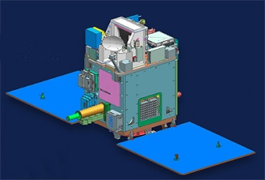
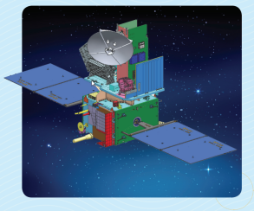
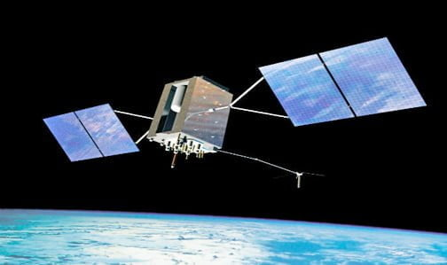
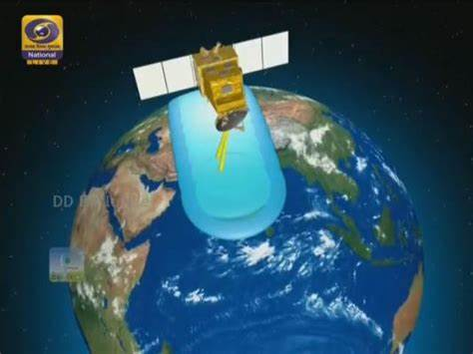
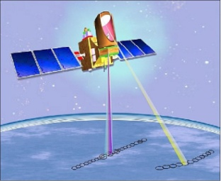

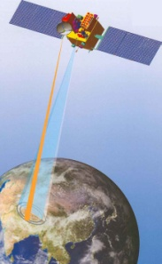
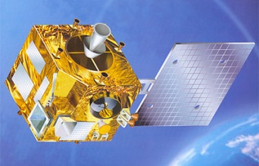
Indian Satellite Data added to the NCMRWF NWP system: Timeline
Microsat-2B (2023 expt)
Prasad et al., (2023)
Rani et al., (2023)
Gupta et al., (2023)
INSAT-3DR AMVs (2017)
Sharma et al., (2021)
Oceansat-3 (2023)
Sankhala et al., (2023)
Srinivas et al., (2023)
Megha-Tropiques SAPHIR (2014)
Singh et al., (2015)
Rani et al., (2016)
Doherty et al., (2018)
Kumar et al., (2018)
Scatsat-1 (2017)
Johny et al., (2019)
Bushair et al., (2021)
INSAT-3D radiances (Imager & Sounder) and AMVs (2013-2014)
Prasad et al.,(2014)
Rani et al., (2016, 2019)
Sharma et al., (2021)
Oceansat-2 (2012)
Prasad et al., (2013)
Rani and Das Gupta (2013)
Rani et al., (2014)
Kalpana AMVs (2009-2010)
Das Gupta and Rani (2013)
Rani and Das Gupta (2013)

Slide 12
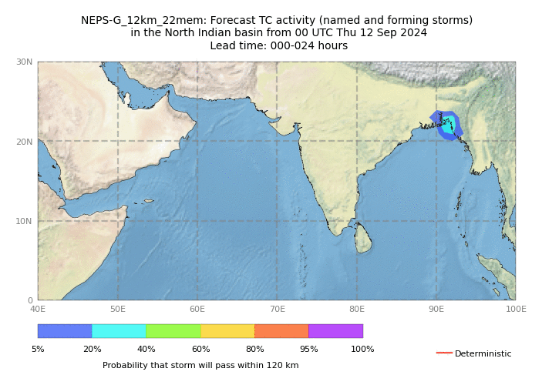
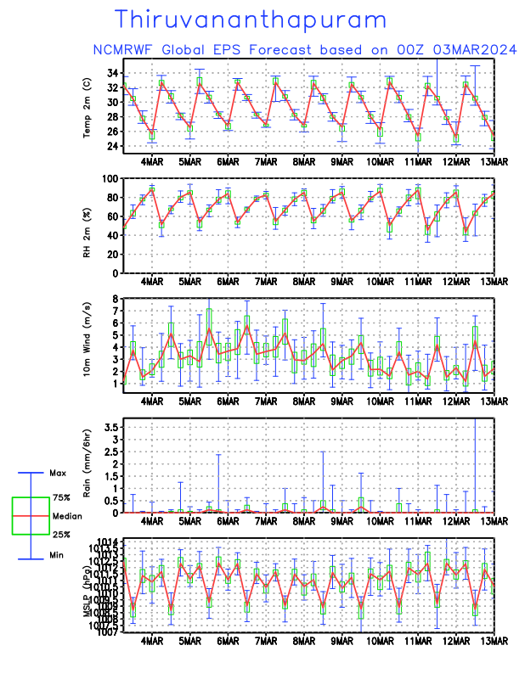
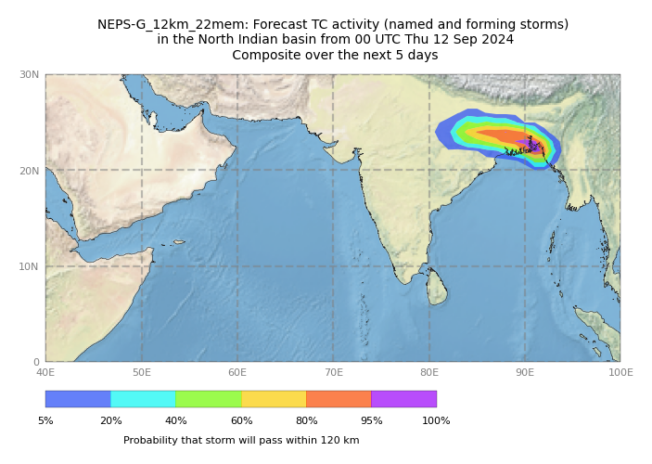

Slide 13
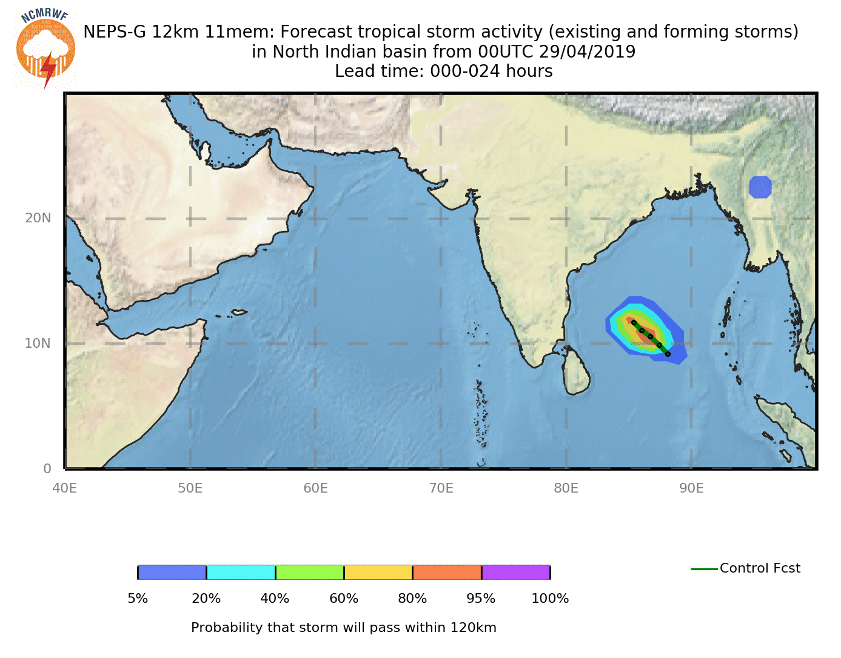

Slide 14
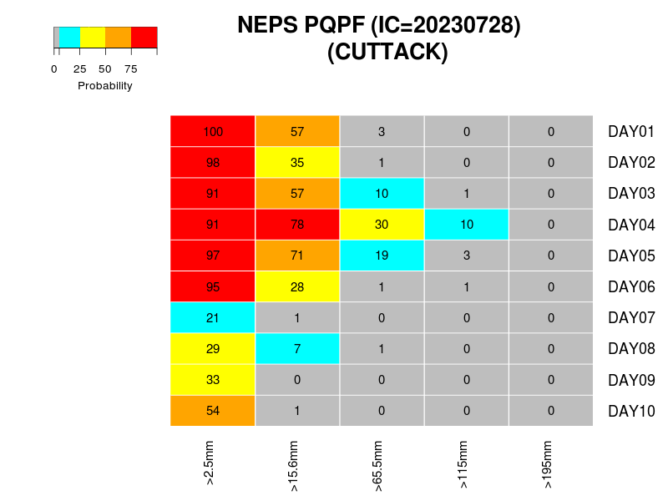
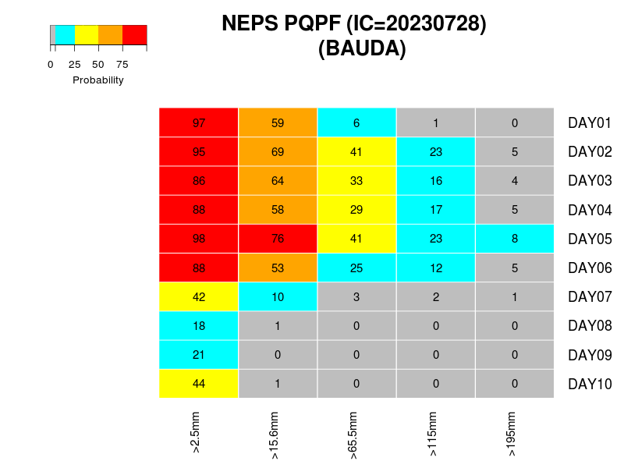
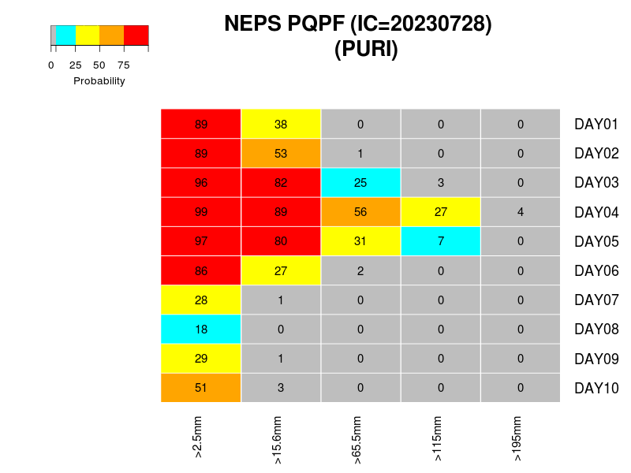
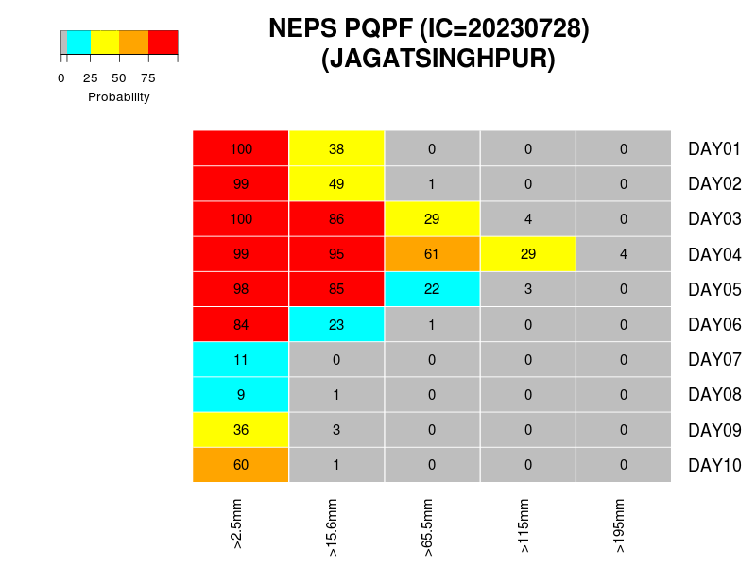
Forecast valid on 2nd Aug

Slide 15
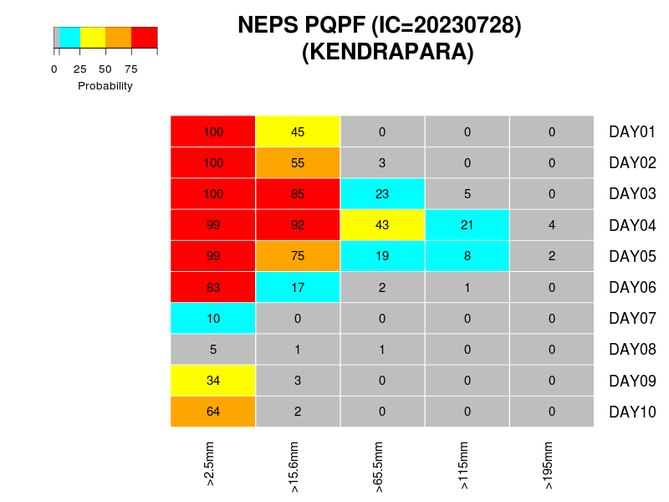
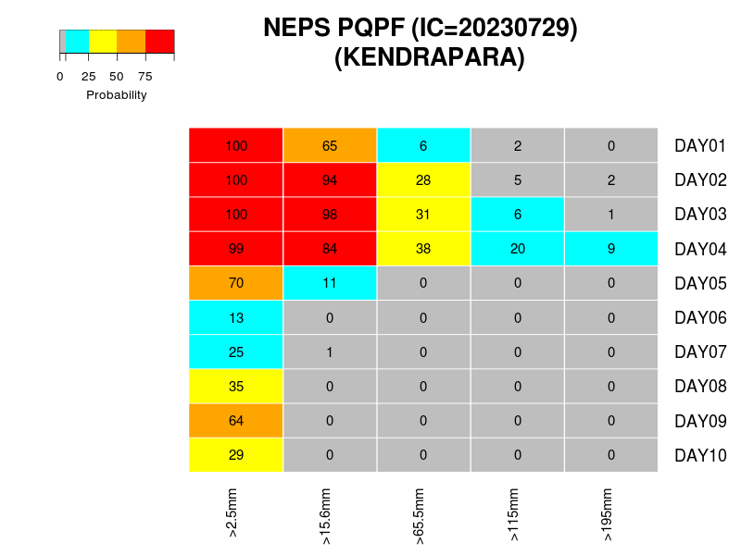
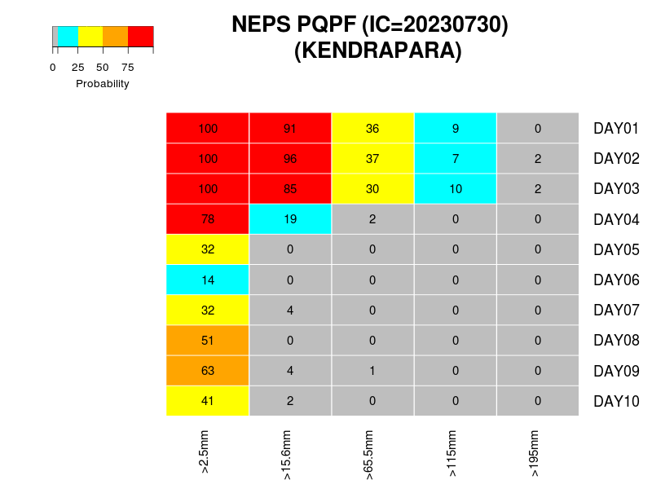

Slide 16
Users : Renewable Energy Sector
Government/Public Sector/State
  National Institute of Wind Energy (NIWE)
  Tamil Nadu (State Load Dispatch Centre)
  GRID-India (POSOCO)
  CEA
Private Companies
  Manikaran Wind Power Ltd, Delhi
  Energon Power Resources Pvt Ltd.
  ReConnect Energy
  KREATE Energy
  Algo Engines
  Leap Green Energy
  Greenko Energy Pvt Ltd
  Utopus Insights India Pvt. Ltd
  Climate Connect/ReNew Power
  Tomorrow.io
  Adani Green Energy
  Solarad

Slide 17
Other Users
Indian Air Force, Indian Navy, Coast Guard
GSI (Landslides)
Hydrological Applications
  IMD’s CRIS River Basins Portal
  CWC, NHP (Ensemble Discharge for over 50 Basins and sub-basins)
  SDMA (Kerala, AP, TN and Telangana)
  NE SAC, Gawhati
  Bhakra Beas Management Board (BBMB)
  Krishna-Bhima basin Study Division (BSD), Ministry of Irrigation, Govt. of Maharastra
  IIT-Madras & TN SDMA
  KSNDMC (Karnataka)
IISc : Forecasting application for Runways
CEA: Central Electricity Authority (RE Applications)
NPCIL : NCMRWF Data for nuclear emergency warning systems
  NCMRWF-NPCIL MOU (April 2019)
  Nine (9) nuclear power plants all over India

Slide 18
NCMRWF Reanalysis
IMDAA Reanalysis - high resolution (12km, 1-hourly) Regional reanalysis over India, from 1979 to 2020 and IMDAA like from 2020 onwards
NGFS Reanlaysis - High resolution (25km, 6-hourly) Global reanalysis, from 1999 to 2019.
These Reanalysis products are available at
NCMRWF REANALYSIS DATA SERVICES portal
https://rds.ncmrwf.gov.in/

Slide 19

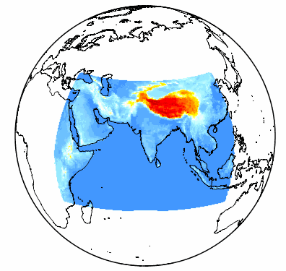
IMDAA Regional Reanalysis : Salient Features
Period | 1979 – 2020 (40 + 2 years)
Domain | 30 - 120˚ E, 15˚ S to 45˚ N
Lateral Boundary Condition (LBC) | ERA-Interim
Data Assimilation Method | 4D-Var (Atmosphere) Simplified Extended Kalman Filter method for Soil Moisture
Atmospheric Model | Unified Model
Horizontal Resolution | 12 km (~0.11˚)
Vertical Resolution | 63 model levels (upto ~ 40 km altitude)
Observation Source | ECMWF, NCMRWF, UK Met Office, IMD
Surface | Soil Moisture Analysis Sea Surface Temperature: HadSST2, OSTIA analysis
IMDAA Domain
Register / Download Free from NCMRWF
https://rds.ncmrwf.gov.in
18,000 users

Slide 20
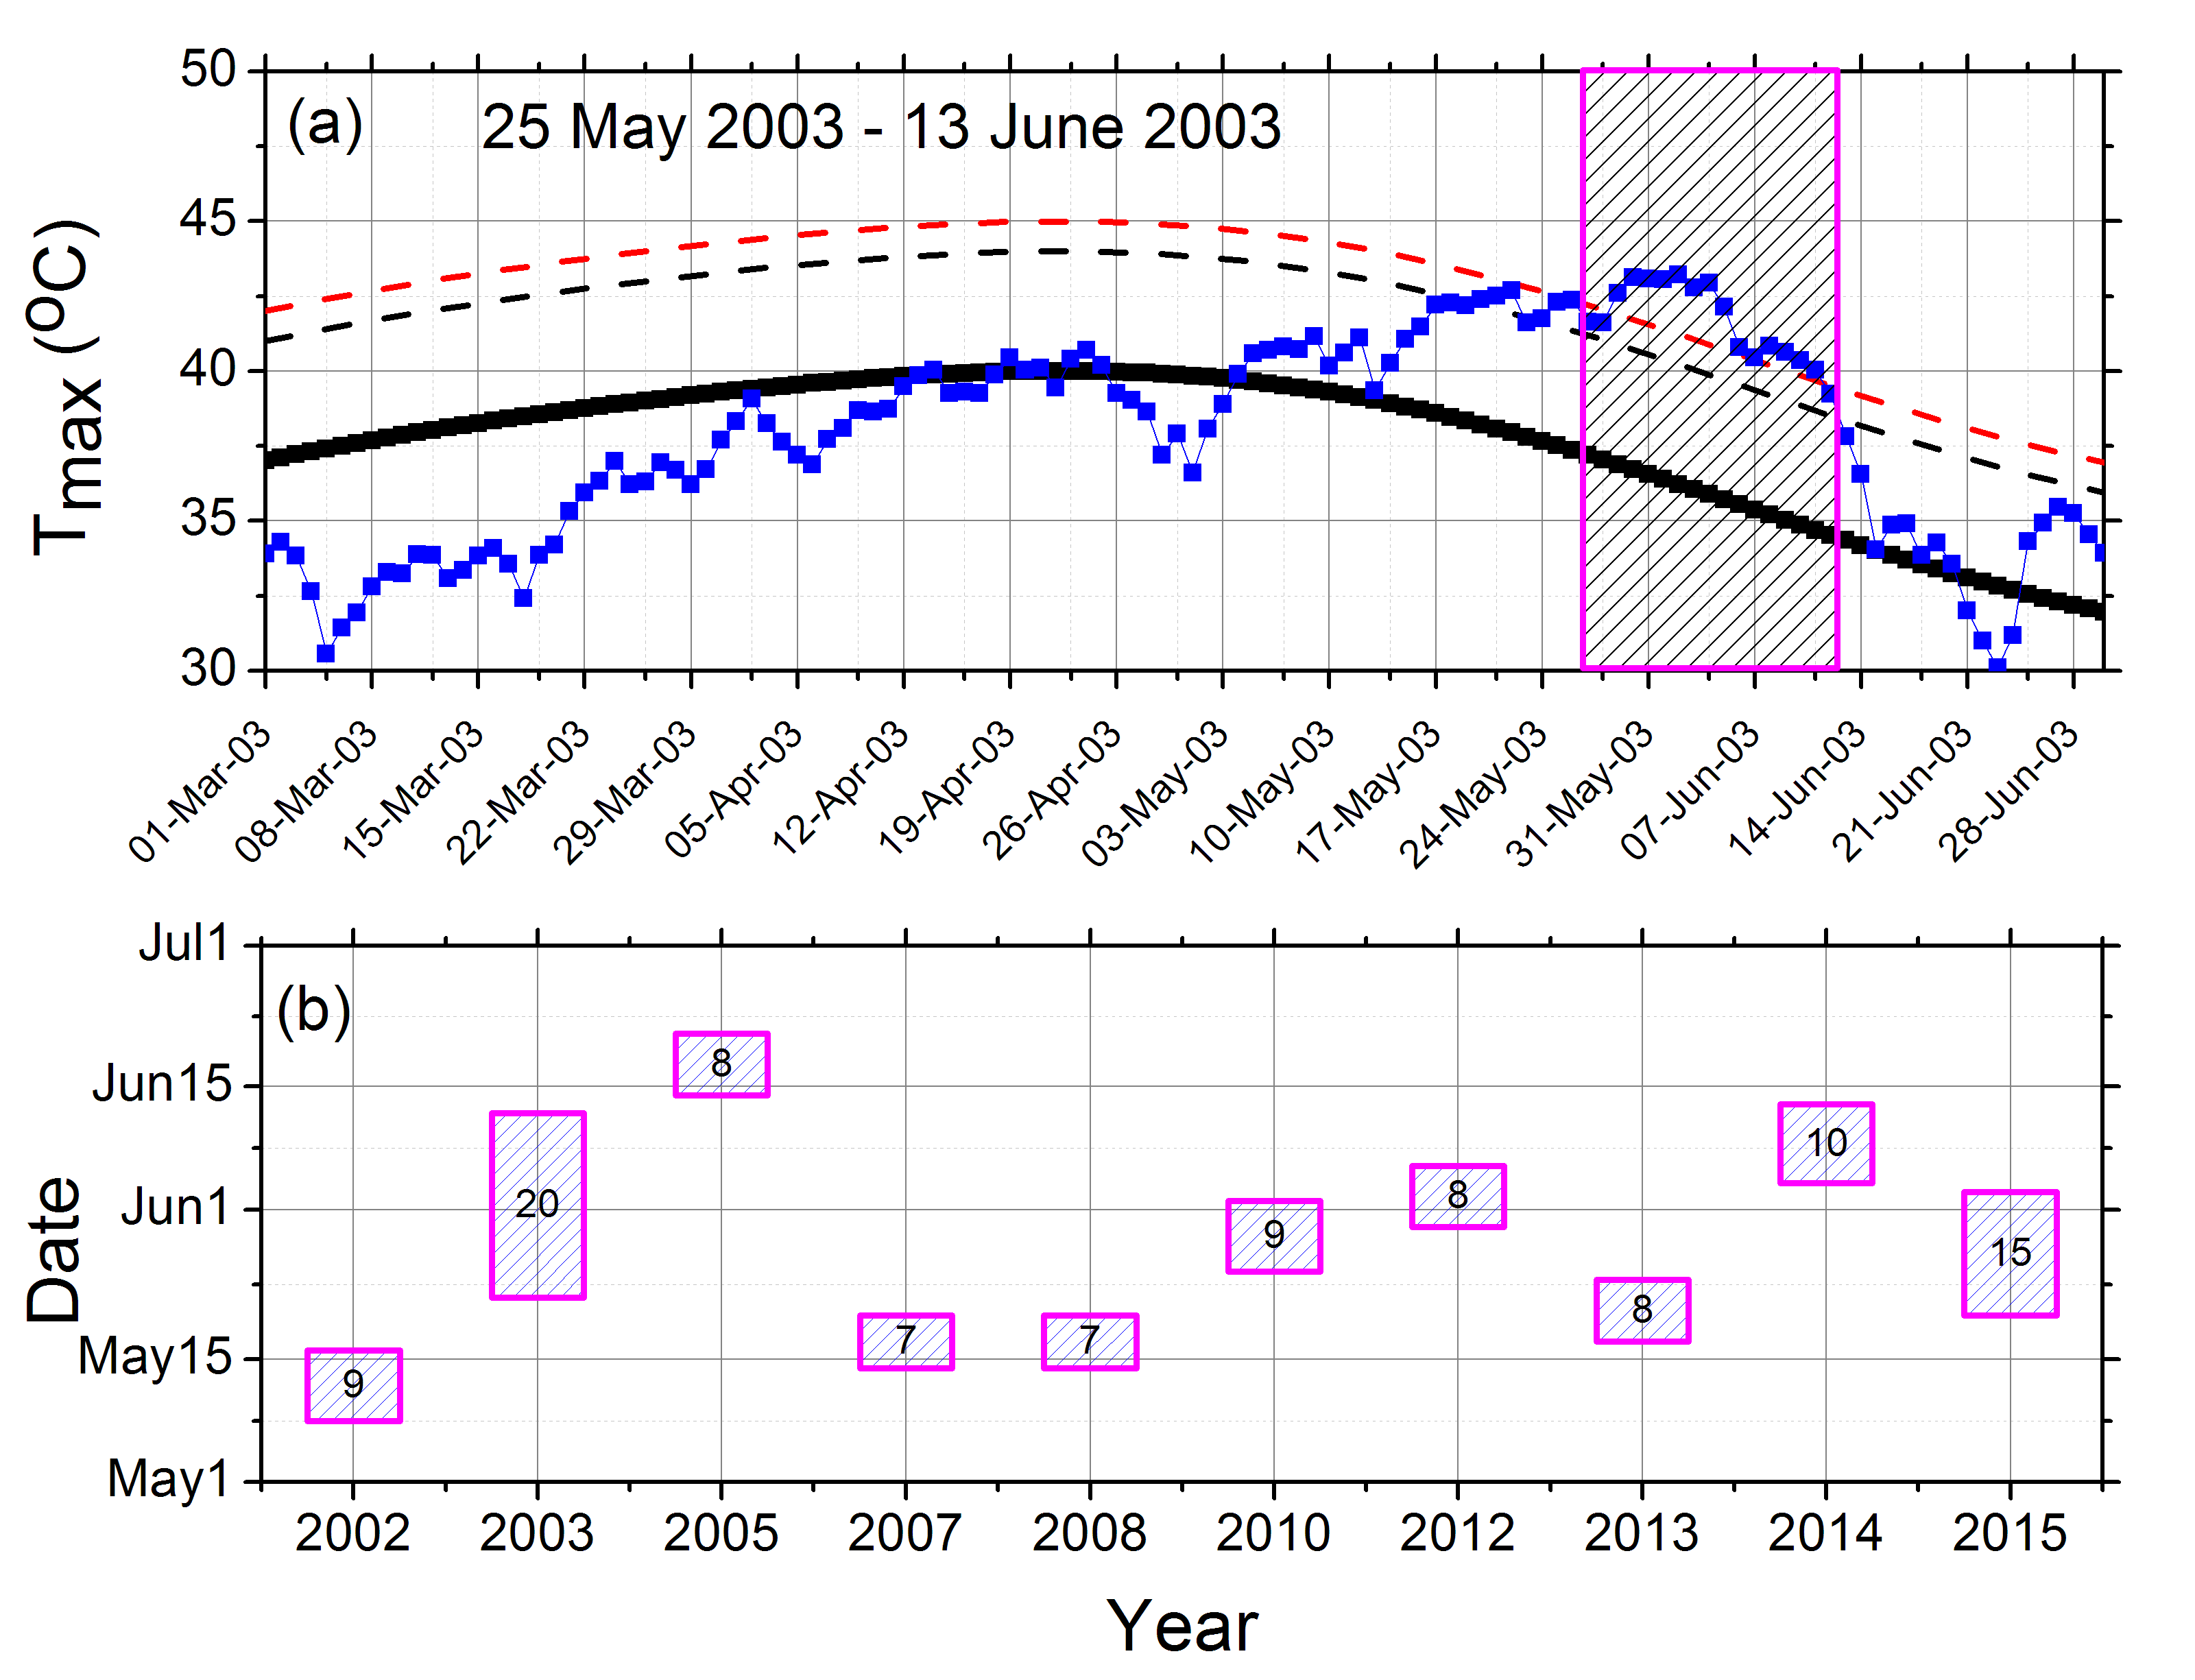
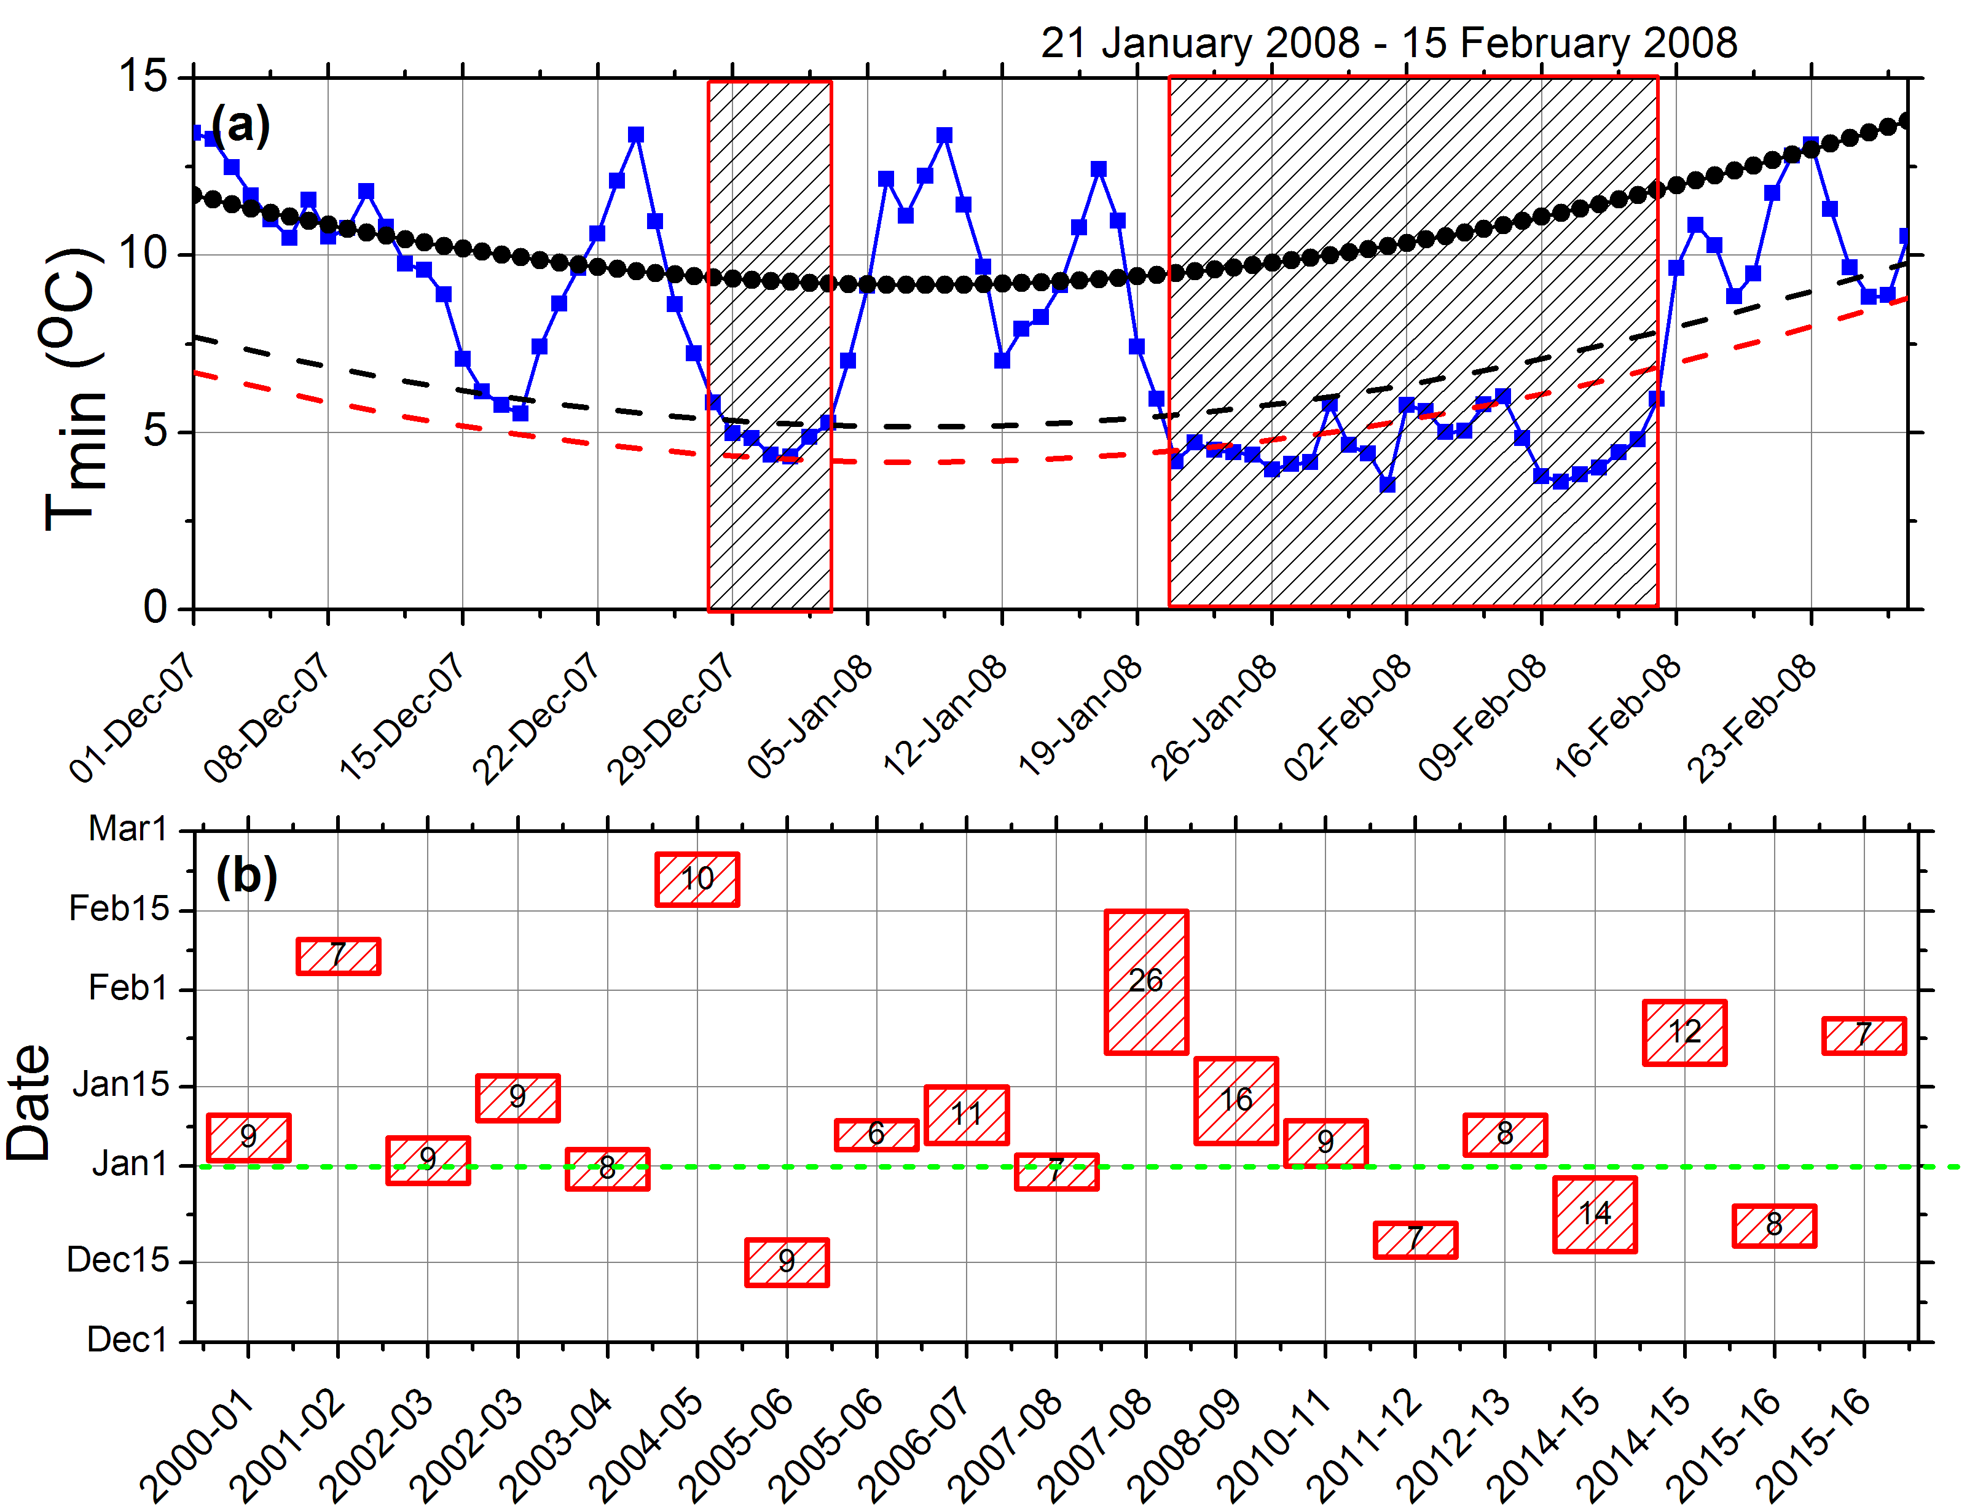
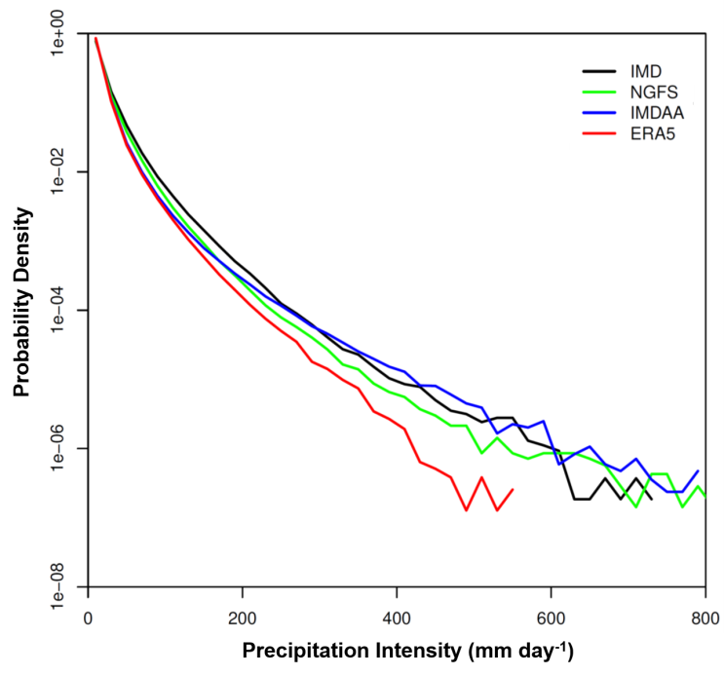
NCMRWF Global Reanalysis 1999-2018 (continued), 6hr ly, 23 km grid:
For research in identifying Extreme weather events & other Applications
Heat Waves
Cold Waves
Extreme Rainfall

Slide 21

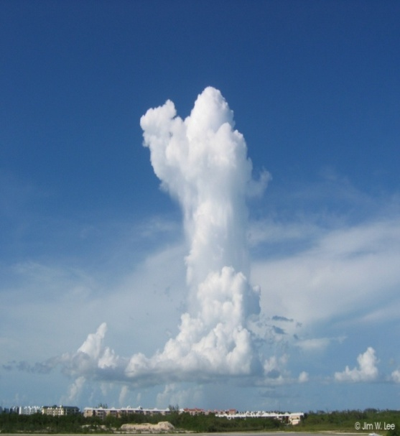
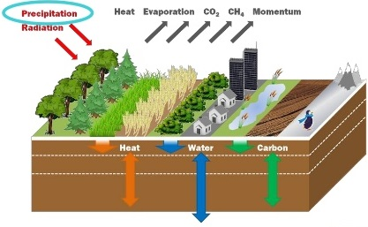
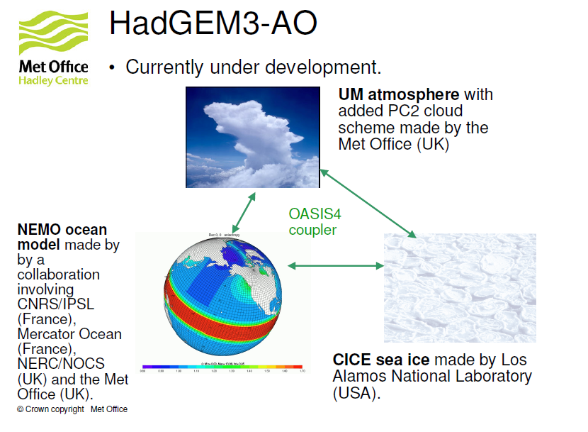
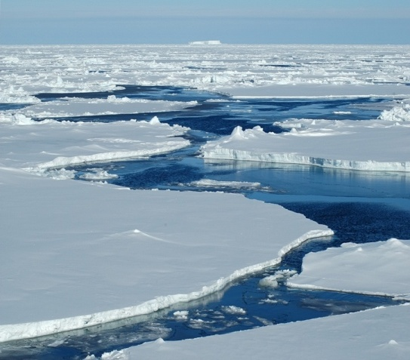
Atmos NCUM
LS Model, JULES
Coupler, OASIS
Ocean. NEMO 3.4
Sea Ice CICE 4.3

Slide 22
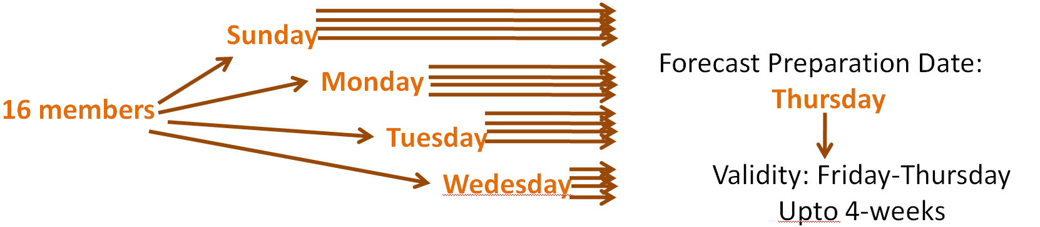
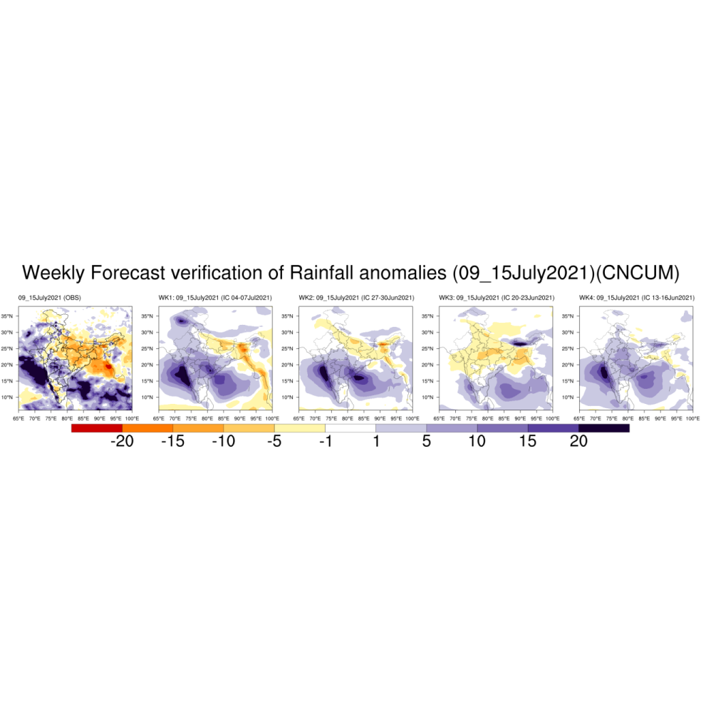
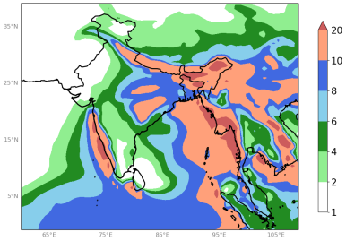
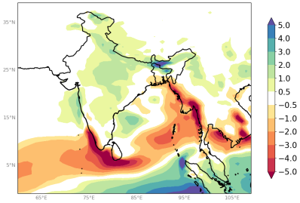
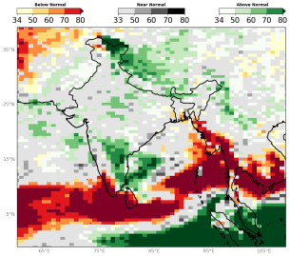
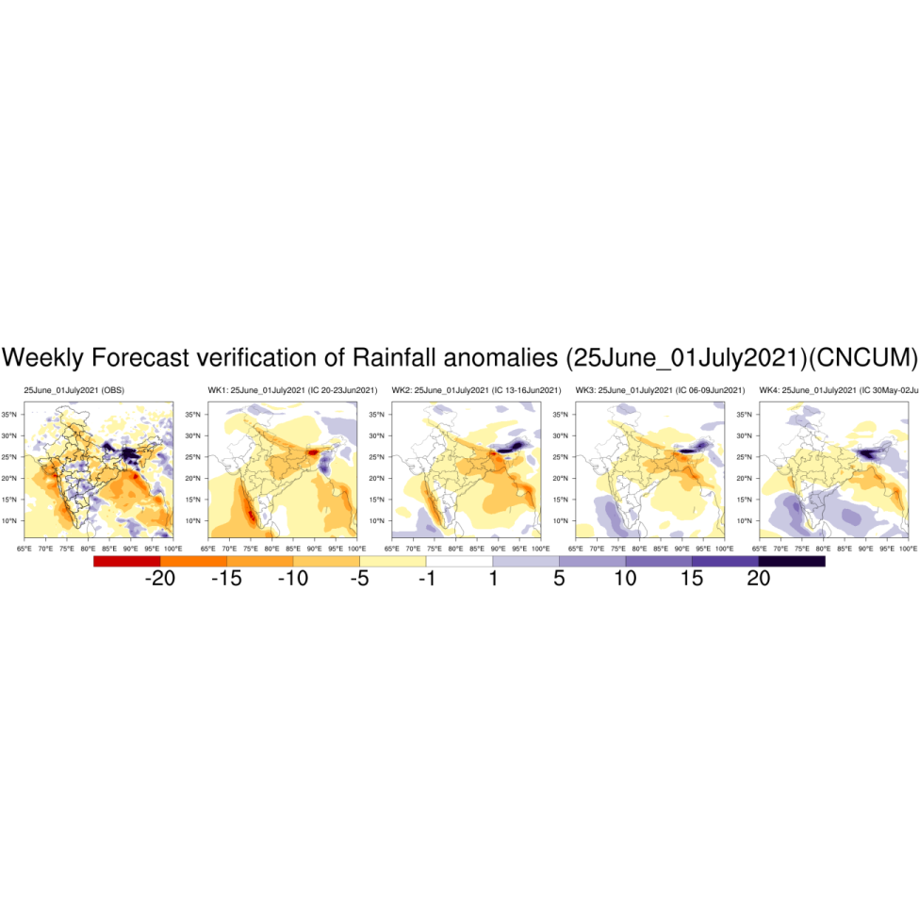
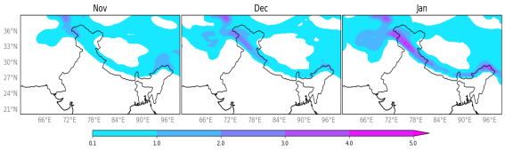
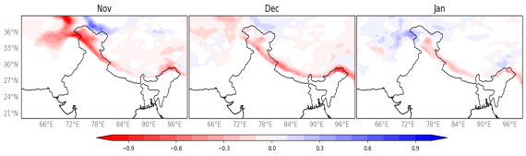
NCMRWF coupled Model for Days-to-Season
2017: 15-day forecast, every day
2018: Up to 4-week forecasts, every week
2019: Seasonal forecasts, every month
NCMRWF Coupled Model Runs with 60 km (NCUM) and 25 km (NEMO)
Model Climatology 23 years (1993-2015) Hindcast data used
Ensemble Strategy: lagged ICs + stochastic physics
7 members hindcast. Hindcasts initialized on 1st, 9th, 17th & 25th of each month.
16 members forecast ERP: 4 members per day. 4-startdates.
55 member Seasonal forecasts: 5 members per day. 11 startdates.
Extended Range Prediction is done using ocean-atmosphere coupled dynamical model. The Extended Range forecasting system consists of 16 members forecast with physical perturbations. This system is run weekly and issues 4-week outlook
Dynamical Modeling based Seasonal Forecast using ocean-atmosphere coupled model. The seasonal forecasting system consists of 55 members forecast with physical perturbations. The probabilistic forecast uses tercile categories computed from the rainfall distribution obtained from 23 years of model runs.
Forecasting wet spell: Observed and forecast rainfall anomalies during the active monsoon conditions over India.
Seasonal Forecast: JAS 2022, Forecast IC: May
Snow Forecast, Forecast IC: October 2022
Forecasting dry spell: Observed and forecast rainfall anomalies during the weak monsoon conditions over India.
Anital et al 2021 https://rmets.onlinelibrary.wiley.com/doi/full/10.1002/qj.4216#:~:text=https%3A//doi.org/10.1002/qj.4216

Slide 23
Ranges of weather forecasting
1. | Nowcasting | 0 -6 hours
2. | Short-range weather forecasting | Up to 72 hours
3. | Medium-range weather forecasting | Beyond 72 hours and up to 240 hours
4. | Extended-range weather forecasting | Beyond 10 days and up to 30 days
5. | Long-range forecasting | Beyond 30 days
National Centre for Medium Range Weather Forecasting

Slide 24



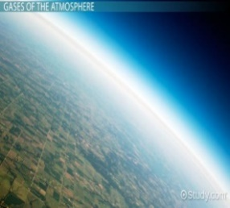




Conventional/surface based
Observations
(Surface, Upper Air, Aircraft,
Wind Profiler, GroungGPS)
Satellite Observations
(Winds (atmosphere and sea surface), Radiances,
GPSRO-Bending angle)
In-situ Observations
(Temperature and salinity
profile )
XBT, ARGO, BUOY: (Moored & Drifter), RVs/SHIP observations)
Satellite Observations
Sea Surface Temperature
Sea Level Anomaly
NEMO
NCUM
OCEAN
ATMOSPHERE
NEMOVAR 3DVAR - FGAT
Hybrid-4DVAR
COUPLER: OASIS
NCMRWF
COUPLED NWP SYSTEM
Land Surface Temp.
soil moisture
Satellite soil wetness observations:
(ASCAT)
OSTIA: SeaIce, SST
COUPLER: OASIS
Sea-Ice Concentration
Satellite Observation:
SSMIS
JULES
CICE
LAND
SEA-ICE
Simplified EKF
NEMOVAR
3DVAR - FGAT

Slide 25
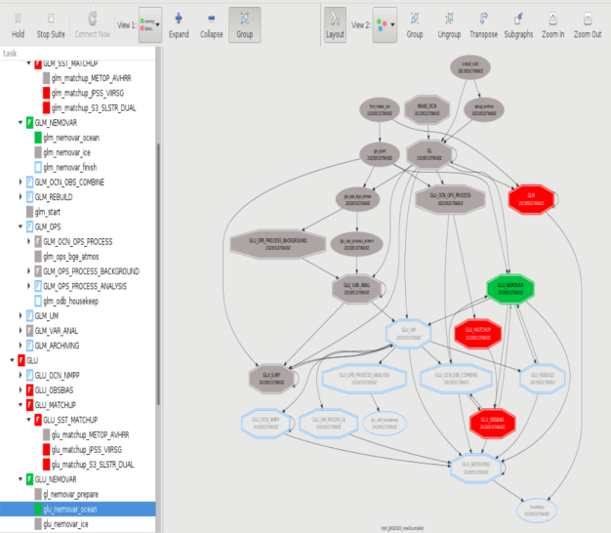
NCMRWF Global Coupled NWP system (CNCUM):pre-operational trials
Coupled NCUM for NWP combines various earth system components – designed for medium range weather forecast.
Weakly coupled DA provide initial condition to Coupled NCUM – Atmosphere, Land, Ocean and Sea Ice. Analyses (6 hour, four times a day) performed separately for each earth system component, using background from previous (6 hour back) coupled model short forecast.
GUI: Run-time Coupled suite
Graph with job’s inter-dependency
Weakly Coupled Data Assimilation for CNCUM
Ocean & SI DA
Land DA
Parallel Runs are being conducted in Pratyush HPC
Resolution: Atmosphere ~10km, Land ~10km, Ocean ~ 25km, Sea Ice 25km
JJAS2023: Completed till 31 July
JJAS2024: completed till 16 of August
Notes:
Weakly coupled: Initial conditions are prepared separately by individual DA systems (such as 4DVAr for atmosphere, NEMOVAR for ocean etc..), however the background is provided by Couple model.

Slide 26
Components of Coupled Global assimilation-forecast System (C-NCUM)
Resolution and Science Configuration
Model | Data Assimilation-Atmosphere | Data Assimilation – Land Surface | Data Assimilation-Ocean & Sea Ice
Model: Unified Model; Version 11.9 Domain: Global Horizontal Resolution:10 km (atmos), 25 (Ocean) (¼) Vertical levels (Atm): 70 levels (model top at 80 km) Vertical Levels (Ocean): 75 levels in the vertical varying in thickness. Time step: 4 min. Time step: Both the ocean and CICE model components use a 20-min time step. | Method: Incremental 4D-Var Observations assimilated: Observations received at NCMRWF from GTS and other sources (Satellite observations from NOAA/NESDIS, EUMETSAT, ISRO etc.) | Soil Moisture analysis: Method: Simplified Extended Kalman Filter (sEKF) Observations assimilated: ASCAT soil wetness obs, Screen Temperature and Humidity increments (pseudo-observations from 3D-Var screen analysis). | Model: NEMO ocean model (Vn 3.6) Assimilation method: 3D-Var FGAT (NEMOVAR) Observations assimilated: Observations received at NCMRWF from GTS and other sources.
In coupled simulations the atmosphere and land components exchange information with the ocean and sea ice components via the OASIS3 coupler using an hourly coupling frequency
Science configuration: Global Atmosphere (GA8.0), Global Land (GL9.0), Global Ocean 6.0 (GO6.0) and Global Sea Ice (GSI8.1).

Slide 27



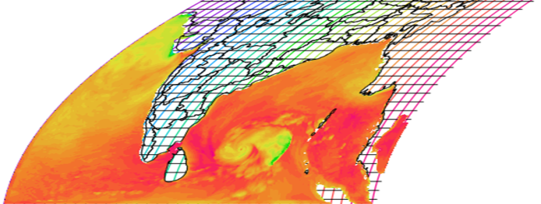

Regional Coupled Model For Monsoon/Severe Weather
Convective Scale Coupled Environmental Prediction System
Regional coupled environmental model with “Ocean”, “Atmosphere” and “Wave” components.
UM-Regional Atmosphere (4 Km)
Land Surface, JULES (4 Km)
UM12.1
NEMO 4.0.4
WAVEWATCH III (v7.12)
OASIS coupler
 | ATMOSPHERE & LAND SURFACE | OCEAN & WAVE
Resolutions | 4.05 km x 4.05 km | 2.2 km x 2.2 km
Easternmost Long. | 64.9835 E | 64.9835 E
Westernmost Long. | 101.393 E | 101.393 E
Southernmost Lat. | 3.464 N | 3.464 N
Northernmost Lat. | 40.0355 N | 26.558 N
Domain Size | 900x904x80 grids | 1100x1760x75 grids
Regional Ocean NEMO (2.2 Km)
WaveWatch III vn.7.12 (2.2 Km)
Global/Regional Boundary Conditions: Forecasts/Analyses
Experiments: UNCOUPLED → PARTIALLY COUPLED → FULLY COUPLED

Slide 28
Impact of Observation on 24-hour Global Forecast of NCUM during ISM
(Left) Percentage-wise impact of observation on 24 hr global NCUM forecast, obtained using adjoint-based Forecast Sensitivity to Observation Impact (FSOI ) approach during the Indian Summer Monsoon period (JJAS) of 2020, 2021, 2022 and 2023. (Right) Percentage of observation assimilated per day for the same period.

Slide 29
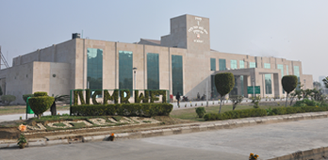
www.ncmrwf.gov.in
Thank You

