Slide 1

Closing the Basic Weather and Climate
Data Gaps in South Asia: Advancing SOFF implementation and creating synergies
Country updates - Nepal
24 – 26 September 2024

Slide 2
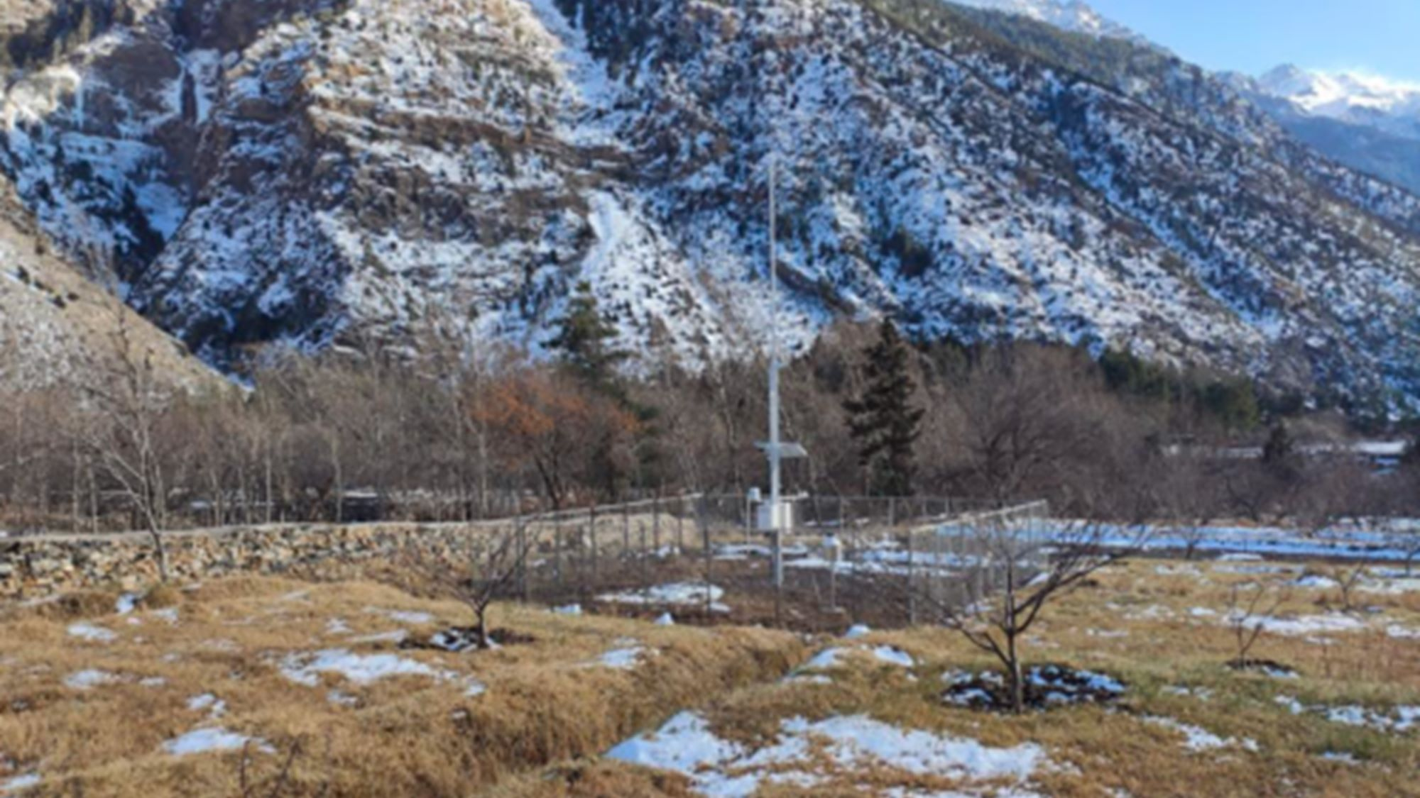
Outline
Brief introduction of the NMHS
Update on SOFF Implementation
Lessons learned and opportunities

Slide 3

Introduction: Department of Hydrology and Meteorology (DHM)
Vision: Timely, reliable, and trustworthy water, weather, and climate services for all
1962: Initiation of hydrological and meteorological activities in institutional approach in Nepal
1966: WMO membership
Mandate:
  Collect and disseminate hydro-met data and information
  Issue hydrological and meteorological forecasts to mitigate hydro-met-induced disasters and to ensure sustainable development

Slide 4
Brief introduction …
Lack of Legislation: hydro-met policy in cabinet for approval
Insufficient operational funding: Current FY’s budget allocation (million USD): Capital: 2.7, Recurring: 2.1
Shortage of staff: Permanent staff: 277 (~85% technical)
Observational Infrastructure: Major infrastructural modernization implemented under PPRC-BRCH (2013–2021), but sparse stations in high altitude
  Hydromet stations: 700+ including following Automatic/Real time stations:
    RLS: ~ 200, Tipping Bucket: 170, AWS: 175
    C-band Doppler weather RADAR: 3, Radiosonde: 1

Slide 5
Brief introduction …
O&M of station is challenging
Mostly done through AMC
Calibration lab not operationalized

Slide 6
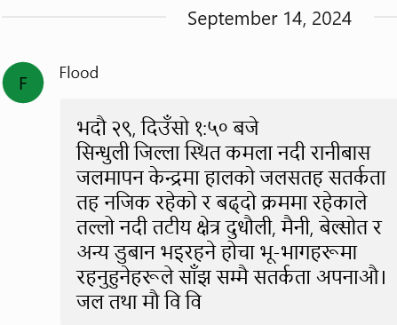
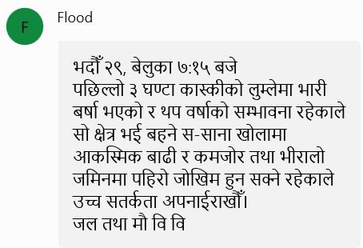
Brief introduction …
Warning and Advisory Services:
  Issue special weather and flood bulletins for high impact events (3 day)
  Issuing mass SMS for flood warnings and planning to extend this for meteorological events as well
Weather forecasting tool:
  Take reference of inhouse LAM products as well as external models (e.g. ECMWF)
  But lacks R&D, operational verification system for NWP
  Climate and Agromet services:
  Providing basic services but NFCS is yet to be prepared

Slide 7
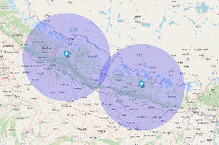
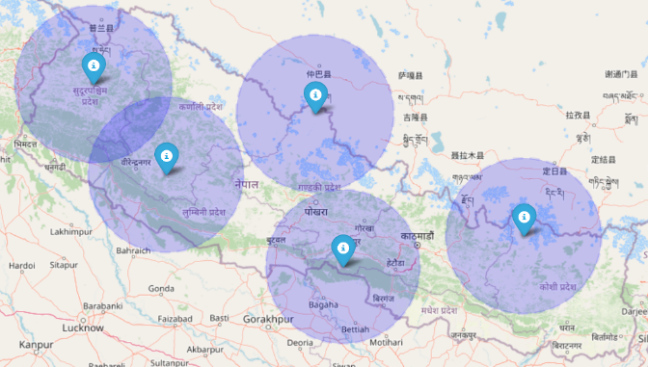

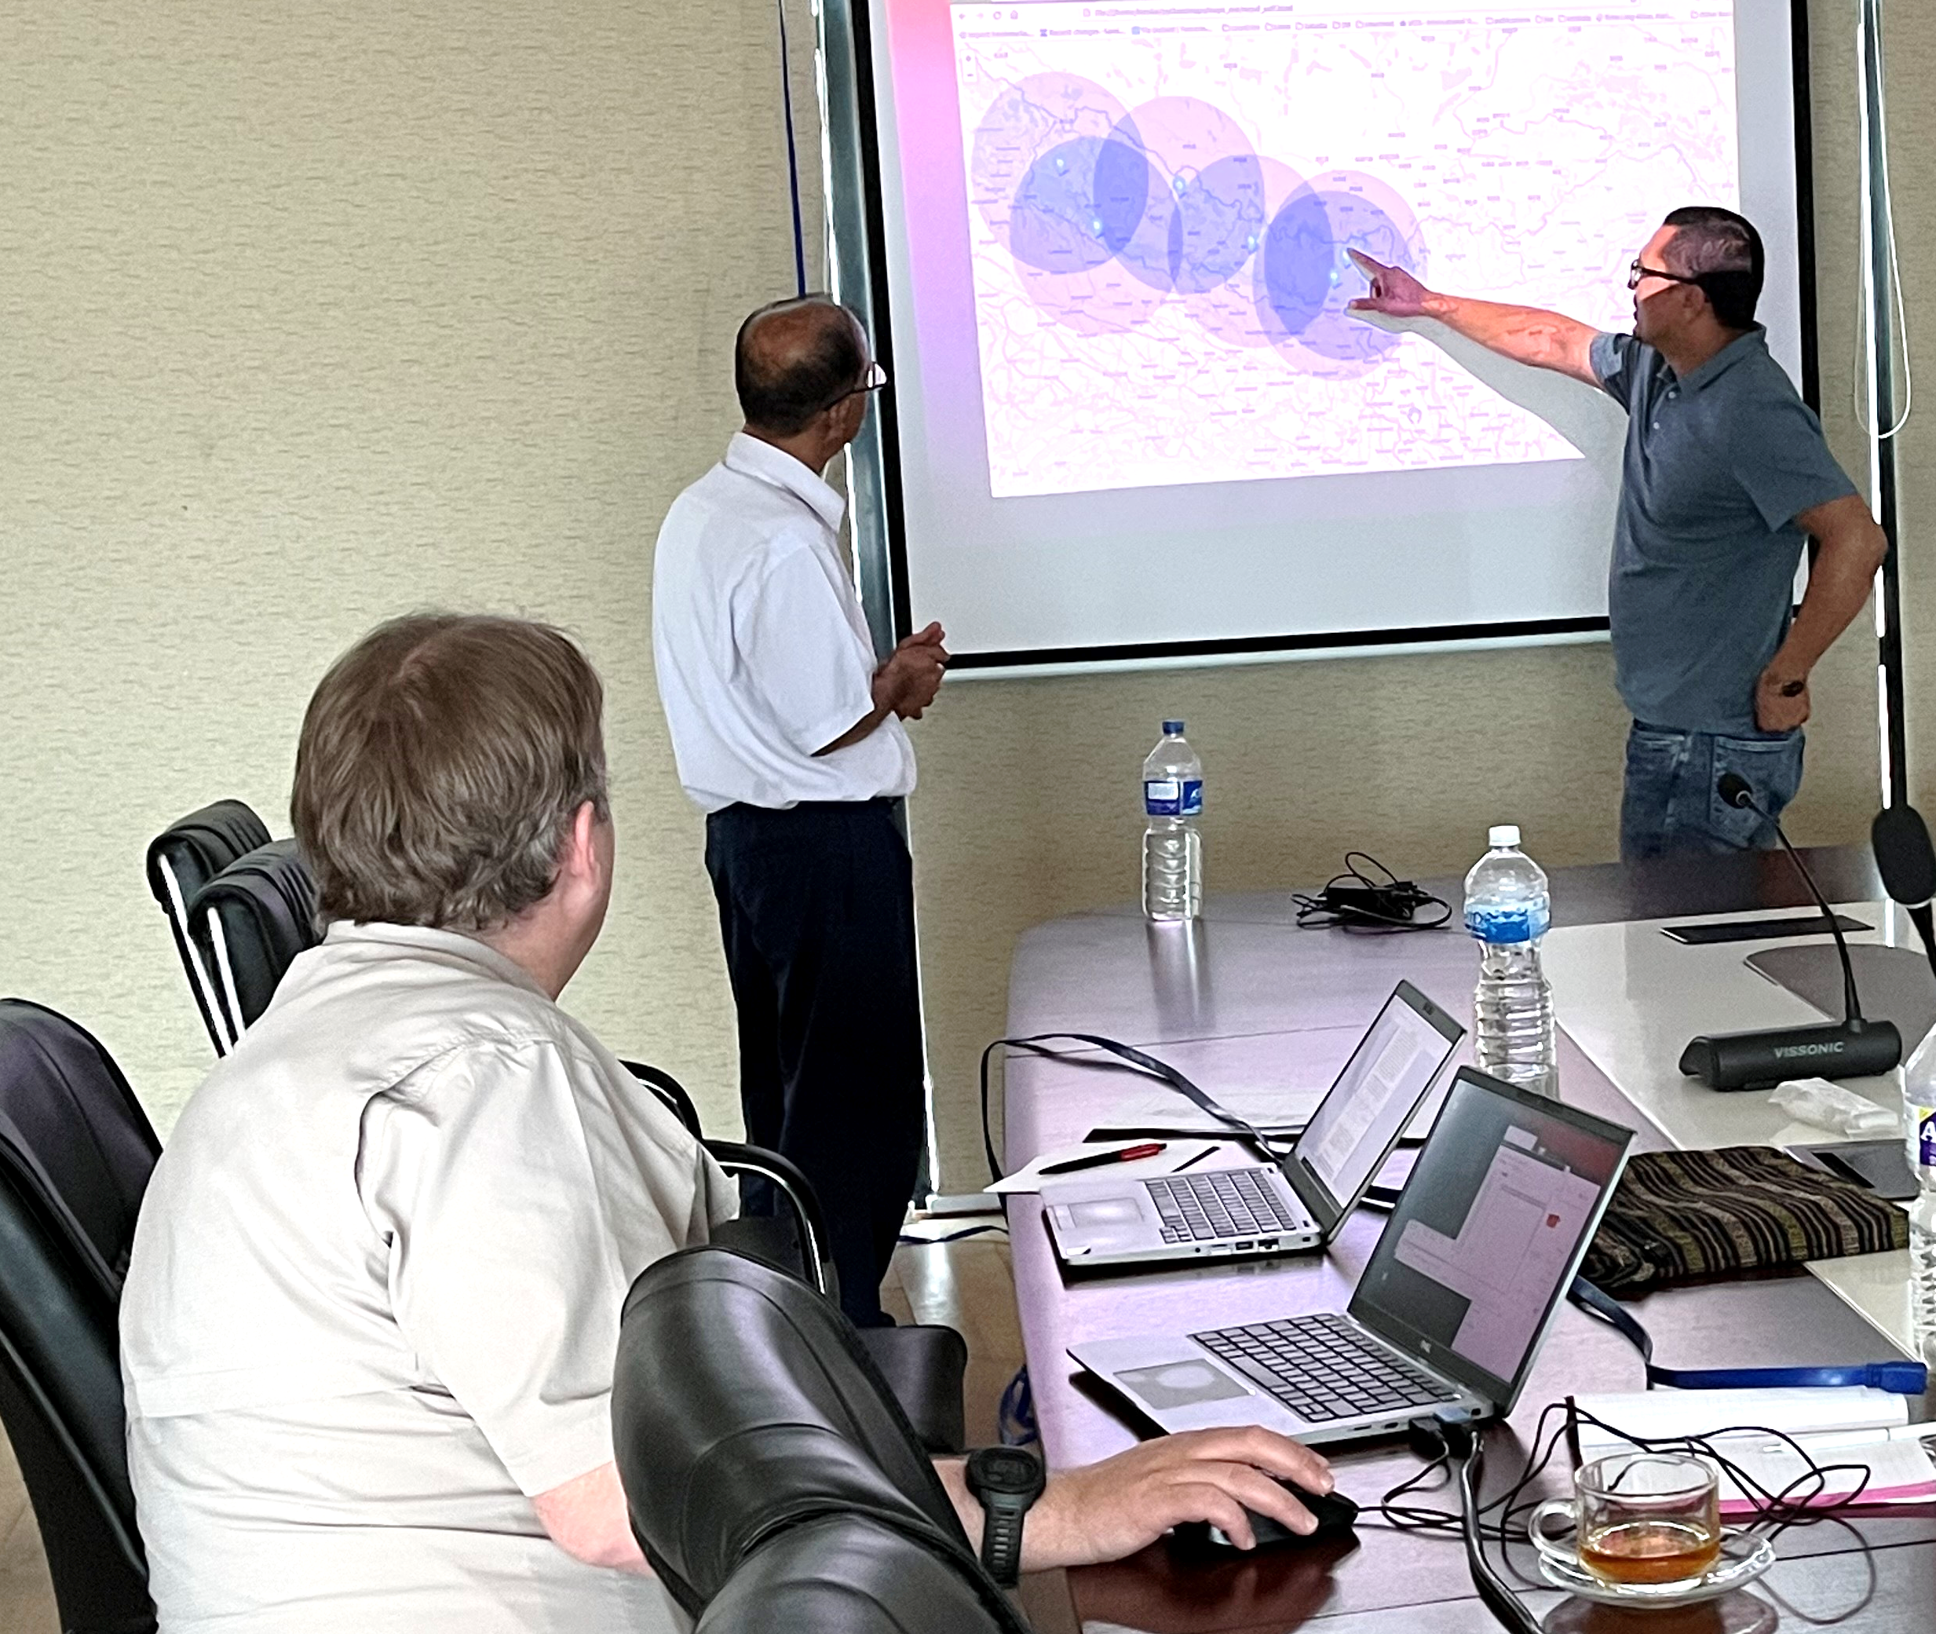
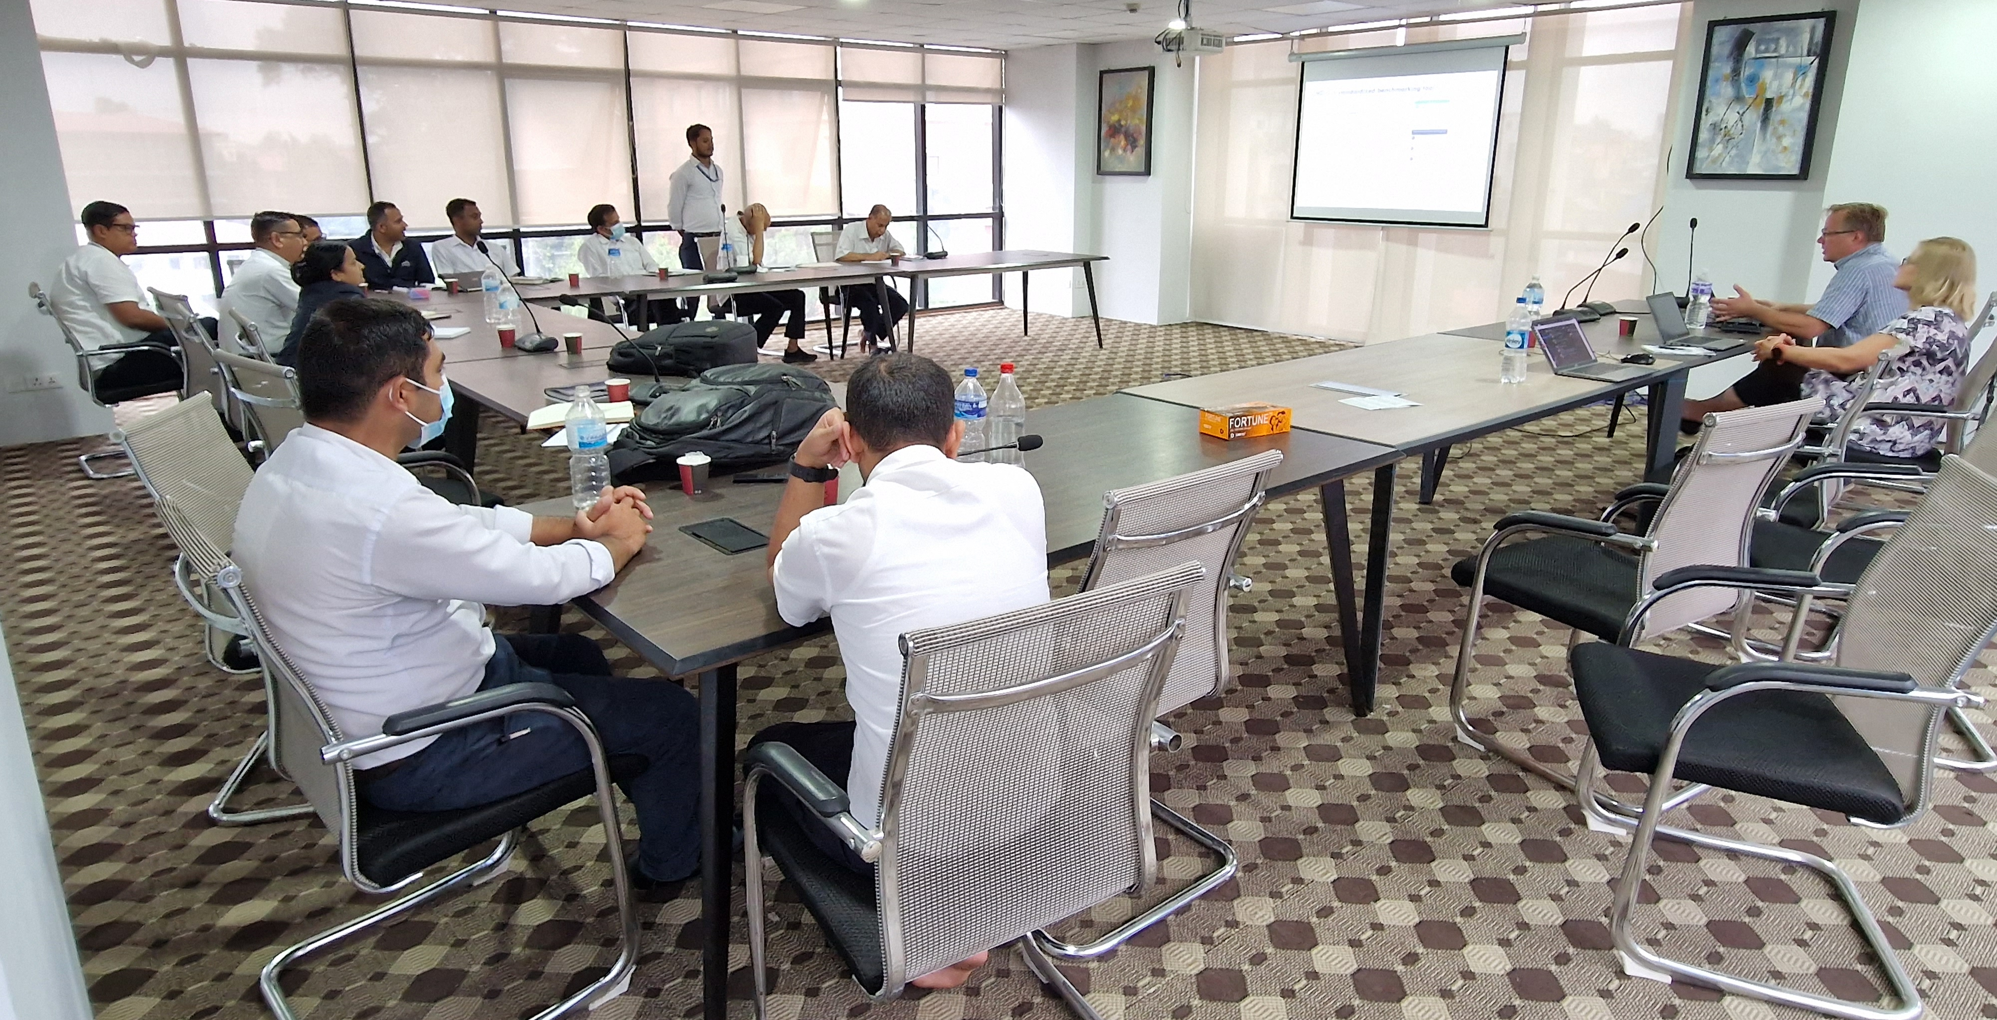



Update on SOFF Implementation
1) Gap Analysis –submitted to SOFF Secretary in Feb 2024, waiting for approval
    Upgrade of 5 AWS + 2 soundings (one new)
    Establish of calibration service
    Development of DMS and processes
    Capacity building & technical assistance
2) Country Hydromet Analysis
CHD submitted to WMO TA
6th Dec 2023
TA comments
19th Dec 2023
Final review of CHD by DHM (Sep 2024)
Revision and Approval of CHD by DHM (in progress)
3) National Contribution Plan:
Gap Analysis 5/2023
Final review of NCP by DHM (Sep 2024)
Revision and Approval of NCP by DHM (in progress)
NCP submitted to WMO TA on 29th Feb 2024
TA comments
Apr & May 2024
4) Investment Plan:
Application for TA comments (Oct 2024?)
Approval of Investment request in Nepal (3-4 months)
Investment request drafted by UNEP (Jun 2024)
Review of the application by DHM (in progress)
Internal CHD workshop 8/2023
Notes:
Current status: DHM should choose 5th AWS. WMO TA and SOFF Secretary has indicated that they will support one additional AWS and operation of existing sounding station.

Slide 8
Lessons learned and opportunities
Hydromet Investments:
Plan well before making investment in advance systems (e.g. RADAR, Lightning Detection network, Ceilometers etc.)
Go for open sources systems as far as possible (Workstation, AWS etc.)
Sharing good practices among recipient countries
SOFF implementation:
Timely Preparation, communication leading to timely decisions
Have common understanding among the stakeholders on country specific rules and regulations and come up with workable solution
  On budget, on treasury Vs Procurement Process
  Custom exemption
Clarity on SOFF terms and conditions
  Investment phase tied with Compliance phase?

Slide 9

Thank you!

