Slide 1
Closing the Basic Weather and Climate Data Gaps in South Asia: Advancing SOFF implementation and creating synergies Country updates Bhutan
24 – 26 September 2024

Slide 2
Presentation Outline
NHCM mandates
1
2
SoFF update
Opportunities and lessons
3

Slide 3
Presentation Outline
NHCM mandates
1
2
SoFF update
Opportunities and lessons
3

Slide 4
Mandates
1
Hydromet Policy of Kingdom of Bhutan 2023
Climate Change policy 2020
Disaster Management act 2013
Civil aviation act 2016

Slide 5
Mandates
Provide reliable and quality services on hydrology, meteorology and cryosphere services
Observation and collection of hydrological and meteorological data and information
Forecasting services (short, medium and long range)
Provision of Early warning services including GLOF
Aviation meteorological services
1

Slide 6
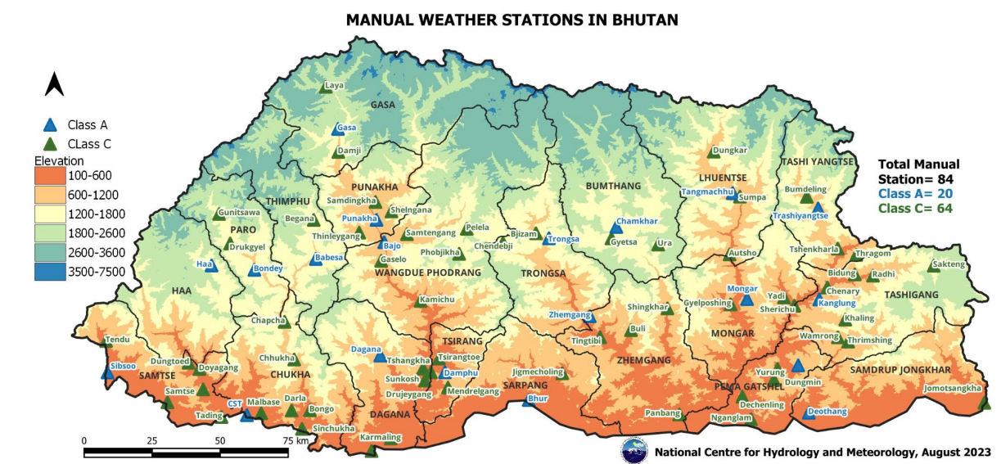

Slide 7
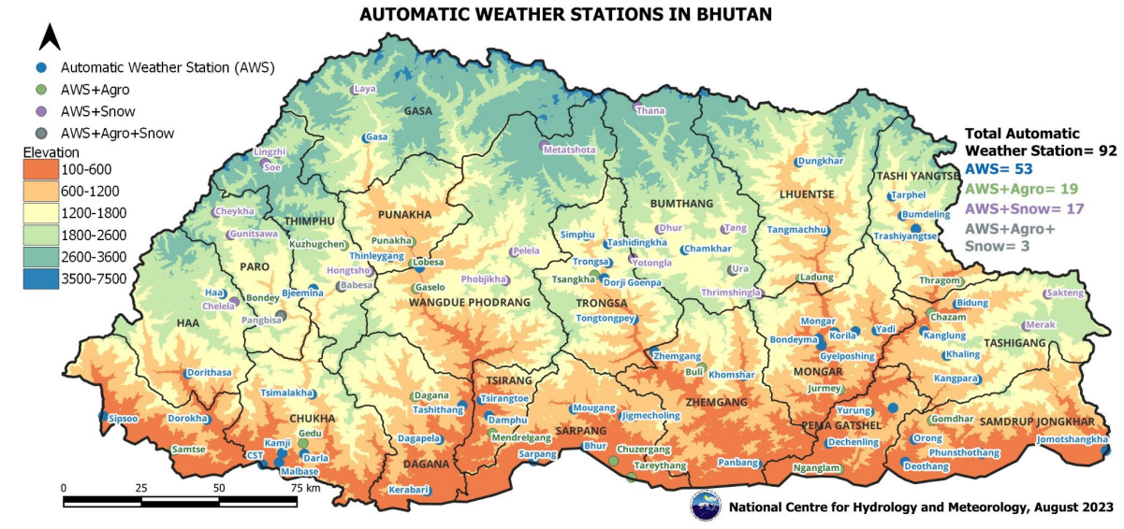

Slide 8
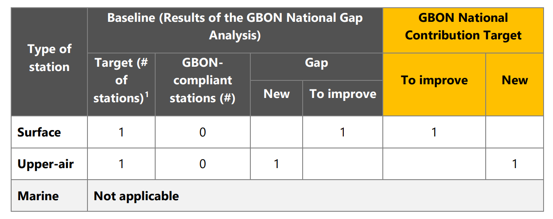

Slide 9
Presentation Outline
NHCM mandates
1
2
SoFF update
Opportunities and lessons
3

Slide 10
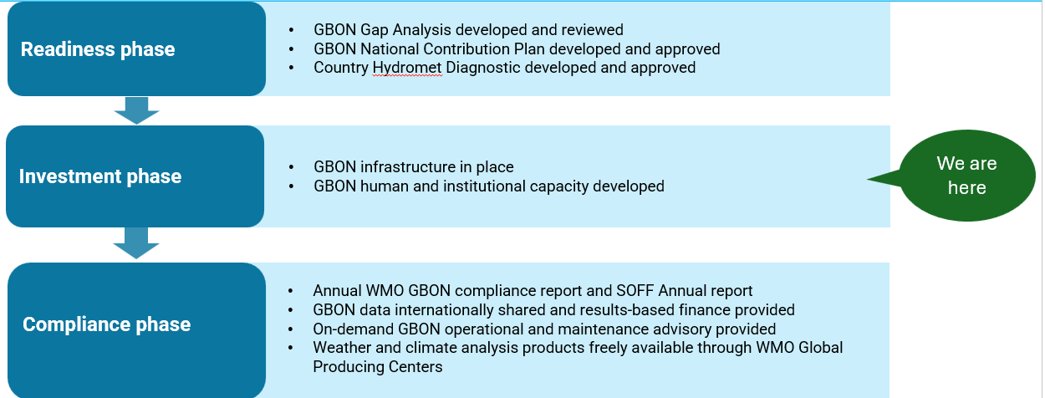
SoFF update

Slide 11
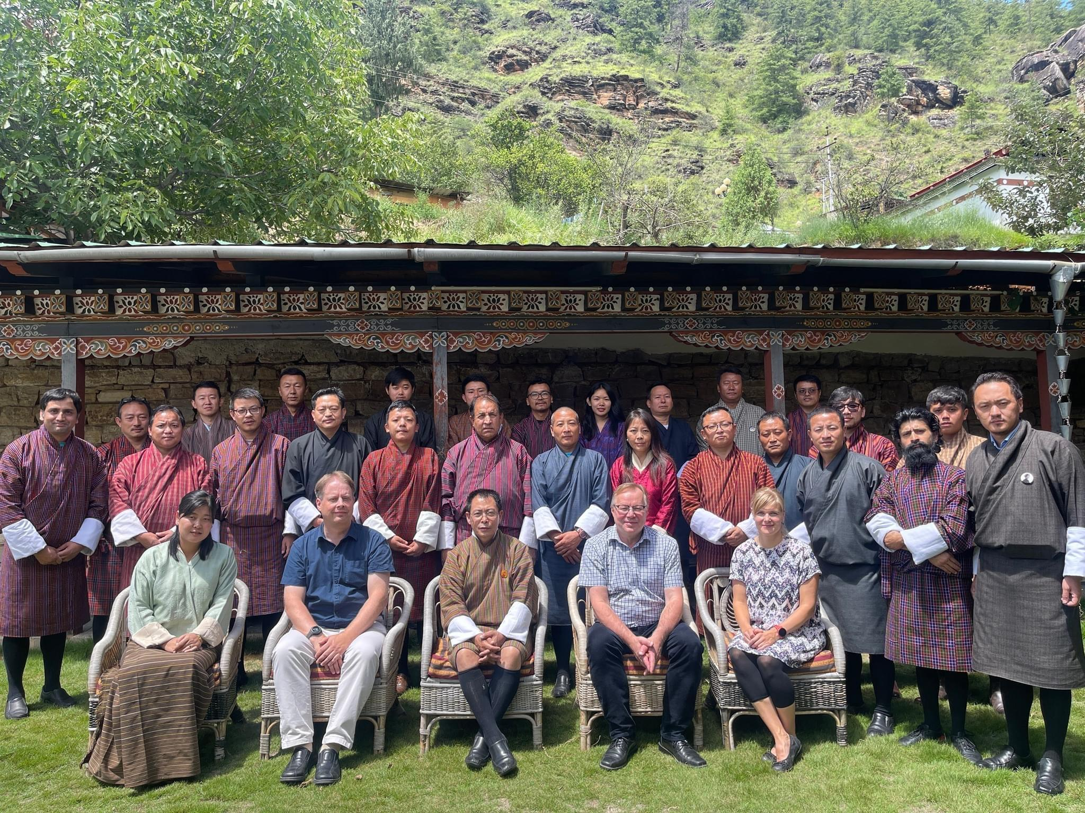
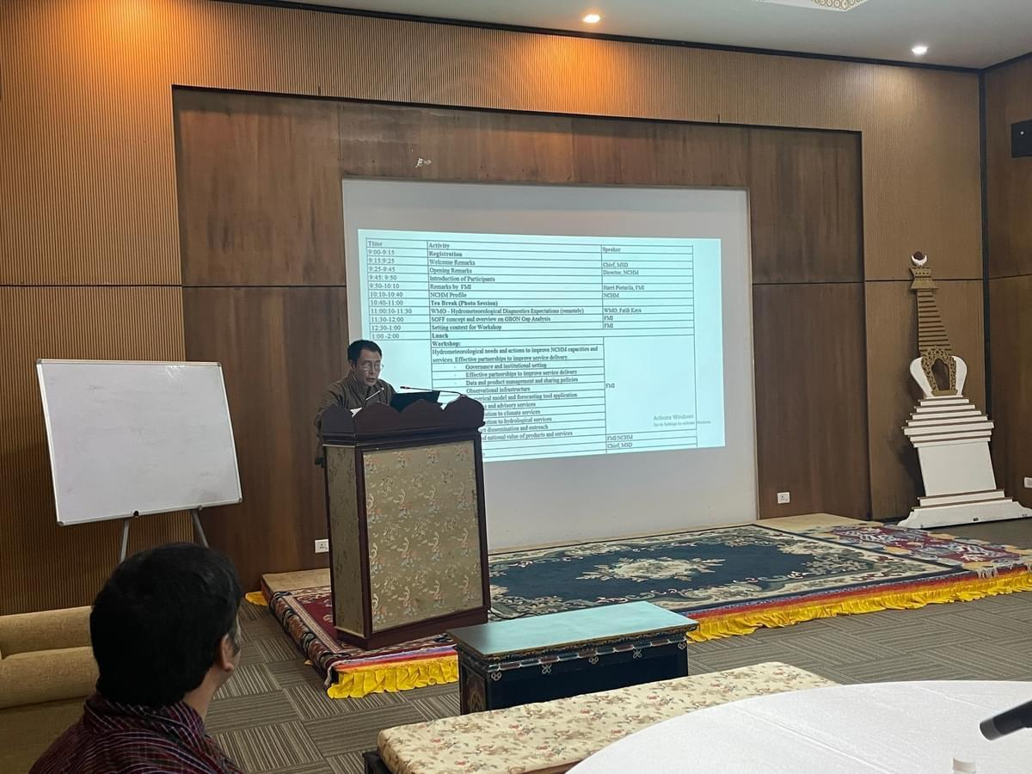
SoFF Consultation Workshop
17 August 2023

Slide 12
Bhutan Progress
Beneficiary Country | Bhutan
Implementing Entity | UNEP
Peer Advisor | FMI

Slide 13
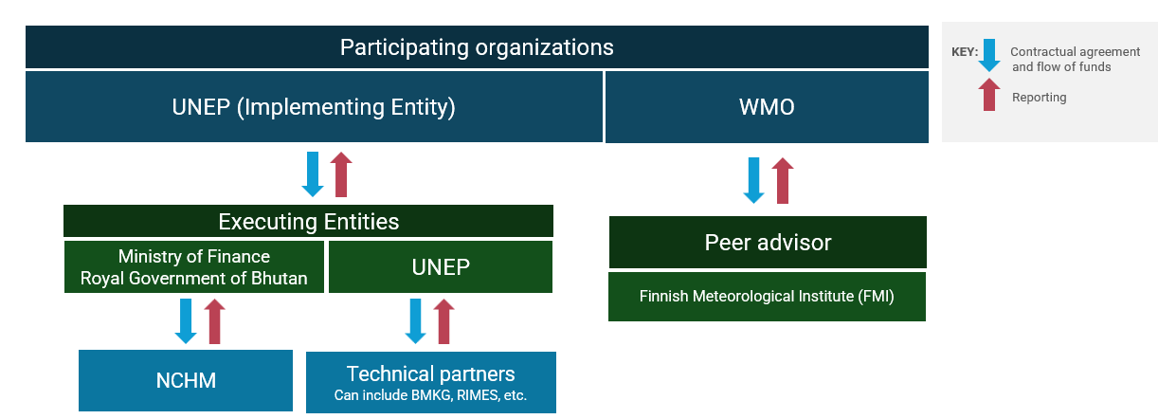

Slide 14
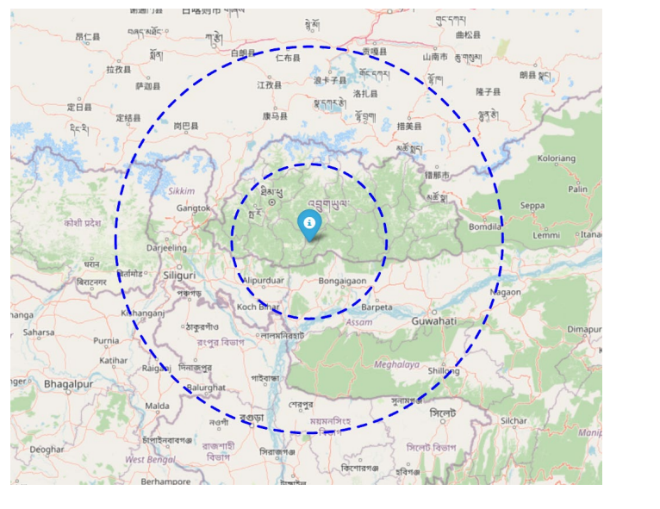
SoFF Bhutan
1 Upper Air
1 AWS
Lat: 27.0095
Lon: 90.1221
Elevation:1548

Slide 15
Presentation Outline
NHCM mandates
1
2
SoFF update
Opportunities and challenges
3

Slide 16
Challenges
Operation and maintenance of stations
Communications
CDMS and ICT infrastructure
Calibration facilities
Quality Management System
Lack of capacity

Slide 17
Opportunitites
Strengthen role of Regional centers through SoFF
Sharing of High Resolution Model outputs
Capacity building and knowledge transfer
SoFF support for sustainability
Improved Services

Slide 18
THANK YOU

