Slide 1
Closing the Basic Weather and Climate Data Gaps in South Asia: Advancing SOFF implementation and creating synergies Session 6: SOFF stakeholder consultations – Private Sector
24 – 26 September 2024

Slide 2
Objective
Providing overview of the private/public sector 4 business models for SOFF implementation
Sharing what we have seen so far in the approved investment phase funding requests in South Asia
Hearing your views on lessons learned, challenges and opportunities in engaging the private sector in SOFF and related investments

Slide 3
Private sector engagement
SOFF recognizes the important role of the private sector to achieve a cost-effective and efficient implementation of GBON
In collaboration with the Association of Hydro-meteorological Equipment Industry (HMEI), SOFF developed 4 business models for implementation – including options for public-private partnerships
SOFF Peer advisors recommend models based on country circumstances and on the assessment of specific technical, political, and legal preconditions needed for a model to be suitable for the specific country.
Countries identify the best model, including exploring innovative options with the involvement of the private sector to ensure GBON compliance.
Regardless of the selected model, NMHS will be strengthened to have basic capacity related to the generation and exchange of observations, including regulatory capacity and the ability to supervise the contracts as needed.

Slide 4
Flows of funds/data
Hydro Alliance
SOFF
COUNTRY
NHMS
PP
WMO / global NWP
NHMS + public

Slide 5
Models for SOFF implementation
Fully State / NHMS owned & operated
State/NHMS owned – Private sector operated
State / NHMS – Private sector concession
Fully Private / Private sector owned & operated

Slide 6
1. Fully State / NHMS owned & operated
Corresponds to business as usual
NHMS has full ownership/control of generation of observations
Pro: full control by state
Cons:
Know-how and personnel might not be available at NHMS on long-term
Missing data (see Hydro Alliance Gap Report)
Implementation of result-based funding can delay implementation

Slide 7
2. State/NHMS owned - PP operated Observation as a service mode
BOT (Build – Operate – Transfer)
Data ownership by NHMS/Public Sector
State contracts (and funds upfront) a private partner to design, construct and operate the SOFF observations infrastructure - Country tailored agreements necessary
Data usage option: by contractor for further commercial activities
NHMS has a significant amount of control over the setup, operation and data delivery and can take a long view concerning the sustainability of the system.
Provides incentives for private sector partners to provide quality products and engage in long-term contracts.

Slide 8
3. State / NHMS – PPP
BOOT (Build – Own - Operate – Transfer) - Concession model
At least partial private investments enable the observation system to be built
Maintenance is duty of contractor
Data ownership by contractor
License/concession from contractor to public for data usage
Further services possible
Country tailored agreements for transfer of the system necessary

Slide 9
4. Fully private / PP owned & operated
BOOT (Built – Own - Operate – Transfer data) contract with NHMS
NZ / SPIRE / Panasonic solution
Design – Built - Maintenance: duty of contractor
Data ownership by contractor (concession for NHMS and public)
Further services included and foreseen
Country tailored agreements necessary
Pro: Result based funding implemented in a straightforward way
Con: New ways to find/contract partners needed

Slide 10
Selection criteria for partners (for country specific tenders by SOFF)
Skills – experiences (References)
Experience with local environment
Financial capabilities (loans, equity etc.)
But:
Avoiding potential for market domination

Slide 11
Selection criteria for business models (for country specific tenders by SOFF)
Concept of weather/climate data as public good
Data ownership
Incentives to commercial industry for further cooperation
Financial conditions (private equity)
Managing possible market distortion by single partner (public or private)

Slide 12
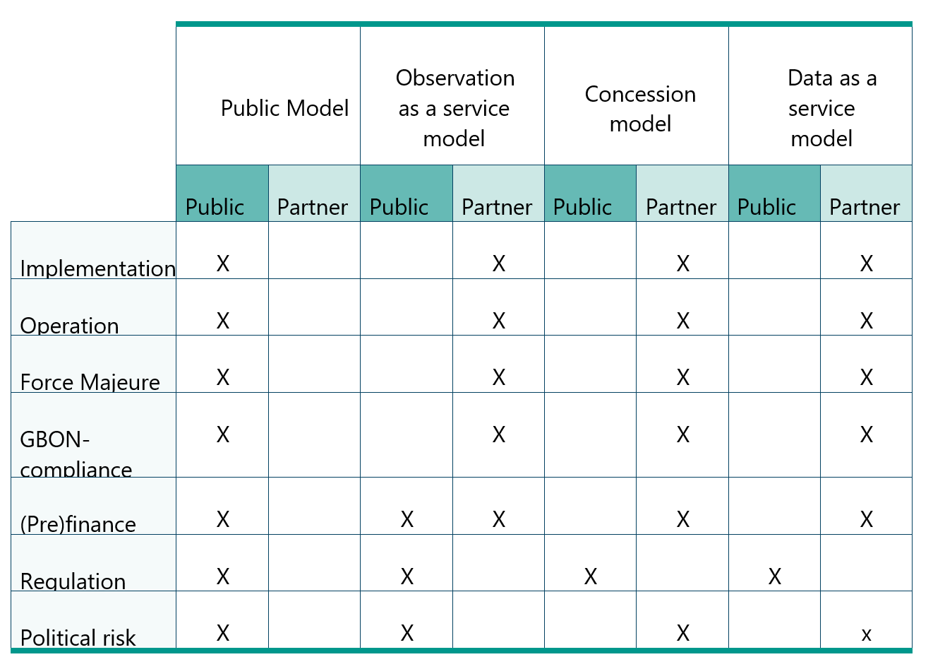
PPP – Risk management elements

Slide 13
SOFF PPP implementation – Countries experiences
Country | Public Private model (Conclusions made)
Bhutan | Plans to use a fully public model. However, Country plans to invite the private sector to workshops to evaluate possible partnerships
Maldives | Country does not plan to use a private public model

Slide 14
Questions
What are the main impediments from the side of NMHS to engage in PPP? Are countries aware of good examples of PPP?
How to incentivize strong private sector engagement on SOFF implementation?
Which partners could help to get the process going?

Slide 15
Reflections from South Asia

