Slide 1
Session 1: Setting the Scene of Regional Context and SOFF in the Caribbean SOFF-IDB-CREWS Regional Workshop in the Caribbean - May 5 – 7 Kingston, Jamaica
GBON compliance in the region: Regional design of the upper-air component of the Global Basic Observing Network (GBON) for the Caribbean subregion
Daniel Alejandro Vila Espigo (presenter)
Technical Coordinator of Infrastructure – Regional Office for the Americas, WMO

Slide 2
Background
The Global Basic Observing Network (GBON) placed for the first time a mandatory requirement on Members to take and exchange basic surface land, upper air, and surface marine observations at a minimum horizontal resolution.
The parallel creation of the Systematic Observations Financing Facility (SOFF) was designed to help Members meet their obligation.
The WMO Global Gap Analysis that was conducted in January 2022, has computed the GBON target number of surface land – and upper air stations operated from land for WMO Members individually. However, while GBON compliance is evaluated per member, there are special geographic and other circumstances that need to be considered individually.

Slide 3
The need for a subregional design of GBON upper air stations
In the context of the Caribbean, where numerous countries are in close proximity to each other, evaluating GBON compliance per member, is not always practical.
The spatial requirements for members whose surface area of the Exclusive Economic Zone (EEZ) is significantly larger than the land surface area, are the same as for surface marine observations (500 km / 1 000 km horizontal resolution for surface/upper air stations respectively).
In this context, the coverage of upper air stations of specific members will be enough to cover more than their own surface and EEZ area and fulfil the horizontal resolution requirements of GBON for a few island states at a time.

Slide 4
Process of consultation
On November 2024, the WMO Secretariat organized a virtual meeting to discuss plans for the operation and GBON compliance of upper air stations in the Caribbean.
The meeting brought together 21 experts from Caribbean countries, including representatives from Sint Maarten, the UK Met Office (serving as SOFF peer reviewers), Martinique (Météo-France), and the United States (as part of the Cooperative Hurricane Upper Air Stations–CHUAS). Additionally, the Chair of the Infrastructure Committee and representatives from the WMO and SOFF Secretariat participated.
During the discussions, and further amendments during the RA IV session, participants explored various configurations to ensure compliance with GBON requirements in the most efficient and resource-effective manner.
On the phase one of the Nineteenth Session of the Regional Association IV, held on 27-29 March 2025, San Salvador, El Salvador, it was approved the following resolution

Slide 5
Decision 3.1/1 (RA IV-19(I))
Noting:
Resolution 2 (Cg-Ext(2021)) – Amendments to the Technical Regulations related to establishment of the Global Basic Observing Network (GBON)
Provision 3.2.2.12 of the Manual on the WMO Integrated Global Observing System (WMO-No. 1160) → minimum horizontal resolution of upper-air stations/platforms over land at 500 km or higher
Provision 3.2.2.15 of the Manual on the WMO Integrated Global Observing System (WMO-No. 1160) → minimum horizontal resolution of upper-air stations/platforms over marine areas of Members’ jurisdiction at 1000 km or higher
Chapter 10 of the Guide to the WMO Integrated Global Observing System (WMO No. 1165) → defines Member-level compliance with GBON provisions
Noting with appreciation the existence of different programmes to support measurements made from regional upper-air stations in the Caribbean, [USA, Bahamas, Dominican Republic]

Slide 6
Decides
A subregional design of the upper-air stations/platforms for the Caribbean:
(1) Covering the following Members of Regional Association IV: Antigua and Barbuda, Bahamas, Barbados, British Caribbean Territories (Anguilla, British Virgin Islands, Cayman Islands, Montserrat and Turks and Caicos Islands), Cuba, Curaçao and Sint Maarten, Dominica, the Dominican Republic, France (Saint-Barthélémy, Guadeloupe, and Martinique only), Guyana (Regional Association III), Grenada*, Haiti, Jamaica, Netherlands (Saba, Bonaire and Aruba only), Saint Kitts and Nevis*, Saint Lucia, Saint Vincent and the Grenadines*, Trinidad and Tobago, and the United States of America (Puerto Rico and US Virgin Islands only);
* It is not a WMO Member but has been included in regional operational coordination at the request of the British Caribbean Territories.

Slide 7
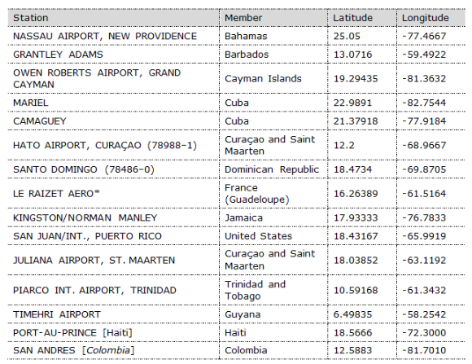
(2) Shall consist of the following stations:
* Taking into account relevant exemption from meeting GBON requirements as per Article 9 of WMO convention [France]

Slide 8
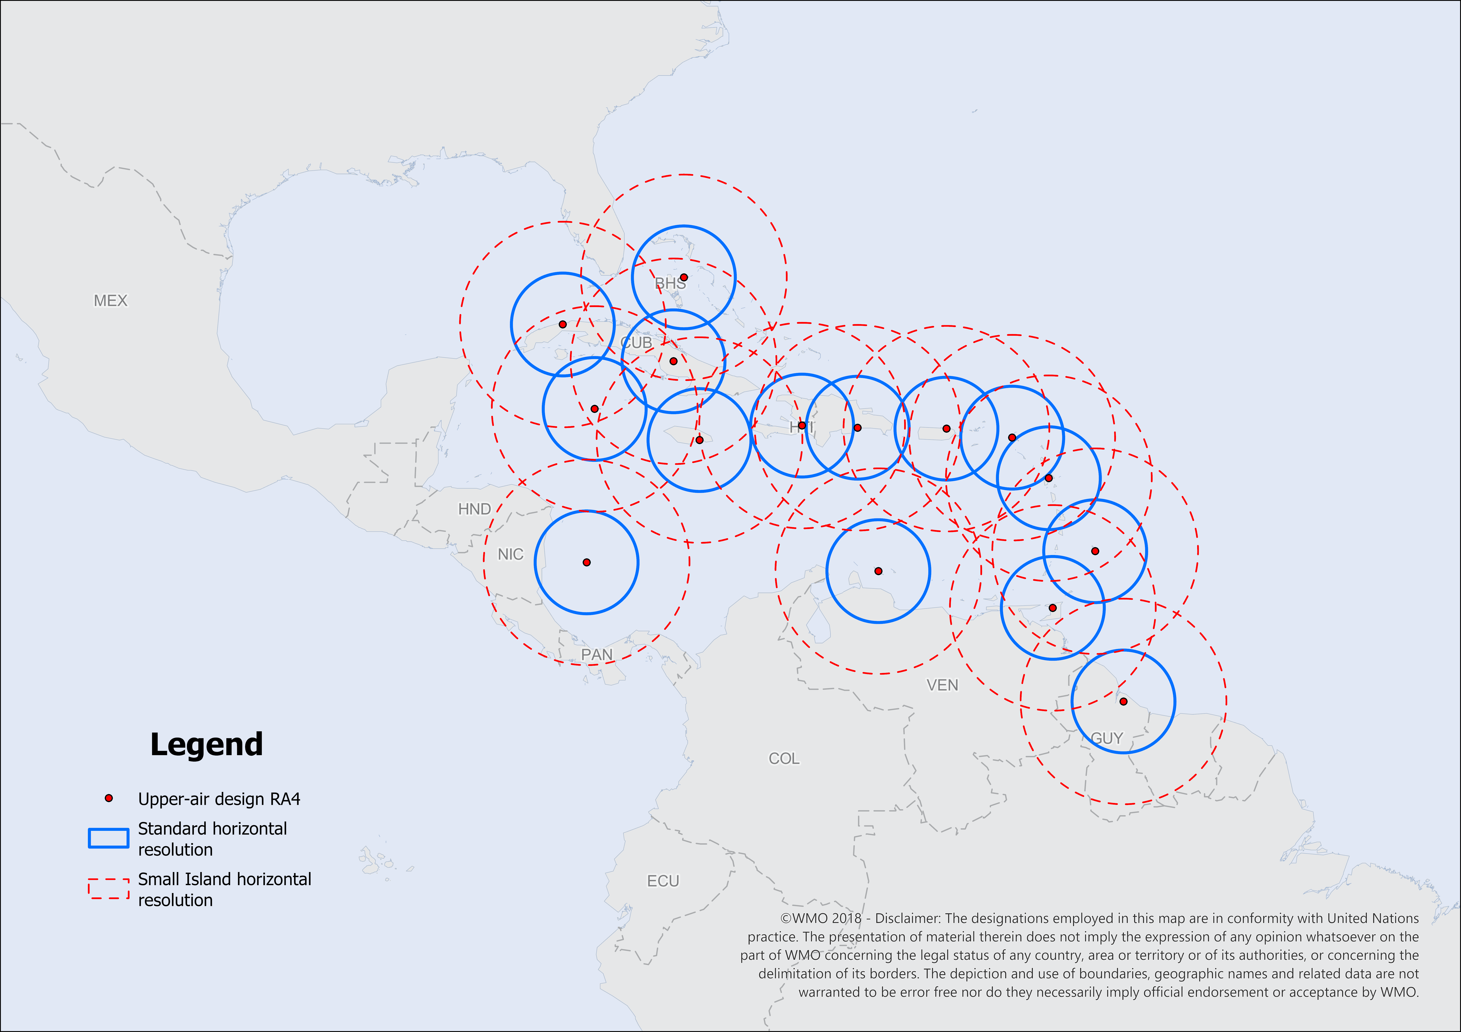
Proposed design
Proposed upper air station network for the Caribbean. The red circles around the individual stations indicate the coverage and horizontal resolution of 1000 km for the Small Island States, while blue circles represents 500 km radius for the standard GBON horizontal resolution.

Slide 9
Further decides that this regional design will be regularly reviewed every four years [Antigua and Barbuda] or earlier [BCT] as required, at subsequent sessions of Regional Association IV;
Requests the RA IV Infrastructure Committee to consider additional GBON subregional designs as appropriate;
Recommends that the Executive Council:
Request the Commission for Observation, Infrastructure, and Information Systems (INFCOM) to reflect this decision in its GBON compliance monitoring;
Requests the Secretary-General, who also serves as Co-Chair of the Systematic Observations Financing Facility (SOFF) Steering Committee, to communicate this decision to the SOFF Steering Committee and encourage its rapid implementation through investments in eligible RA IV members.

Slide 10
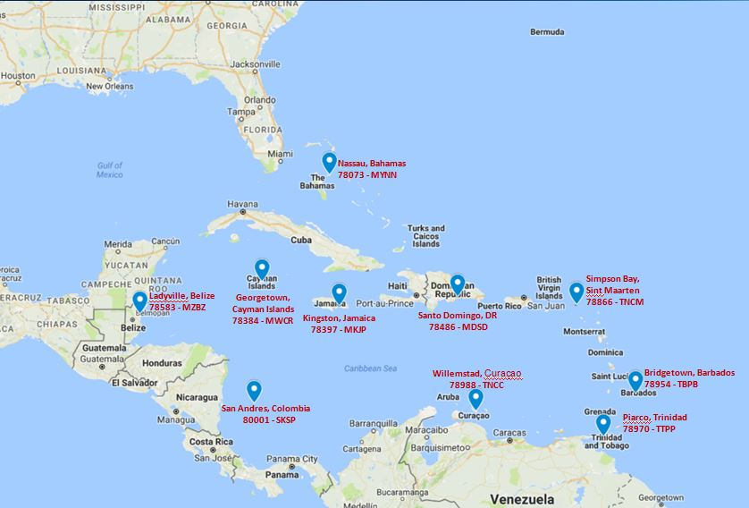
Map of CHUAS network
1 | Bahamas | 78073 | Lynden Pindling International Airport
2 | Barbados | 78954 | Grantley Adams International Airport
3 | Belize | 78583 | Phillip Goldston International Airport
4 | Colombia | 80001 | Gustavo Rojas Pinilla International Airport, San Andres
5 | Dominican Republic | 78486 | Los Mameyes, Santo Domingo
6 | Grand Cayman Island | 78384 | Owen Roberts International Airport
7 | Jamaica | 78397 | Norman Manley International Airport
8 | Curacao, Netherlands Antilles | 78988 | Hato International Airport
9 | Trinidad and Tobago | 78970 | Piarco International Airport
10 | Saint Maarten | 78866 | Princess Juliana International Airport
Note: No other active upper air stations in the Caribbean or from central America participate in the National Weather Service CHUAS network.
Radiosonde Ground Equipment (GRAW GS-E) - DFM-17

Slide 11
CARIBBEAN SUBREGION GBON COMPLIANCE STATUS FOR June 2023 and 2024
COUNTRIES | June 2023 compliance |  | 2024 compliance
 | SURFACE | UPPER-AIR | SURFACE | UPPER-AIR
Antigua & Barbuda | Target 1 - to improve | Target 1-new | Compliant (station replacement) | Regional coverage – RA IV decision
Barbados | Compliant | Compliant (CHUAS) | Compliant | Compliant (CHUAS) (UAS automation requested)
Trinidad & Tobago | Target 1, 2 – reporting | 1 UAS improvement | Compliant (upgrade to AWS) | Compliant (CHUAS) (UAS renewed recently)
Bahamas | Target 3 – 3 improve | Target 1- to improve | 2- reporting and 1- to improve | Hydrogen generator & line-conditioner requested from SOFF, CHUAS supported
Belize | Target 1- to improve | Compliant (CHUAS) | 2 –to improve | CHUAS supported
Cuba | Target 2- to improve | Target 1 – to improve | Compliant (Q4) (8 improve,1 new)- long and thin country shape | 2 new to install
Dominica | Target 1 – to improve | Target 1-new | 1 – to improve | Regional coverage – RA IV decision
Dominican Republic | Target 2 – to improve | Compliant (CHUAS) | 4- to improve | Consolidate current agreement with NOAA, WIS 2.O data transmission ensure
Guyana | Target 2 – 1reporting, 1 improve | Target – 1 new | 6 – to improve (high resolution criteria) | 1 new to install
Haiti | Target 1 – to improve | Target – 1 new | 3 – to improve (new methodology) | 1 new to install
Jamaica | Target 2- to improve | Compliant (CHUAS) | 2 –to improve | Compliant (CHUAS)
Saint Lucia | Target 1 – to improve | Target – 1 new | 1 – to improve | Regional coverage – RA IV decision
Suriname | Target 2- to improve | Target 1-new | 4- to improve and 1 new | 1 new to improve
Grenada (non WMO member) | Compliant | Target 1-new | 1- to improve requested | Regional coverage – RA IV decision
St. Kitts & Nevis (non WMO member) | Target 1 – to improve | Target – 1 new | 1 – to improve ( upgrade to AWS) | Regional coverage – RA IV decision
St. Vincent & Grenadines (non WMO member) | Target 1 – to improve | Target – 1 new | 1 – to improve ( upgrade to AWS) | Regional coverage – RA IV decision

