Slide 1
Closing the Basic Weather and Climate Data Gaps in the Caribbean : SOFF regional implementation and creating synergies Caribbean GBON Implementation 2023 - 2025 & Compliance Criteria
5 - 7 May 2025

Slide 2
GBON regulations
Certain density (horizontal & temporal) for observation network
Reporting of hourly observations
GBON station compliance is assessed using :
Observational Data Available (reporting frequency & regularity)
High-quality (accuracy and completeness)
Timeliness (must be sent in near real-time)
Format (exchange GBON data through WIS in standard format such as BUFR)

Slide 3
Compliance criteria for GBON Surface Land & Marine Stations
KPI Name | Description | Criteria
Monthly availability (%) Primary GBON performance measure | No. of received monthly reports/(Days per month x 24) Two Qualifiers: Must be received by at least one WDQMS monitored NWP centre For manually operated stations not operational 24 hours per day, this number can be reduced to operational hours; but must be registered as an exception to GBON reg.. | ≥ 80%
Timeliness (%) | No. of late reports /(Days per month x 24) Qualifier: Must be sent in near real-time over WIS in standard format (BUFR) Monthly aggregation of reports that missed the time cut-off from NWP centres /WIS | < 5%
Monthly quality (%) | No. of rejected monthly reports/ (Days per month x 24) Could also be gross errors or outside of OB-FG threshold | < 5%

Slide 4
Compliance criteria for GBON Upper-air Land & Marine Stations
Name | Description | Criteria
Monthly availability (%) | No. of received monthly profile (to 30hPa) reports/(Days per month x 24) Qualifier: Received by at least two of the NWP centres For NMHS undertaking only one sounding per day, number can be reduced to the scheduled reporting and registered as an exception to GBON regulations | ≥ 80%
Vertical resolution | Vertical resolution is at least 100 m Cconfirmed by at least one WDQMS monitored NWP centre | Yes
Timeliness (%) | No. of late reports/ (Days per month x 24) Monthly aggregation of reports that missed the time cut-off from NWP centres /WIS | < 5%
Monthly quality (%) | No. of rejected monthly reports/ (Days per month x 24) Could also be gross errors or outside of OB-FG threshold | < 5%

Slide 5
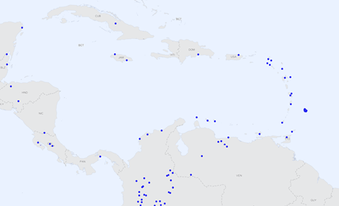
Caribbean Country Level Declared GBON Stations February 2023 vs April 2025
Feb 2023
Approx. < 50 %
Approx. > 90 %
April 2025
(GBON) Station Visualization Web Tool
GBON Station
No GBON Station

Slide 6
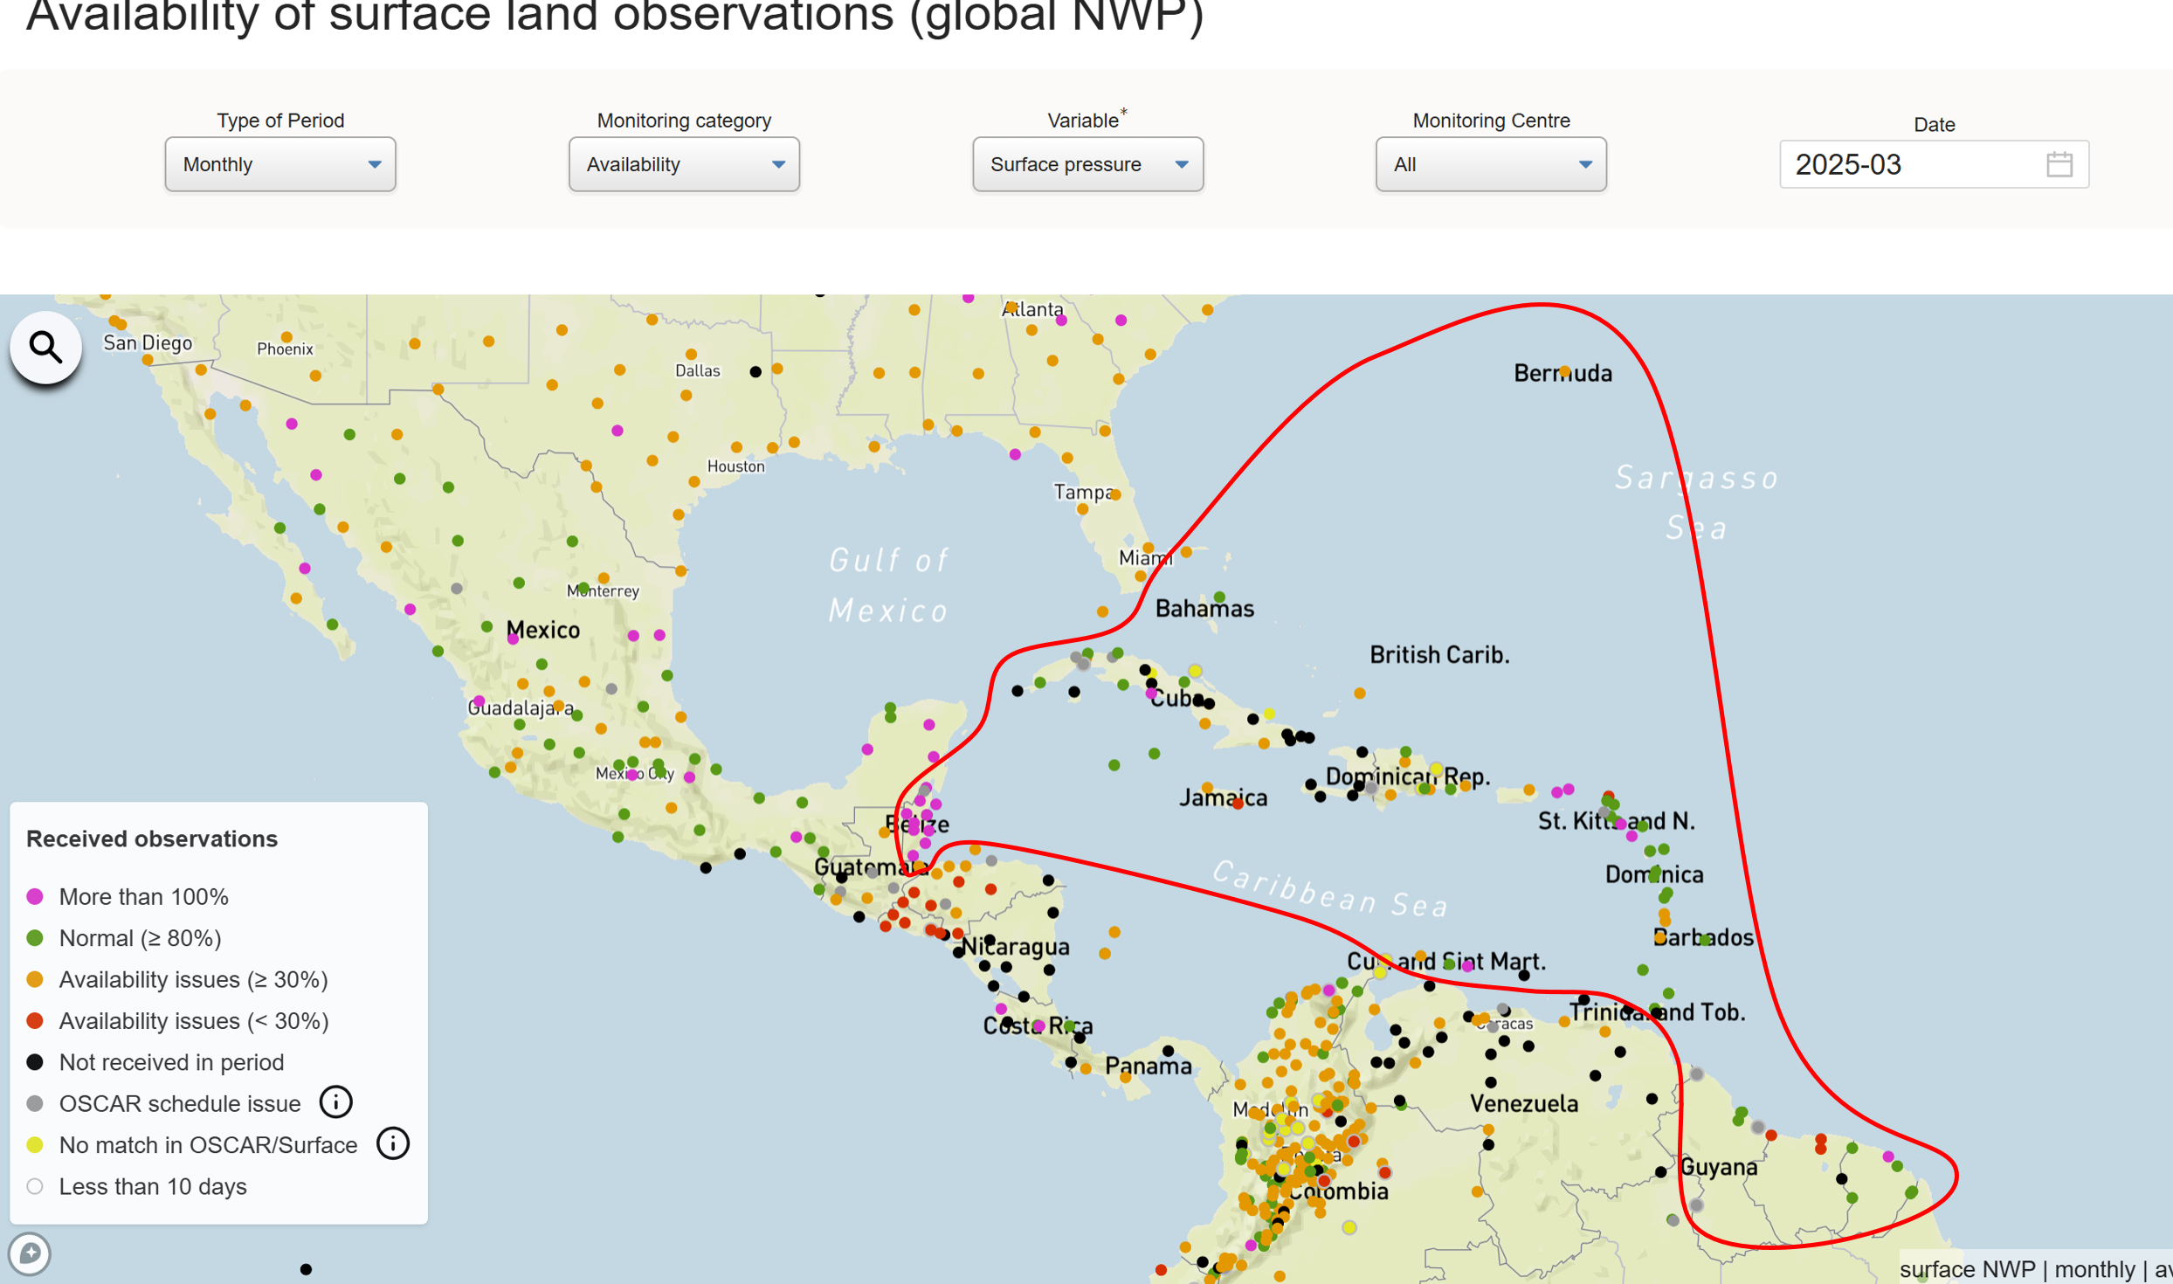
Data availability 2023 vs 2025
2025 Significantly more Caribbean GBON stations achieved data availability compliance
2023 few Caribbean GBON stations achieved data availability compliance

Slide 7
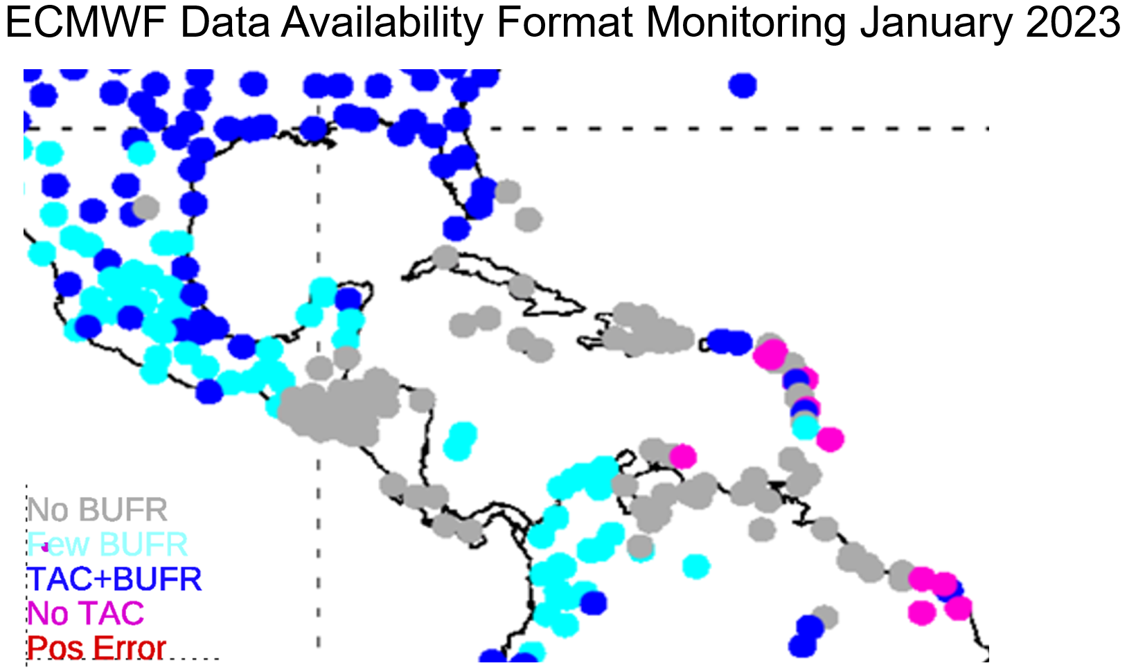
GBON Data Availability Format (WIS 2-BUFR)
Source: https://confluence.ecmwf.int/display/TCBUF/Data+availability
More than 90% of Caribbean stations now report in BUFR through WIS 2
Very few Caribbean stations reported in BUFR via WIS

Slide 8
Questions to consider?
1. How would you describe the impact of the regionally implemented CMO Caribbean WIS 2.0 box on your country’s achieving GBON compliance?
2. And, do you think other components of GBON implementation, such as capacity development, procurement, spare parts pools, etc., can benefit similarly from a regional approach?

