Slide 1
Closing the Basic Weather and Climate Data Gaps in the Caribbean: SOFF Regional implementation and creating synergies Session 7: Creating leverage with other
partners – achieving objectives of EW4All
through partnership
5 – 7 May 2025

Slide 2
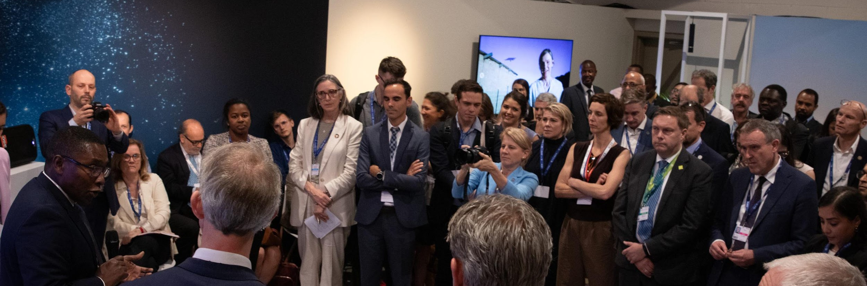
Framework for collaboration for enhancing systematic observations
Framework developed by the Secretariats of SOFF, AF, CIF, CREWS, GCF, GEF
Adopted by 6th Steering Committee
Signed at COP28 by representatives of the six funds

Slide 3
Framework for collaboration for enhancing systematic observations
Aims to enhance complementarity, collaboration, and joint action across the Secretariats of the SOFF, AF, CIF, CREWS, GEF, and GCF for enhancing systematic observations and improving the use of basic weather and climate data for effective climate action.
Each SOFF Investment funding request aims at building on, leveraging and sustaining investments from the other funds as well as from SOFF Implementing Entities
In addition to the 5 major climate funds, SOFF through the operational partners identifies other investments and initiatives in the region that will complement and leverage SOFF investments

Slide 4
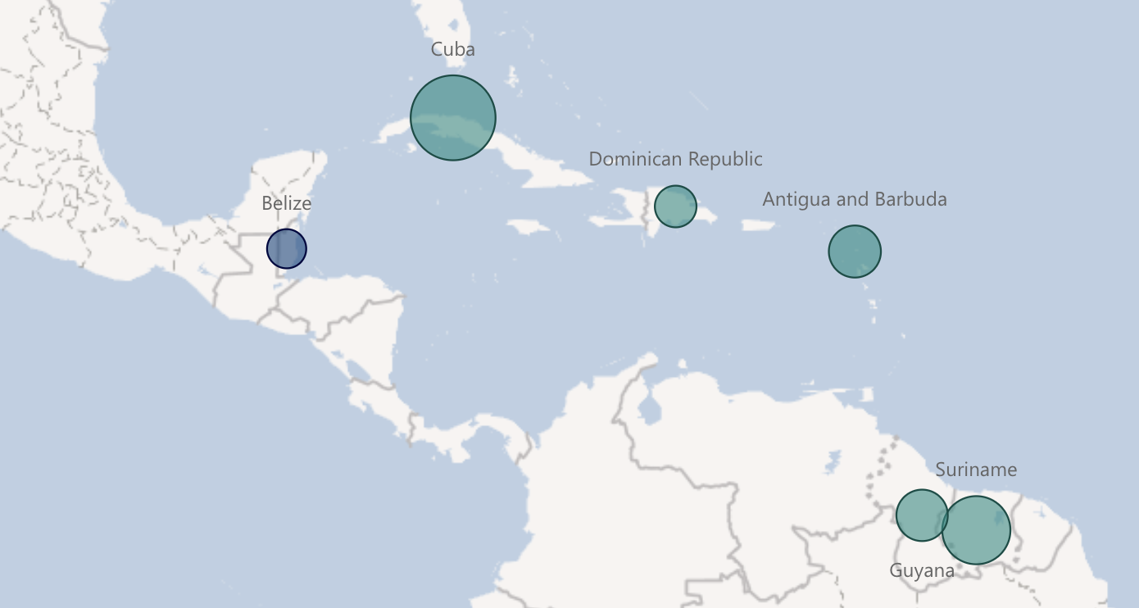
SOFF investments in the Caribbean & other climate funds
Dominican Republic
AF | CIF | CREWS | GCF | GEF
Antigua and Barbuda
AF | CIF | CREWS | GCF | GEF
Cuba
AF | CIF | CREWS | GCF | GEF
Belize
AF | CIF | CREWS | GCF | GEF
Guyana
AF | CIF | CREWS | GCF | GEF
 | SOFF Investment Phase ongoing
 | SOFF Investment funding request submitted
Suriname
AF | CIF | CREWS | GCF | GEF

Slide 5
SOFF investments in the Caribbean & other climate funds
Dominican Republic
AF | CIF | CREWS | GCF | GEF
Antigua and Barbuda
AF | CIF | CREWS | GCF | GEF
Cuba
AF | CIF | CREWS | GCF | GEF
Belize
AF | CIF | CREWS | GCF | GEF
Suriname
AF | CIF | CREWS | GCF | GEF
 | SOFF Investment Phase ongoing
 | SOFF Investment funding request submitted
Guyana
AF | CIF | CREWS | GCF | GEF

