Slide 1
Closing the Basic Weather and Climate Data Gaps in Africa for Effective Adaptation in Africa Compliance Phase Consultation
5-7 May 2025

Slide 2
SOFF phases and GBON compliance
Readiness
Investment
Compliance
Gap assessed based on GBON requirements
Contribution Plan aimed at achieving GBON compliance
Investment towards GBON compliance
Tested at the end of this phase with WDQMS in commissioning period
Steering Committee decides on extension or additional investment in case of force majeure or unforeseen difficulties hindering GBON compliance
Full SOFF Compliance Phase Framework to be co-developed by SOFF and WMO in October 2025

Slide 3
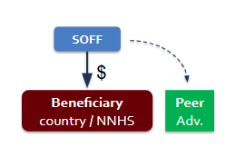
Compliance phase: The unique element ensuring long-term sustainability of SOFF investments
Results-based funding and peer advisors’ technical assistance to countries to operate and maintain the surface-based observation network and the international sharing of data
Responsibility for implementing the Compliance Phase sits with the NMHS of each SOFF beneficiary country (no Implementing Entity)
Peer advisors provide on-demand advisory support; inform WMO Technical Authority of issues and progress

Slide 4
Preview of Compliance phase
SOFF
$
Beneficiary country / NNHS
Peer
Adv.
Direct results-based payment to the country (ideally directly to met service)
to cover operations and maintenance, hardware, staff costs, training, inspections, site security/vandalism, maintenance, repair and replacement of equipment, communications, IT costs.
Peer advisory services by need
Performance monitoring. Regular, routine monitoring and verification of the performance will be carried out with WMO through the WIGOS Data Quality Monitoring System - WDQMS.
Expected co-investment from Beneficiary country (% to be defined) for co-ownership
Two-way street: expected better access to improved prediction products (ECMWF support to SOFF beneficiary countries), but funded by SOFF partners / other projects, with SOFF specializing in the basic observations as a foundation

Slide 5
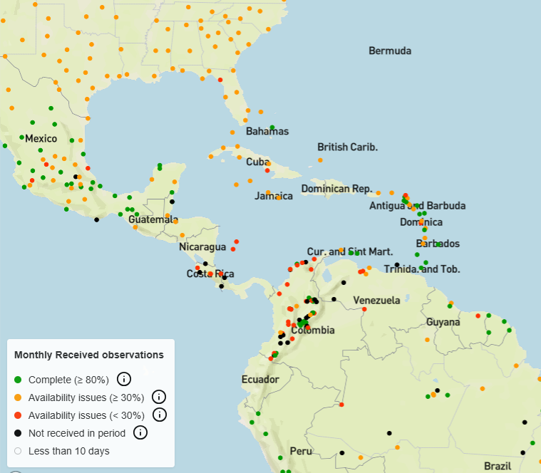
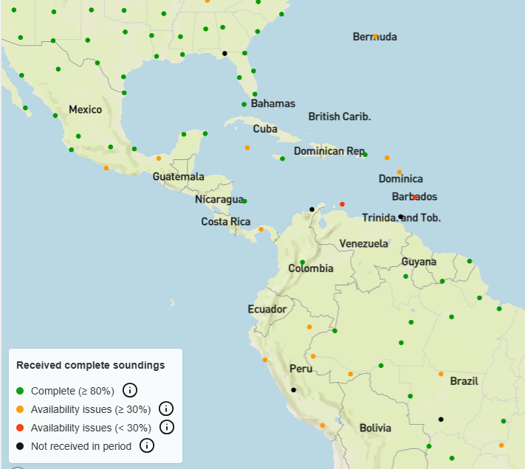
GBON Station Compliance last month
surface observations
upper air observations
WIGOS Data Quality Monitoring System WDQMS

Slide 6
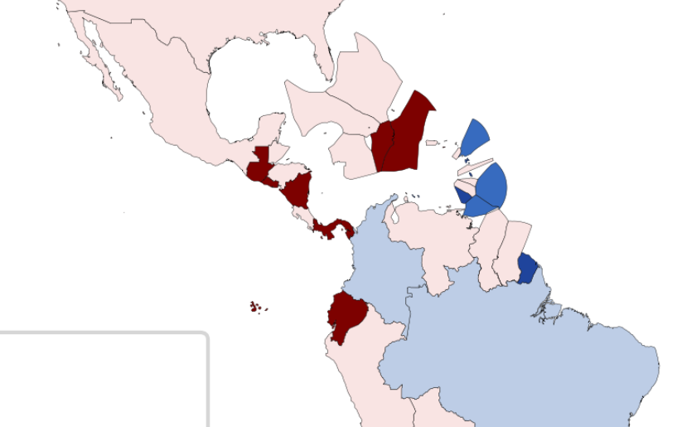
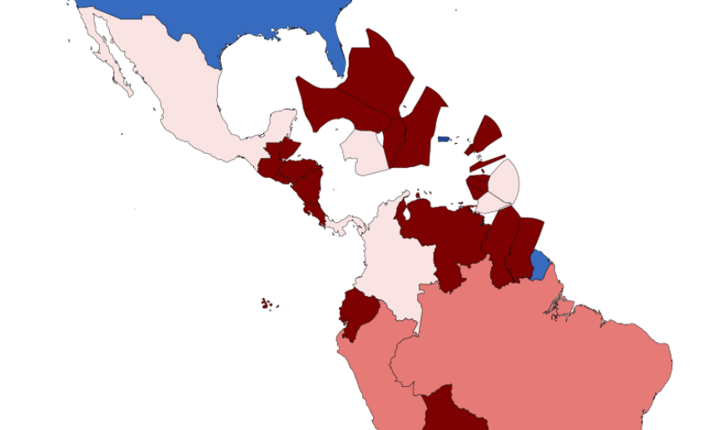
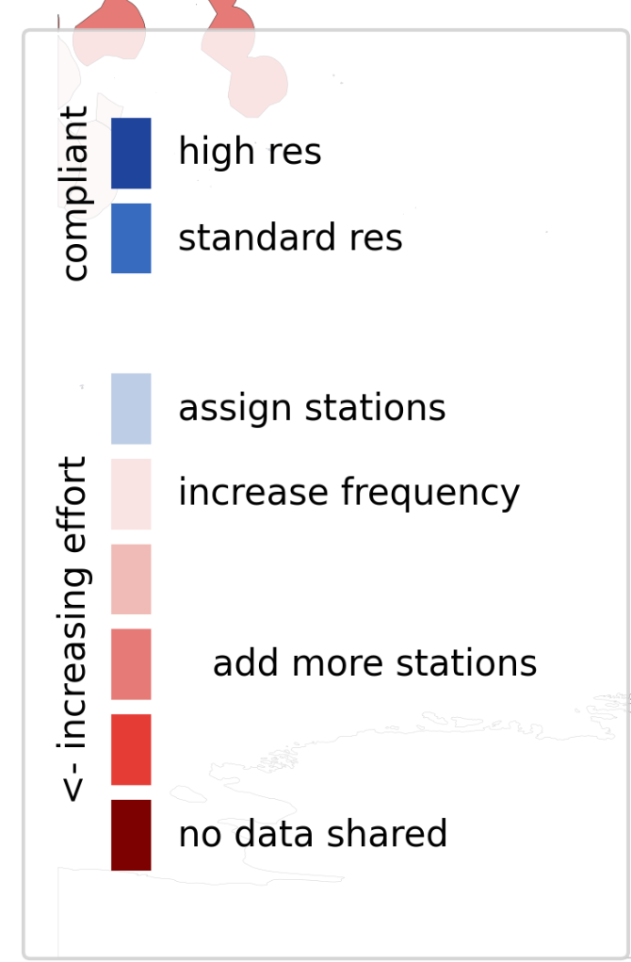
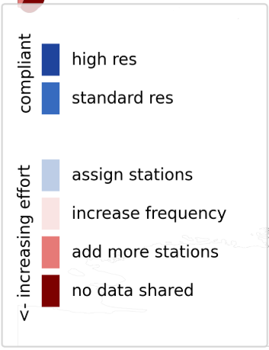
GBON Country Compliance* in Q1 2025
surface observations
upper air observations
GBON compliance app (wmo.int)
*RA IV Decision approved the regional GBON upper air network.

Slide 7
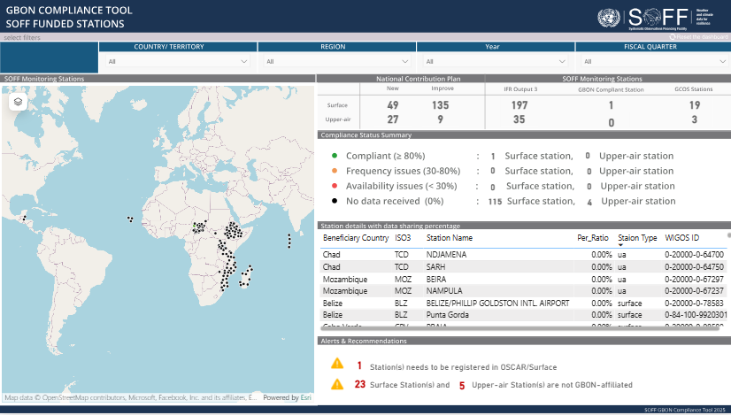
SOFF GBON Compliance Tool

Slide 8
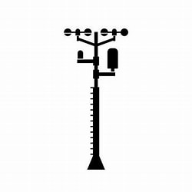
GBON Guide: EC-77 (Feb. 2023)
GBON compliance: tools and criteria
GBON station compliance
Availability ≥80%
Timeliness <5%
Quality <5%
Security
Power
Comms
Comms
WIS2 node
Station
Data
processing
centre
WMO
Information
System
Global NWP
centre
Consumables
Trained operators
Regular maintenance and calibration
Assign as GBON in OSCAR Surface
WIGOS
Data Quality
Monitoring
System
WDQMS
WMO and WIGOS Regional Centres
Tailored SOFF reporting
Notes:
For upper air, additionally we are looking at required resolution
WDQMS is operated in cooperation with DWD (Germany), ECMWF, JMA (Japan), and NOAA/NCEP (USA)

Slide 9
Cost of compliance

Slide 10
Countries' ability to financially contribute to the Compliance phase: results from CHDs

Slide 11
Guiding question
What level of co-investment (financial or in kind) in GBON compliance is your meteorological service ready to make (5-25%)?

Slide 12
Guiding questions
The amount of the payment is country-specific O&M costs calculated by NMHS, IE and PAs. Are there cases when the O&M costs can be significantly different between two stations in one country (separated islands)? How will episodic needs (i.e., vandalism, equipment failure, training new staff) be dealt with in the results-based financing model?

Slide 13
Incentivizing regional efficiency & collaboration
Regional WIGOS centers support for addressing GBON data performance issues / incidents
Regional Instrument Centres support for calibration of meteorological instruments
Regional pools of spares or regional operations and maintenance support provided by a regional SOFF beneficiary country
Regional data sharing arrangements
Regional troubleshooting and peer advisory support

Slide 14
Guiding question
While the SOFF Compliance phase will provide support to individual SOFF beneficiary countries, how could additional (sub) regional Compliance phase support be designed?

Slide 15
Supporting countries in the effective use of global forecast products – ensuring SOFF support is a “two-way-street"
Commitment to beneficiary countries in closing GBON gap and having access to improved NWP forecast products and support in effective use
Preliminary list of NWP forecast products and potential capacity building activities outlined in Inf-5.2 ECMWF support to SOFF beneficiary countries

Slide 16
Guiding question
What kind of NWP Forecast products do beneficiary countries require? What capacity is there to access and use these to underpin services, what kind of training is required?

Slide 17
Thank you

Slide 18
LAC: Global GBON Gap Analysis, June 2023
SOFF- supported country | Station type | Target | Reporting** | Gap (improve) | Gap (new) | Gap (total)
Antigua and Barbuda | Surface Land | 1 | 0 | 1 | 0 | 1
 | Upper-Air | 1 | 0 | 0 | 1 | 1
Bahamas | Surface Land | 3 | 0 | 3 | 0 | 3
 | Upper-Air | 1 | 0 | 1 | 0 | 1
Barbados | Surface Land | 1 | 1 | 0 | 0 | 0
 | Upper-Air | 1 | 1 | 0 | 0 | 0
Belize | Surface Land | 1 | 0 | 1 | 0 | 1
 | Upper-Air | 1 | 1 | 0 | 0 | 0
Cuba | Surface Land | 2 | 0 | 2 | 0 | 2
 | Upper-Air | 1 | 0 | 1 | 0 | 1
Dominica | Surface Land | 1 | 0 | 1 | 0 | 1
 | Upper-Air | 1 | 0 | 0 | 1 | 1
Dominican Republic | Surface Land | 2 | 0 | 2 | 0 | 2
 | Upper-Air | 1 | 1 | 0 | 0 | 0

Slide 19
LAC: Global GBON Gap Analysis, June 2023
SOFF- supported country | Station type | Target | Reporting** | Gap (improve) | Gap (new) | Gap (total)
Grenada | Surface Land | 1 | 1 | 0 | 0 | 0
 | Upper-Air | 1 | 0 | 0 | 1 | 1
Guyana | Surface Land | 2 | 1 | 1 | 0 | 1
 | Upper-Air | 1 | 0 | 0 | 1 | 1
Haiti | Surface Land | 1 | 0 | 1 | 0 | 1
 | Upper-Air | 1 | 0 | 0 | 1 | 1
Jamaica | Surface Land | 2 | 0 | 2 | 0 | 2
 | Upper-Air | 1 | 1 | 0 | 0 | 0
Saint Kitts and Nevis | Surface Land | 1 | 0 | 1 | 0 | 1
 | Upper-Air | 1 | 0 | 0 | 1 | 1
Saint Lucia | Surface Land | 1 | 0 | 1 | 0 | 1
 | Upper-Air | 1 | 0 | 0 | 1 | 1
Saint Vincent and Grenadines | Surface Land | 1 | 0 | 1 | 0 | 1
 | Upper-Air | 1 | 0 | 0 | 1 | 1

Slide 20
LAC: Global GBON Gap Analysis, June 2023
SOFF- supported country | Station type | Target | Reporting** | Gap (improve) | Gap (new) | Gap (total)
Suriname | Surface Land | 2 | 0 | 2 | 0 | 2
 | Upper-Air | 1 | 0 | 0 | 1 | 1
Trinidad and Tobago | Surface Land | 1 | 2 | 0 | 0 | 0
 | Upper-Air | 1 | 0 | 1 | 0 | 1

